Slide 1
Recommendations for application of the functional evidence PS3/BS3 criterion using the
ACMG/AMP sequence variant interpretation framework – testing, testing, testing…
George Burghel
Brnich et al 2019 https://www.biorxiv.org/content/10.1101/709428v1

Slide 2

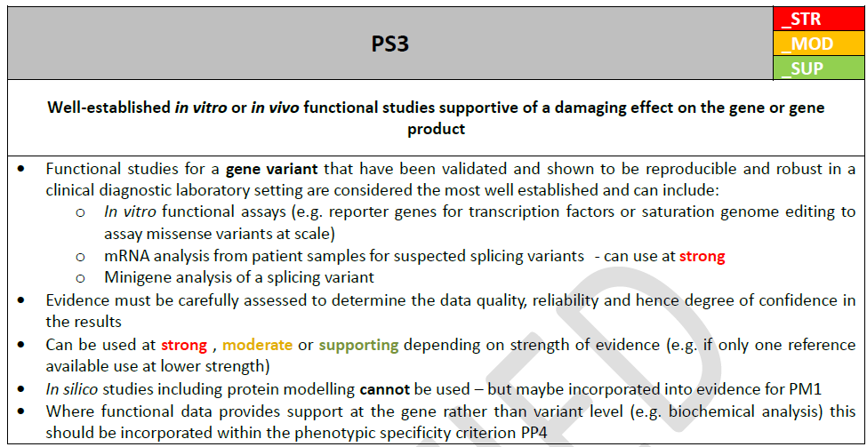
The issue
Richards et al 2015 did not provide detailed guidance on how functional evidence should be evaluated
ACGS 2019 – a bit more details

Slide 3
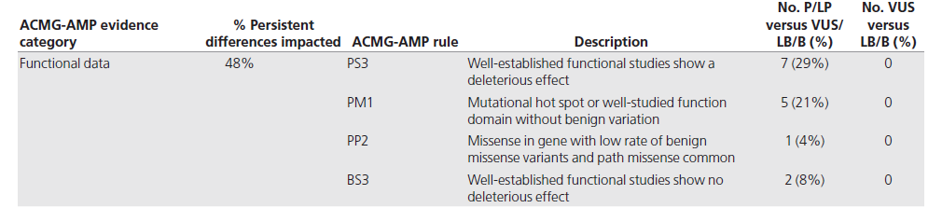
Harrison et al 2017
As part of a ClinGen initiative, four clinical laboratories (Ambry, GeneDx, Partners Healthcare Laboratory for Molecular Medicine, and University of Chicago Genetic Services Laboratory) collaborated to identify the basis of interpretation differences and to investigate if data sharing and reassessment resolve interpretation differences by analyzing a subset of variants.
The application of the PS3/BS3 codes is a major contributor to variant interpretation discordance between laboratories.
Genet Med. 2017 Oct;19(10):1096-1104. doi: 10.1038/gim.2017.14. Epub 2017 Mar 16. https://www.ncbi.nlm.nih.gov/pubmed/28301460

Slide 4
Brnich et al 2019
Aim:
What defines a “well-established” functional assay suitable for BS3/PS3 application?
How should functional assay evidence be structured?
Brnich et al 2019 https://www.biorxiv.org/content/10.1101/709428v1

Slide 5
Recommendations and evaluation process
They gave 6 general recommendations (genomic context, patient derived material, model organisms etc)
4 steps evaluation process
Define the disease mechanism
Evaluate general classes of assays used in the field
Evaluate validity of specific instances of assays
Apply evidence to individual variant interpretation.
Brnich et al 2019 https://www.biorxiv.org/content/10.1101/709428v1

Slide 6
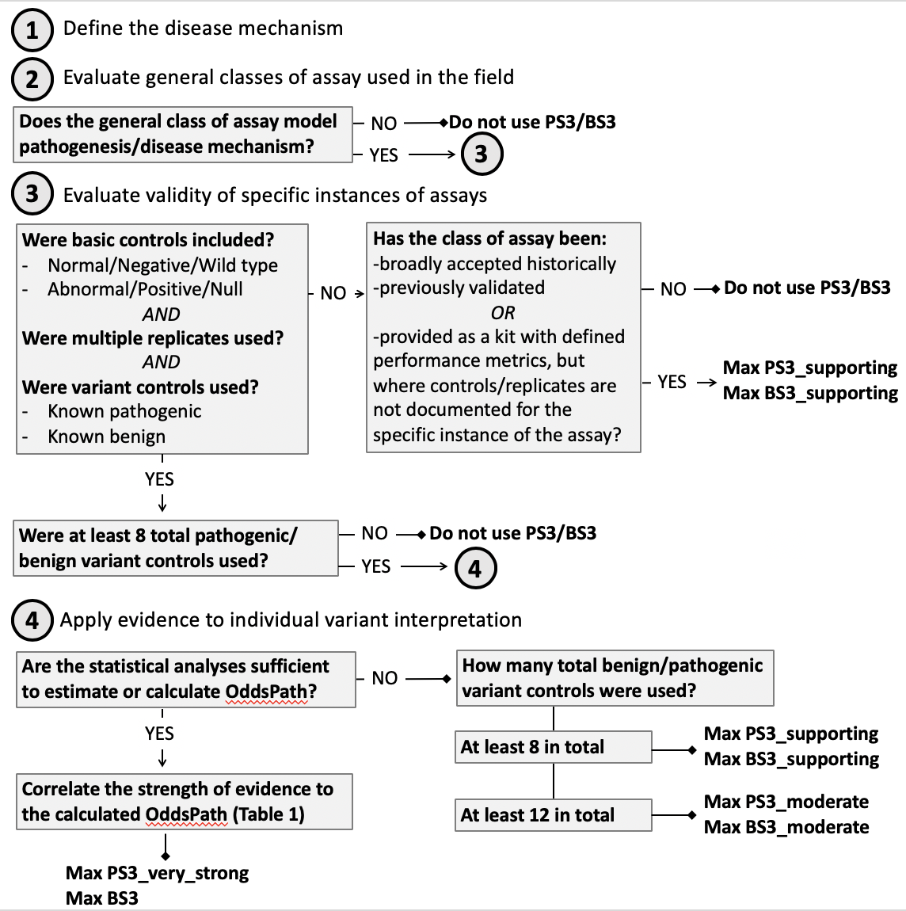
1
AD/AR, LoF, GoF etc
2
3
3
4
4
Brnich et al 2019 https://www.biorxiv.org/content/10.1101/709428v1

Slide 7
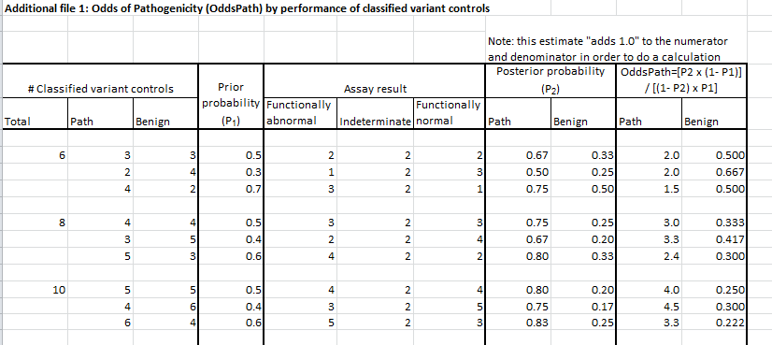
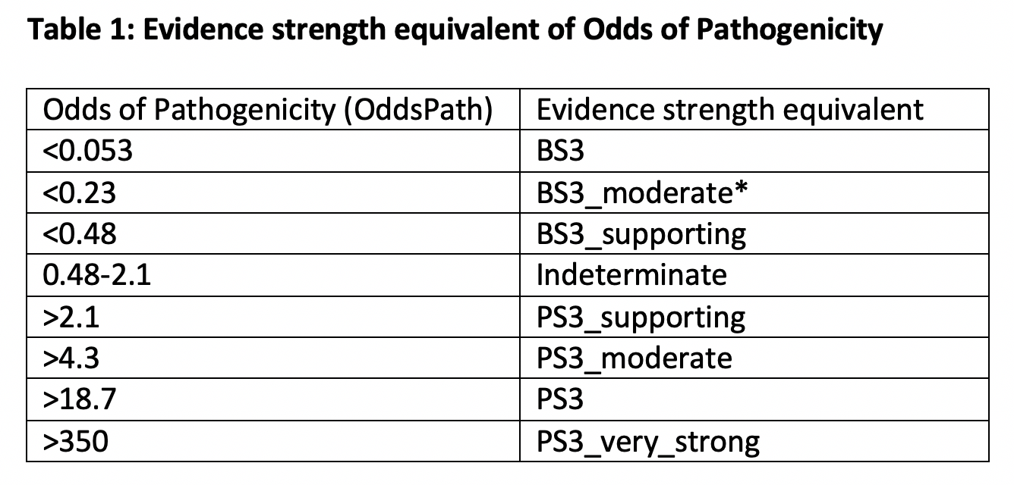
Brnich et al 2019 https://www.biorxiv.org/content/10.1101/709428v1

Slide 8
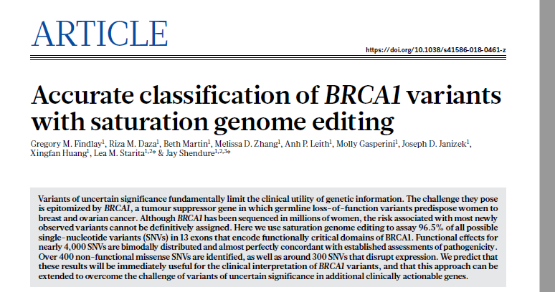

Slide 9
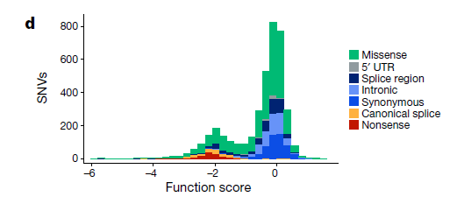
Findlay et al 2018
Used saturation genome editing to assay 96.5% of all possible single-nucleotide variants (SNVs) in 13 exons that encode functionally critical domains of BRCA1 (3,893 SNVs)
Calculated function scores for each of the SNVs

Slide 10
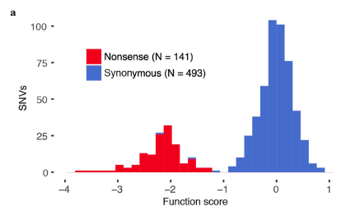
Findlay et al 2018
Used saturation genome editing to assay 96.5% of all possible single-nucleotide variants (SNVs) in 13 exons that encode functionally critical domains of BRCA1 (3,893 SNVs)
Calculated function scores for each of the SNVs

Slide 11
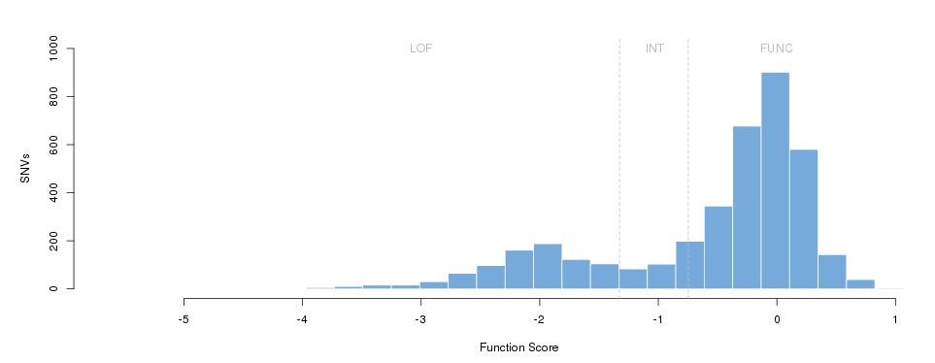
Findlay et al 2018
Used saturation genome editing to assay 96.5% of all possible single-nucleotide variants (SNVs) in 13 exons that encode functionally critical domains of BRCA1 (3,893 SNVs)
Calculated function scores for each of the SNVs

Slide 12

Findlay et al 2018
1
AD/AR, LoF, GoF etc
2
3
3
4
4
Brnich et al 2019 https://www.biorxiv.org/content/10.1101/709428v1

Slide 13
Findlay et al 2018
1
AD/AR, LoF, GoF etc
2
3
3
4
4
Brnich et al 2019 https://www.biorxiv.org/content/10.1101/709428v1

Slide 14
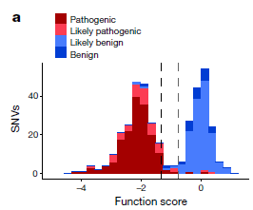
Findlay et al 2018
191 ‘known’ pathogenic (169) and benign (22) controls
Of 169 SNVs deemed ‘pathogenic’ in ClinVar that overlapped with our classifications, 162 were designated ‘non-functional’, two ‘functional’, and the remaining five ‘intermediate’.
By contrast, of 22 SNVs deemed ‘benign’ in ClinVar, 20 were designated ‘functional’, one ‘non-functional’, and one ‘intermediate’
Three SNVs that scored unambiguously discordant with ClinVar suggest potential errors in the available clinical variant interpretation
The distribution of SNV function scores coloured by ClinVar interpretation. Scores are shown for n = 375 SNVs with at least a ‘one-star’ review status in ClinVar and either a ‘pathogenic’ or ‘benign’ interpretation (including ‘likely’). The dashed lines indicate the functional classification thresholds determined by mixture modelling. Grey divides ‘functional’ and ‘intermediate’ (function score = −0.748), and black divides ‘intermediate’ and ‘non-functional’ (function score = −1.328).

Slide 15
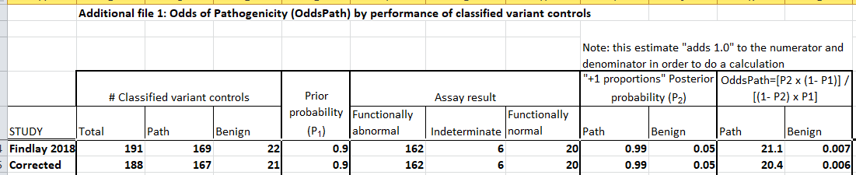
Findlay et al 2018

Slide 16
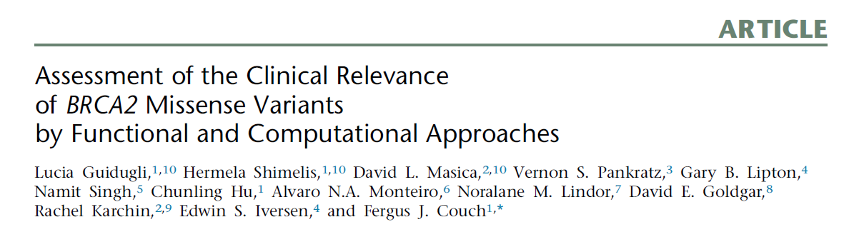

Slide 17
Guidugli et al 2018
Comprehensive functional analysis of variants encoding missense alterations in the BRCA2 DNA binding domain (DBD) (amino acids 2,460–3,170) by using a homology-directed DNA repair (HDR) assay.
They developed a statistical classifier yielding probabilities of pathogenicity for VUS on the basis of high sensitivity and specificity of the assay for established pathogenic missense mutations.
They assessed the functional accuracy of the Align-GVGD in silico sequence-based prediction model by comparing it to the functional results and combined function-based and sequence-based probabilities of pathogenicity in VarCall, a computational tool that predicts the overall likelihood of pathogenicity for BRCA2 VUS

Slide 18
Guidugli et al 2018
A total of 139 BRCA2-encoded DBD missense variants identified in individuals receiving clinical genetic testing for BRCA1 and BRCA2 mutations were selected for this study.
Variants were identified through the ENIGMA, ClinVar, and BIC databases and were selected to allow comparison of the HDR assay and Align-GVGD in silico prediction model categories

Slide 19
Guidugli et al 2018
At the time that these studies were completed:
12 variants in the DBD of BRCA2 had been categorized as class 1 known neutral variants (posterior probability of pathogenicity %0.01) (21 variants had been classified as classes 1 and 2 combined (class 1/2) (0.01– 0.049))
13 variants had been categorized as class 4 and 5 (class 4/5) known pathogenic variants (class 4 posterior probability 0.95–0.99; class 5 pathogenic, posterior probability R 0.99)
The sensitivity and specificity of the HDR assay were calculated on the basis of the normalized HDR fold change for the class 4/5 and class 1 variants

Slide 20
Guidugli et al 2018
Next, 105 additional VUS from the BRCA2 DBD were selected for HDR analysis. These were enriched with Align-GVGD categories C0 (prior probability of pathogenicity of 0.03) and C65 (prior probability of pathogenicity of 0.81) but also included variants from other Align-GVGD categories (C15–C55)
To exclude the potential influence of these missense changes on mRNA splicing, we assessed all VUS with Human Splicing Finder 3.0 for effects on consensus splice sites, branch points, splice enhancer and silencer motifs, and the formation of de novo splice sites

Slide 21
Guidugli et al 2018
Analysis of the normalized mean HDR results for the established pathogenic and neutral variants identified HDR fold-change thresholds of <1.66 and <1.78, which correspond to 99% and 95% probabilities of pathogenicity, respectively, and HDR fold changes of >2.25 and >2.41 for 95% and 99% probabilities of neutrality, respectively
The sensitivity and specificity of the assay according to these standards were estimated at 100%
Extending to 21 class 1/2 and the 13 class 4/5 known standards also yielded sensitivity and specificity estimates of 100%

Slide 22
Guidugli et al 2018
1
AD/AR, LoF, GoF etc
2
3
3
4
4
Brnich et al 2019 https://www.biorxiv.org/content/10.1101/709428v1

Slide 23
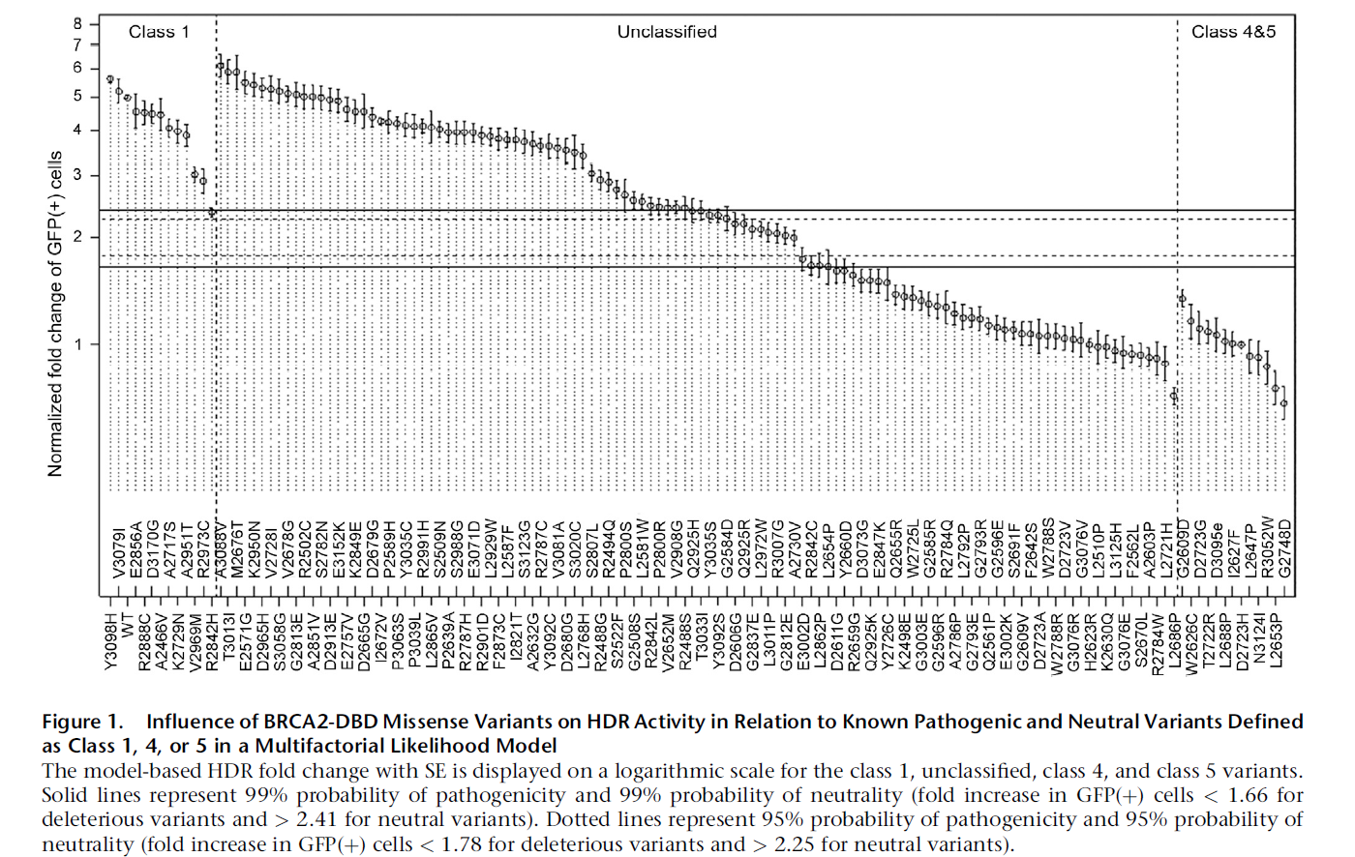
Guidugli et al 2018
12
13

Slide 24
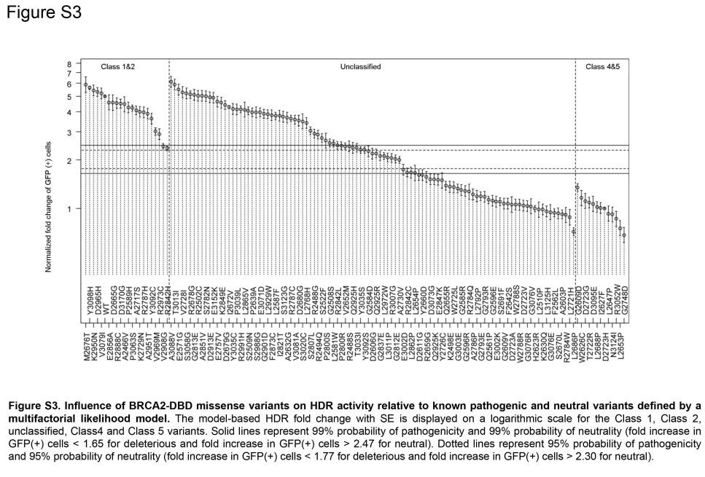
Guidugli 2018
Guidugli et al 2018
21
13

Slide 25
Guidugli et al 2018
PS3_ moderate or PS3_strong?

Slide 26
Guidugli et al 2018
PS3_ moderate and BS3_moderate

Slide 27
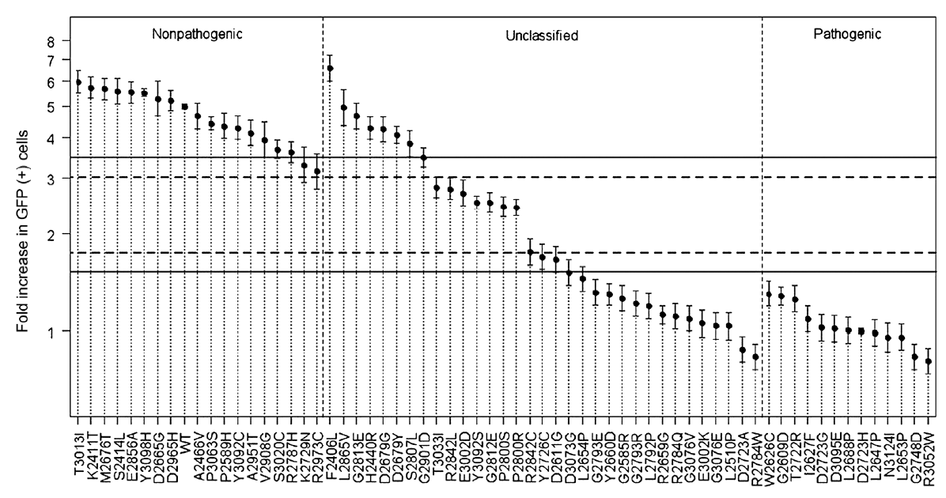
Guidugli et al 2013
18!
13

Slide 28
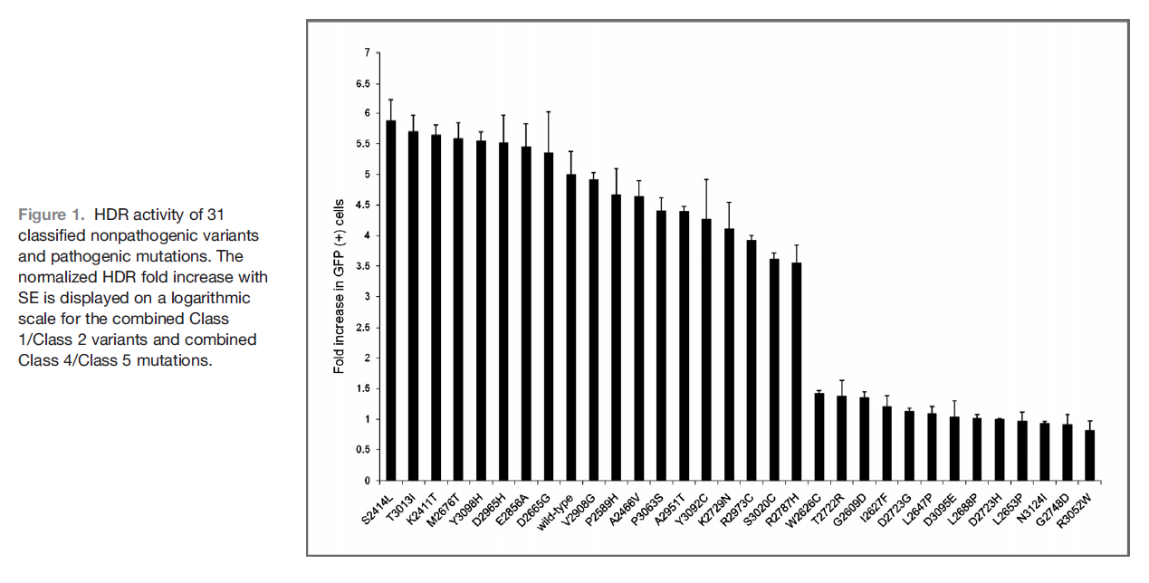
Guidugli et al 2013

Slide 29

Guidugli et al 2013

Slide 30
Guidugli et al 2013

Slide 31
Kato et al 2003
The common missense mutations in the TP53 gene disrupt the ability of p53 to bind to DNA and consequently to transactivate downstream genes
Site-directed mutagenesis technique and a yeast based functional assay to construct, express, and evaluate 2,314 p53 mutants representing all possible amino acid substitutions caused by a point mutation throughout the protein (5.9 substitutions per residue), and correlated p53 function with structure- and tumor-derived mutations.

Slide 32
Kato et al 2003
Site-Directed Mutagenesis. To design oligonucleotide sequences for site-directed mutagenesis, they substituted every first, second, and third nucleotide of all but the first ATG codon of p53 (codons 2–393) by another nucleotide, and then excluded nonsense mutations and silent mutations.
They synthesized 2,314 distinct mutant oligonucleotides with one base mismatch
To evaluate the effect of each mutant on p53 function, the ability of the expressed mutant p53 to transactivate the EGFP reporter plasmid through the p53 binding sequence (p53BS) derived from the p21WAF1 promoter was quantitatively measured by the fluorescence intensity of EGFP, and mapped onto the p53 primary structure

Slide 33
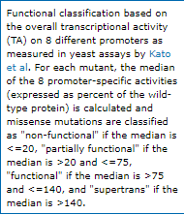
Kato et al 2003
Overall, one-third (36.0%) of the p53 mutants were functionally inactive. Approximately two-thirds (64.0%) of the mutants in the core domain of p53 were inactive
When the transcriptional transactivities of the p53 mutants were fractionated, there were at least three subtypes:
  mutants with no activity (type N: 9.6%),
  mutants with significantly reduced but some residual activity (type R: 26.5%),
  and mutants with activity comparable with that of wild-type p53 (type W: 63.9%).

Slide 34
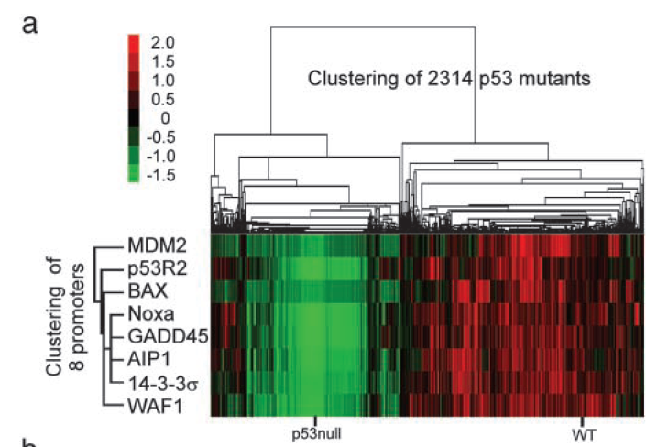
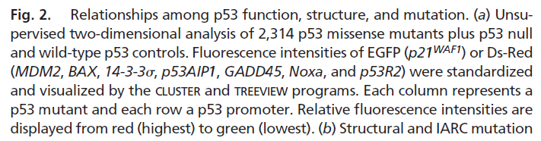
Kato et al 2003
To gain an insight into the relationships among p53 function, protein structure, and mutation, the 2,314 missense mutants plus p53 null and wild-type p53 controls were clustered by unsupervised two dimensional analysis (Fig 2a)
The transactivities of the p53 mutants were divided into two large clusters: the first cluster contained wild-type p53 and the mutants with functional activity for all or most of the promoters (56.3%), and the second cluster contained p53-null clones and the mutants lacking functional activity for all or most of the promoters (43.7%).

Slide 35
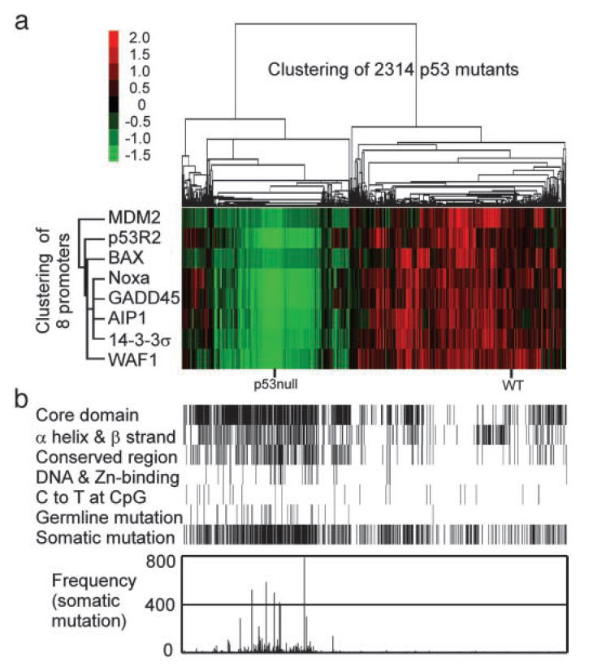
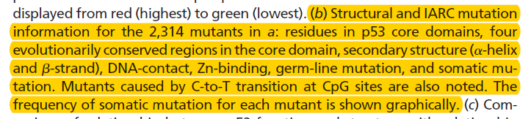
Kato et al 2003
Background information related to p53 structural features (residues in core domain, secondary structure, highly conserved regions, DNA-contact, and Zn-binding) and the IARC database (tumor-related germ-line mutations, somatic mutations, and their frequencies) for each amino acid substitution was then correlated to the clusters

Slide 36
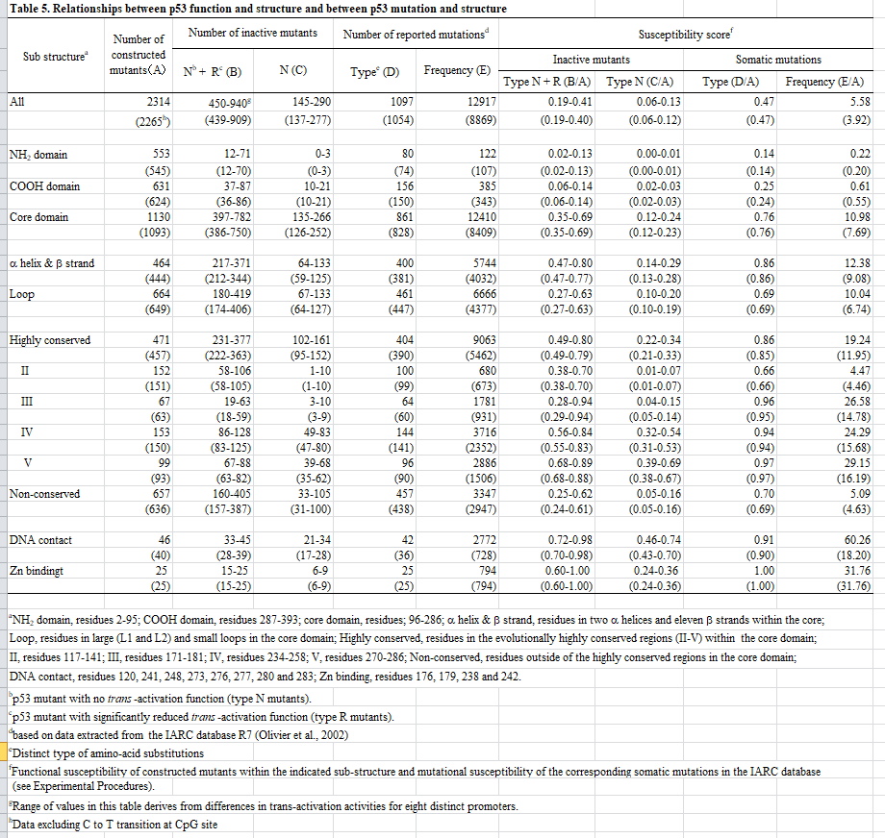
Kato et al 2003

Slide 37
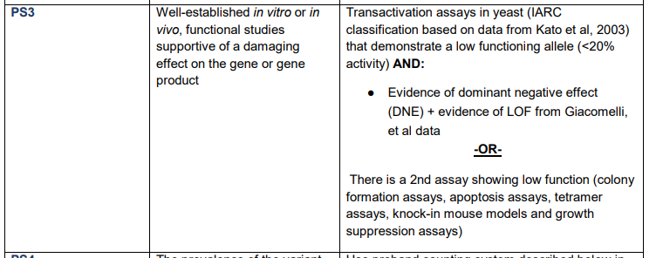
Kato et al 2003
AT best – moderate?

Slide 38
Summary
Findlay et al 2018 STRONG (Pathogenic and benign)
Guidugli et al 2013 and 2018 MODERATE (Pathogenic and Benign)
Kato et al 2003 in progress
To do:
  Kotler et al 2018
  Giacomelli et al 2018
  More?
Second person to sign off?
Add on CanVar?

