Slide 1
The potential benefit of MMR, MSI and TMB as SoC in the RMH Diagnostic pathway considering the introduction of the NHS National Genomic Test Directory Andrew George MSc | Trainee Clinical Scientist | Clinical Genomics | The Royal Marsden Hospital NHS Foundation Trust Dr Kevin J Monahan FRCP PhD | Consultant Gastroenterologist | The St Mark’s Centre for Familial Intestinal Cancer | St Mark’s Hospital Dr Terri McVeigh MB BAO BCh (Hons), PG Cert (Med. Gen.), PG Dip (Med. Sci), MSc (Clin. Ed.), PhD, MRCS, MRCP | Consultant Clinical Geneticist | Clinical Genetics | The Royal Marsden Hospital NHS Foundation Trust Consultant Clinical Geneticist

Slide 2
Colorectal cancer testing in the UK
CI Code | Clinical Indication Name | Test Code | Test Name
M1 | Colorectal Carcinoma | M1.1 | Multi-target NGS panel - small variant (KRAS, NRAS, BRAF, MLH1, MSH2, MSH6, PMS2, POLD1, POLE, DPYD)
 |  | M1.2 | KRAS hotspot
 |  | M1.3 | NRAS hotspot
 |  | M1.4 | MSI Testing
 |  | M1.5 | MLH1 promoter hypermethylation
 |  | M1.6 | Multi-target NGS panel - structural variant (NTRK1, NTRK2, NTRK3)
 |  | M1.7 | DPYD hotspot
1. NHS England. National Genomic Test Directory for cancer. November 2020. https://www.england.nhs.uk/publication/national-genomic-test-directories/

Slide 3
The RMH200
ABL1 | B2M | CCND3 | CREBBP | FADD | GPR161 | KIAA1549 | MPL | NTRK2 | PPP2R2A | RIT1 | SRSF2
ACVR1 | BAP1 | CCNE1 | CRLF1 | FANCI | GPR161 | KIT | MRE11A | NTRK3 | PRKAR1A | ROS1 | STAG2
AKT1 | BARD1 | CCNE2 | CTNNB1 | FANCL | H3F3A | KLF2 | MSH2 | OTX1 | PTCH1 | RUNX1 | STK11
AKT2 | BBC3 | CD79b | DAXX | FAT1 | H3F3B | KMT2A | MSH6 | PALB2 | PTCH2 | SDHA | SUFU
AKT3 | BCL2 | CDH1 | DDR2 | FBXW7 | HIST1H3B | KMT2C | MTOR | PAX5 | PTEN | SDHB | TCEB1
ALK | BCOR | CDK12 | DDX3X | FGF10 | HIST1H3C | KMT2D | MYC | PBRM1 | PTPN11 | SDHC | TCF3
AMER1 | BCORL1 | CDK2 | DICER1 | FGFR1 | HIST2H3C | KRAS | MYCL1 | PDCD1LG2 | RAD21 | SDHD | TERT
ANTXR2 | BIRC3 | CDK4 | DPYD (hotspots) | FGFR2 | HRAS | LIN28B | MYCN | PDGFRA | RAD50 | SETBP1 | TET2
APC | BRAF | CDK6 | DROSHA | FGFR3 | ID3 | LZTR1 | MYD88 | PHOX2B | RAD51B | SETD2 | TFE3
AR | BRCA1 | CDKN1A | EGFR | FGFR4 | IDH1 | MAP2K1 | NF1 | PIK3CA | RAD51C | SF3B1 | TG
ARAF | BRCA2 | CDKN2A | EMSY | FH | IDH2 | MAP2K4 | NF2 | PIK3CD | RAD51D | SH2B3 | TP53
ARID1A | BRIP1 | CDKN2B | EP300 | FLT3 | IGF1R | MAP3K1 | NFE2 | PIK3R1 | RAD54L | SMAD2 | TP63
ARID1B | BTK | CDKN2C | EPHB2 | FOXL2 | IRF4 | MAPK1 | NFE2L2 | PIN1 | RAF1 | SMAD3 | TSC1
ARID2 | C19MC | CEBPA | ERBB2 | FOXO1 | IRS2 | MCL1 | NOTCH1 | PMS1 | RB1 | SMAD4 | TSC2
ASXL1 | CALR | CHEK1 | ERBB3 | GATA1 | JAK2 | MDM2 | NOTCH2 | PMS2 | RBM10 | SMARCA4 | U2AF1
ATM | CASP8 | CHEK2 | ESR1 | GATA3 | KBTBD4 | MEN1 | NOTCH3 | POLD1 | RET | SMARCB1 | VHL
ATR | CBL | CIC | ETV6 | GNA11 | KDM6A | MET | NPM1 | POLE | RFN43 | SMARCE1 | WT1
ATRX | CCND1 | CDKN1B | EZH2 | GNAQ | KDR | MLH1 | NRAS | POT1 | RHOA | SMO | YAP1
AURKA | CCND2 | CKS1B | F2R | GNAS | KEAP1 | MN1 | NTRK1 | PPM1D | RICTOR | SOX2 | YES1
 |  |  |  |  |  |  |  |  |  |  | YWHAE

Slide 4
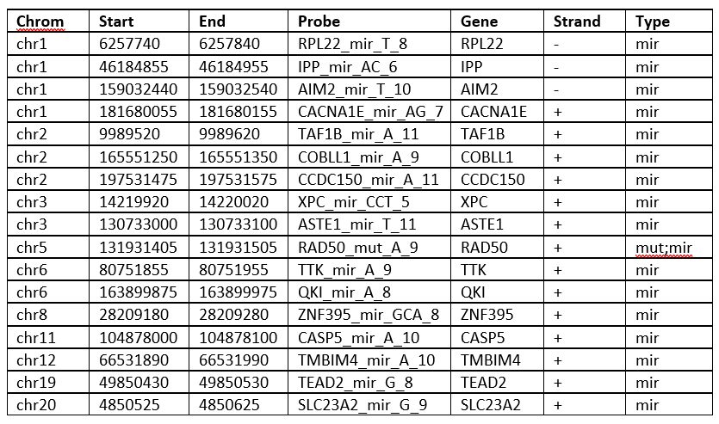
RMH200 MSI probes

Slide 5
Experimental design
Reanalyse diagnostic CRC samples for MMR genes + POLE/POLD1
n=1052
Correlate with available MMR IHC
N=388
Validate MSI caller with MSI by PCR
Attempt to identify candidate Lynch Syndrome cases
Assess TMB scores of MMR-p vs MMR-d
Run through MSI and TMB NGS callers

Slide 6
MMR gene testing in somatic CRC
Of the 1052 samples re-analysed 102 (9.7%) carried potential pathogenic variants in the MMR genes.
MLH1 – 26/1052 – 2.47%
MSH2 – 16/1052 – 1.52%
MSH6 – 68/1052 – 6.46%
PMS2 – 18/1052 – 1.71%
Correlating with available MMR-IHC - 26/102 candidate Lynch syndrome cases, or 2.5% of the total dataset.

Slide 7
MMR gene testing in somatic CRC failure rates (<100 mean depth, ROI coverage <95%)
MLH1 – 123/1051 = 11.70%
MSH2 – 154/1051 = 14.65%
MSH6 – 114/1051 = 10.85%
PMS2 – 341/1051 = 32.45%
Average failure rate 12.5% excluding PMS2
Reasons for NGS failure:
1. Tumour cellularity affecting DNA yield
2. Tumour content affecting sensitivity
3. Technical issues / variability of the assay

Slide 8
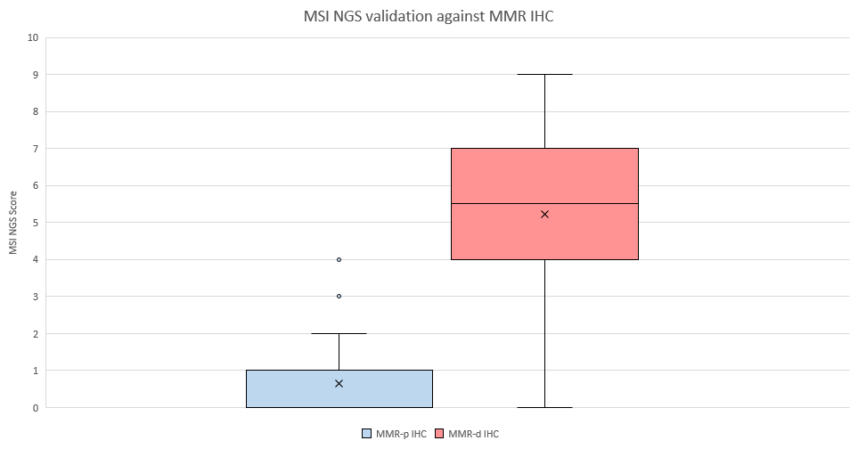
MSI NGS caller vs MMR IHC

Slide 9
MSI NGS caller performance vs Promega’s OncoMATETM MSI Dx Analysis System.
 | No. of samples | MSS/MSI-L (0-1) | MSI-H/I (≥2) | Concordance
MMR-p IHC | 29 | 29 | 0 | 100%
MMR-d IHC | 24 | 2 | 22 | 92%
MMR status unknown | 38 | 3 | 35 | 92%
All samples | 91 |  |  | 95%
15.03% MSI (≥3) n=124/825 – expected ~15%

Slide 10
Identifying candidate Lynch Syndrome cases
Combining MMR NGS, MMR IHC, MSI NGS score and considering tumour content and VAF highlights 1.6% n= 17/1052 candidate cases.
We correctly identified a known Lynch Syndrome case with frameshift variants in MSH6 and PMS2 detected with an MSI NGS score of 9, confirmed by MSI PCR and corresponding loss of expression by IHC.

Slide 11
Summary
Integration of MMR gene testing and MSI by NGS into existing somatic testing strategies is a cost-effective, tissue efficient and potentially time-saving improvement to diagnostic pathways.
The RMH200 MSI NGS caller performs comparable to published methods in CRC.

