Slide 1

Exponent scoring system for variant classification
Dr. Alice Garrett
Clinical Research Fellow
Institute of Cancer Research

Slide 2
Probabilities of pathogenicity in 2015 ACMG guidelines
Classification | Posterior probability of pathogenicity
Pathogenic | >0.99
Likely pathogenic | 0.90-0.99
Variant of uncertain significance (VUS) | 0.10-0.90
Likely benign | 0.001-0.10
Benign | <0.001
Richards et al., ACMG Laboratory Quality Assurance Committee. Standards and guidelines for the interpretation of sequence variants: a joint consensus recommendation of the American College of Medical Genetics and Genomics and the Association for Molecular Pathology. Genet Med. 2015 May;17(5):405-24

Slide 3
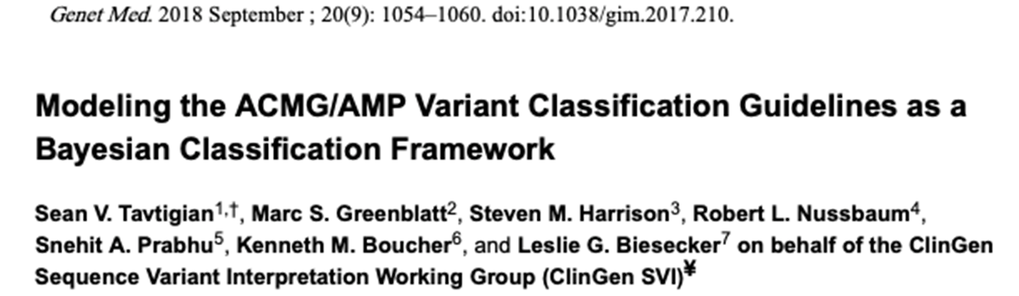

Slide 4
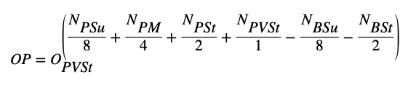
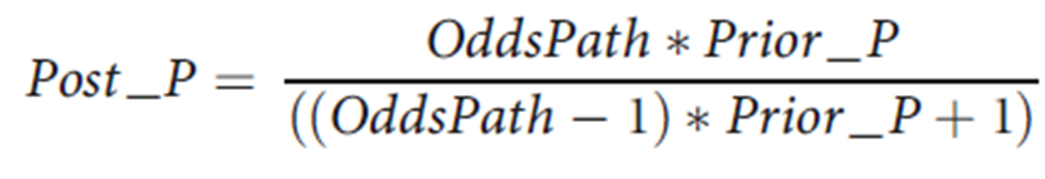
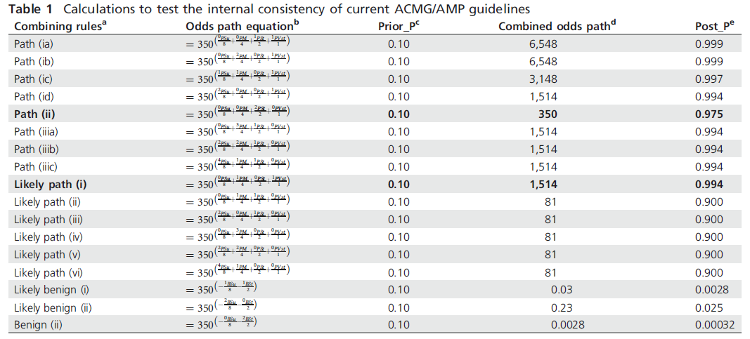
Checking existing combinations against model

Slide 5
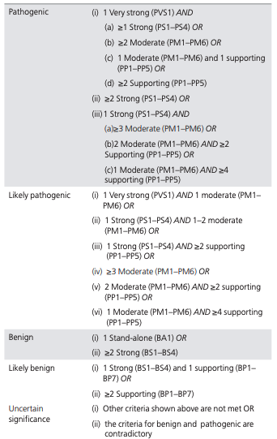
Incompatible combinations
Post probability 0.975
Post probability 0.994

Slide 6
Exponential progression
Exponential progression between evidence levels = 2
  2 x supporting = 1 x moderate
  2 x moderate = 1 x strong
  2 x strong = 1 x very strong
Garrett, A., Durkie, M., Callaway, A. et al. Combining evidence for and against pathogenicity for variants in cancer susceptibility genes: CanVIG-UK consensus recommendations. J Med Genet. 2020 Nov 18

Slide 7

Ranges for classifications
CanVIG-UK recommended ranges
Classification category | Prior Probability | Combined odds of pathogenicity | Exponent Sum | Posterior probability
Pathogenic | 0.1 | 1514 (2.08⁺¹⁰) | ≥10 | 0.99
Likely pathogenic |  | 81 (2.08⁺⁶) | 6-9 | 0.90
Likely benign |  | 0.48 (2.08⁻¹) | (-1)-(-5) | 0.05
Benign |  | 0.01 (2.08⁻⁶) | ≤-6 | 0.001*
Tavtigian et al., 2020 recommended ranges
Garrett, A., Durkie, M., Callaway, A. et al. Combining evidence for and against pathogenicity for variants in cancer susceptibility genes: CanVIG-UK consensus recommendations. J Med Genet. 2020 Nov 18:
Tavtigian SV et al., Fitting a naturally scaled point system to the ACMG/AMP variant classification guidelines. Hum Mutat. 2020 Jul 27.

Slide 8
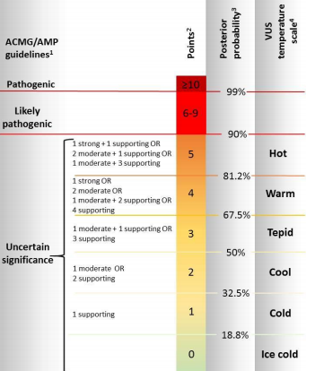
Variants of Uncertain Significance
Ellard et al. ACGS Best Practice Guidelines for Variant Classification in Rare Disease 2020

Slide 9

CanVIG-UK classification recommendations
Variants should not be classified as pathogenic, likely pathogenic, benign or likely benign on the basis of a single evidence item, except BA1 (‘stand-alone evidence’ for benignity)
Non-orthogonal evidence items should be downweighted or not combined
Garrett, A., Durkie, M., Callaway, A. et al. Combining evidence for and against pathogenicity for variants in cancer susceptibility genes: CanVIG-UK consensus recommendations. J Med Genet. 2020 Nov 18:

Slide 10
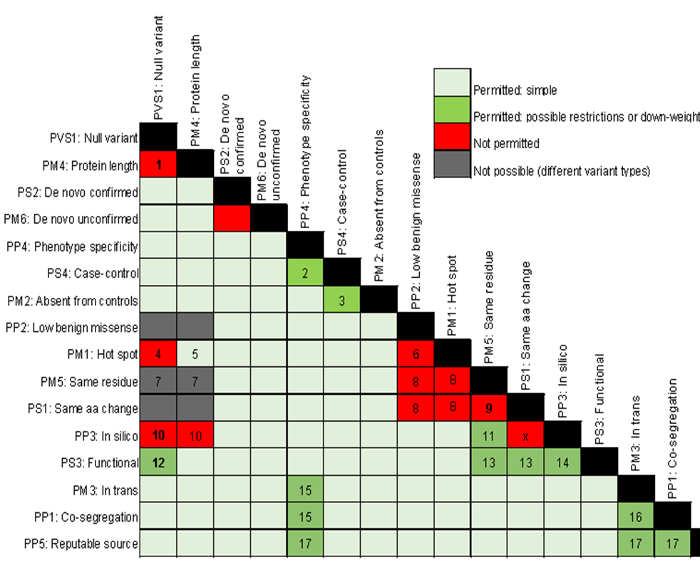
Evidence item combination
recommendations in progress

Slide 11
Proposed new classification combinations
Evidence elements | Exponent score | Classification
1 V Strong + 1 Moderate | 10 | Pathogenic
2 Strong + 1 Moderate | 10 | Pathogenic
2 Strong + 2 Supporting | 10 | Pathogenic
5 Moderate | 10 | Pathogenic
4 Moderate + 2 Supporting | 10 | Pathogenic
3 Moderate + 4 Supporting | 10 | Pathogenic
2 Moderate + 6 Supporting | 10 | Pathogenic
1 Moderate + 8 Supporting | 10 | Pathogenic
10 Supporting | 10 | Pathogenic
2 Strong | 8 | Likely pathogenic
6 Supporting | 6 | Likely pathogenic
Garrett, A., Durkie, M., Callaway, A. et al. Combining evidence for and against pathogenicity for variants in cancer susceptibility genes: CanVIG-UK consensus recommendations. J Med Genet. 2020 Nov 18:

Slide 12
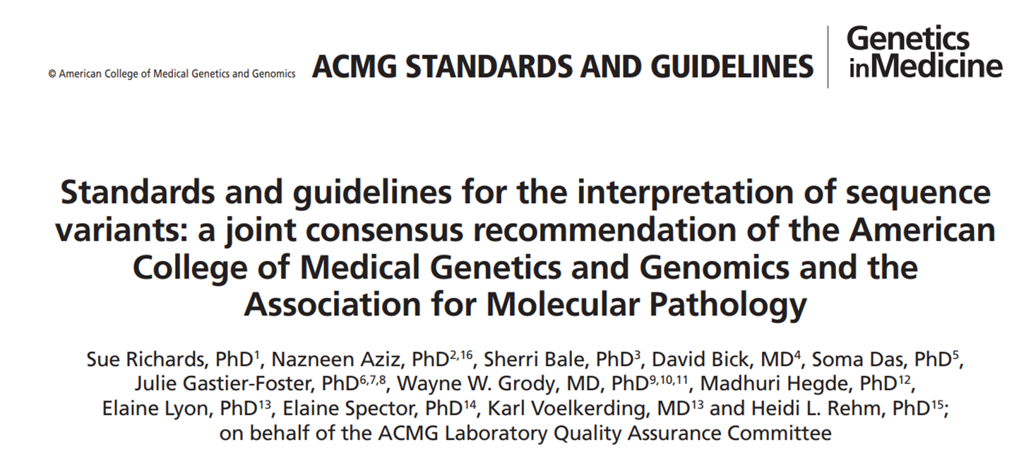
Conflicting evidence for and against pathogenicity
“If … the evidence for benign and pathogenic is conflicting, the variant defaults to uncertain significance.”

Slide 13
CanVIG recommendations for conflicting evidence
Conflicting evidence items should be combined to calculate a net exponent sum for classification using the ‘exponent score system’, providing there is no more than one discordant evidence element at no more than supporting level
Where there is discordant evidence, the classification class cannot exceed Likely Pathogenic or Likely Benign
PM2 (absence in population databases) can be ignored when calculating the net exponent sum for benignity.
Garrett, A., Durkie, M., Callaway, A. et al. Combining evidence for and against pathogenicity for variants in cancer susceptibility genes: CanVIG-UK consensus recommendations. J Med Genet. 2020 Nov 18:

