Slide 1
CanVIG BA1/BS1 for Lynch genes and PALB2
Miranda Durkie
On behalf of CSTAG

Slide 2
CRC supporting data
Lifetime population risk of bowel cancer is 1 in 15 for males and 1 in 18 for females (CRUK)
  Go for highest incidence for most conservative BS1/BA1
Genetic heterogeneity - proportion CRC caused by gene
  Used combined evidence from Hampel et al (2008); Julie et al (2008); van Lier et al (2012); Moreira et al (2012); Canard et al (2012); Yurgelun et al (2017)
  MLH1: 0.44%; MSH2: 0.56%
  MSH6: 0.23%; PMS2: 0.13% - use endometrial data for these genes
  However smallest increment for all settings on https://www.cardiodb.org/allelefrequencyapp/ is 1%

Slide 3
CRC supporting data 2
Allelic heterogeneity
  use same conservative 10% for BRCA1/2 (ENIGMA)
Penetrance
  Looked at data from Moller et al 2017 (3119 patients) and Dominguez-Valentin et al 2020 (6350 patients)
  Dominguez-Valentin’s cases overlap with Moller’s
  MLH1 penetrance 0.45 (Moller) & 0.53 (DV)
  MSH2 penetrance 0.43 (Moller) & 0.49 (DV)
  I tried both in calculator and made no significant difference to AF

Slide 4
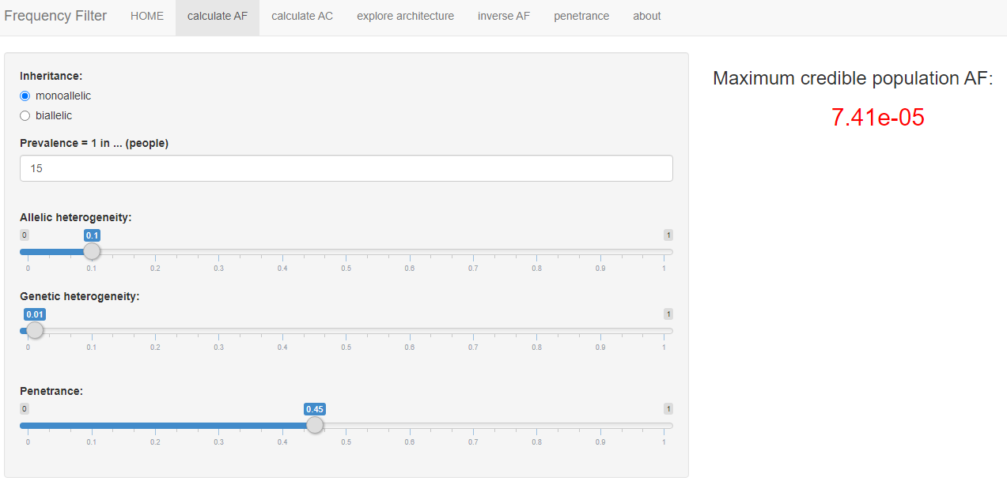
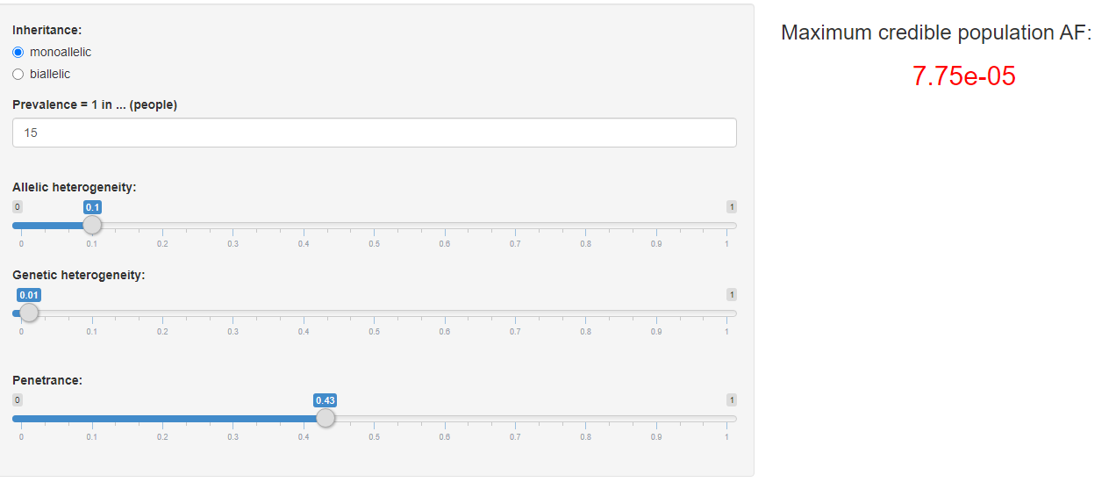
MLH1
MSH2

Slide 5
Max Credible AF results from cardiodb.org/allelefrequencyapp/
MLH1:
  BS1: round to 1e-04 / 0.0001 / 0.01%
  BA1: 1e-03 / 0.001 / 0.1%
MSH2:
  BS1: round to 1e-04 / 0.0001 / 0.01%
  BA1: 1e-03 / 0.001 / 0.1%
Checked gnomAD for top ten most frequent LS pathogenic variants and highest allele count in gnomAD was 1
Same Max Credible AF as BRCA1/2 ☺

Slide 6
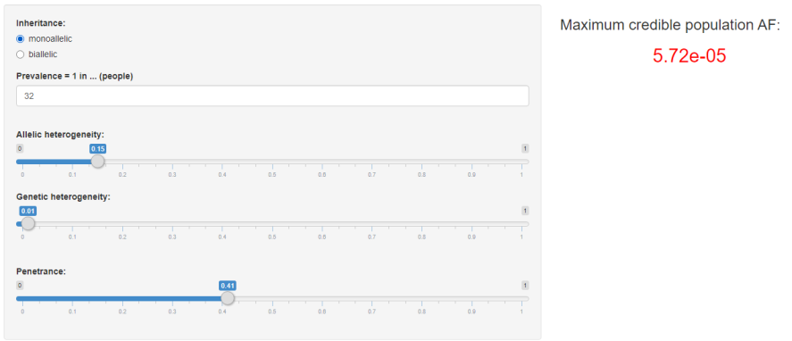
MSH6 – EC supporting data
Lifetime population risk of uterine cancer is 1 in 36 (CRUK) for females
Genetic heterogeneity
  Ryan et al (2019) meta-analysis of 12,633 patients: found 3% of EC due to Lynch; >1% for MSH6
  Ryan et al (2020) PLOS PETALS study 1.5% MSH6
  Use 1% and correct allelic het below
Allelic heterogeneity = 10%
  Correct to 15% to account for genetic het from PETALS
Penetrance MSH6
  41% Dominguez-Valentin et al
BS1: 5.72e-05 (round to 1e04) 0.0001 / 0.01%
BA1: 1e-03 / 0.001 / 0.1%

Slide 7
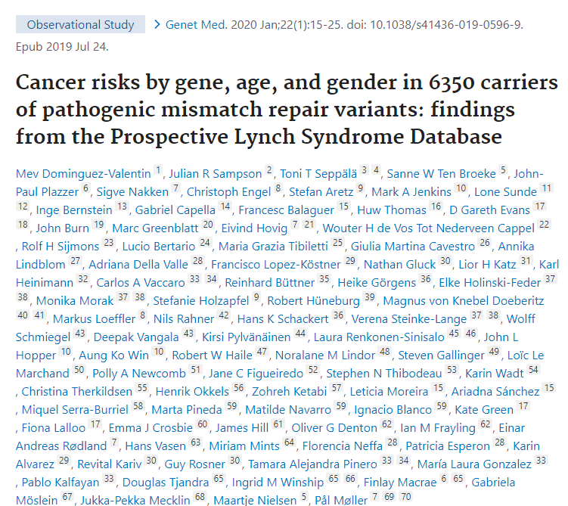
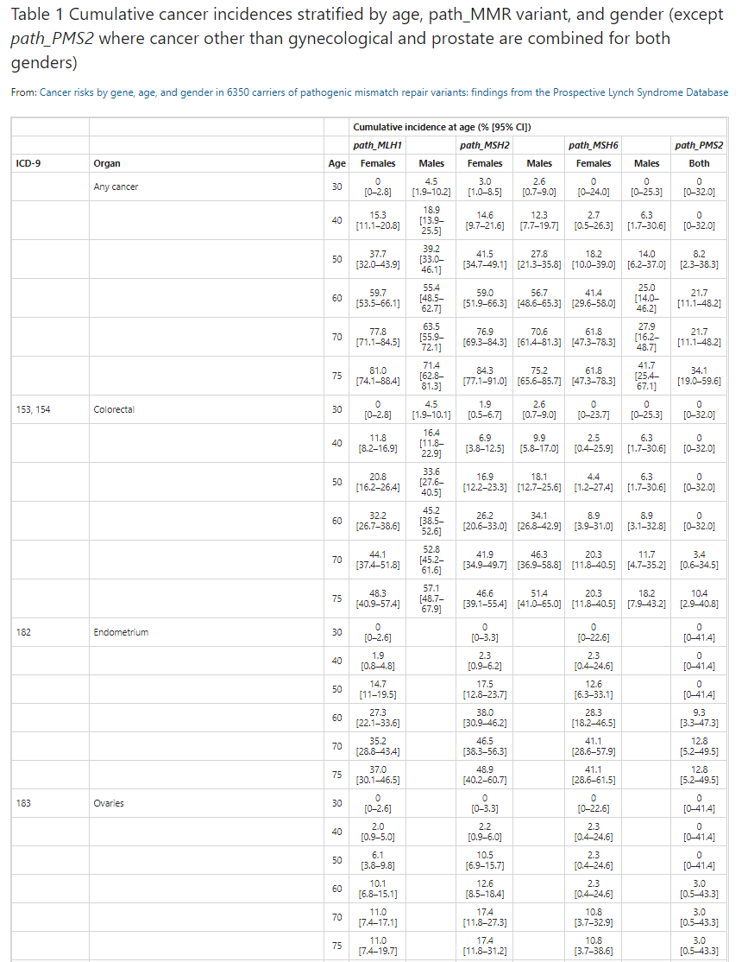
PMS2 data
Had to use online data as typo in pdf!

Slide 8
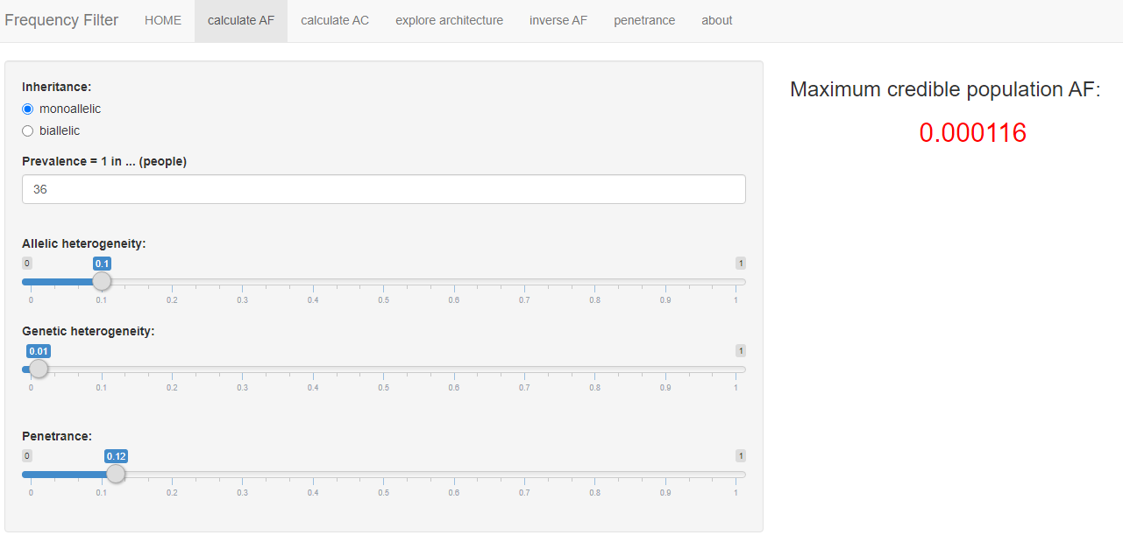
PMS2 data
Lifetime population risk of uterine cancer is 1 in 36 (CRUK) for females
Genetic heterogeneity
  Ryan et al (2019) meta-analysis of 12,633 patients
  3% of EC due to Lynch; no exact numbers for
  individual genes; go with 1% PMS2
Allelic heterogeneity = Use 10%
Penetrance PMS2
  EC: 26% Moller et al; 12% Dominguez-Valentin et al
Result = 1e-04 using most conservative penetrance DV
BS1: 1e-04 / 0.0001 / 0.01%
BA1: 1e-03 / 0.001 / 0.1%

Slide 9
PALB2 supporting data
Lifetime population risk of breast cancer is 1 in 8
Genetic heterogeneity - proportion BrCa caused by PALB2 gene
  used 1%
Penetrance
  Yang et al (2020) Journal of Clinical Oncology 38: 674-685 Cancer Risks Associated With Germline PALB2 Pathogenic Variants: An International Study of 524 Families
  Penetrance 53% for female breast cancer to age 80
Allelic heterogeneity
  Stick with conservative 10% (as per BRCA figures)
  Result: BS1 0.0001 (0.01%) & BA1 0.001 (0.1%)

Slide 10
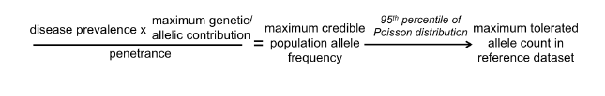
Summary
Remember to look at female non-cancer controls in gnomAD for BRCA1/BRCA2/PALB2/MSH6 & PMS2
BRCA1/BRCA2/PALB2/MLH1/MSH2/MSH6/PMS2:
BS1 0.01% & BA1 0.1% maximum credible population AF (this is not the same as gnomAD MAF!!)
  Don’t use these figures directly from gnomAD: further calculation is reqd to calculate maximum tolerated Allele Count (AC) from cardiodb.org/allelefrequencyapp/ to use to assess gnomAD allele counts
Whiffin et al 2017

Slide 11
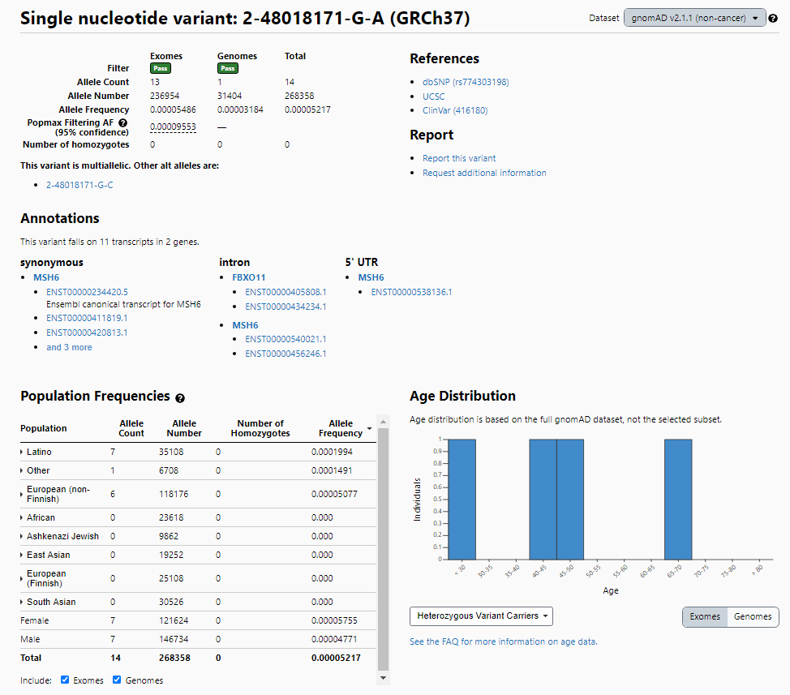
MSH6 gene therefore select female non-cancer controls
Don’t use the gnomAD MAF figure here
X
You DO need this allele number

Slide 12
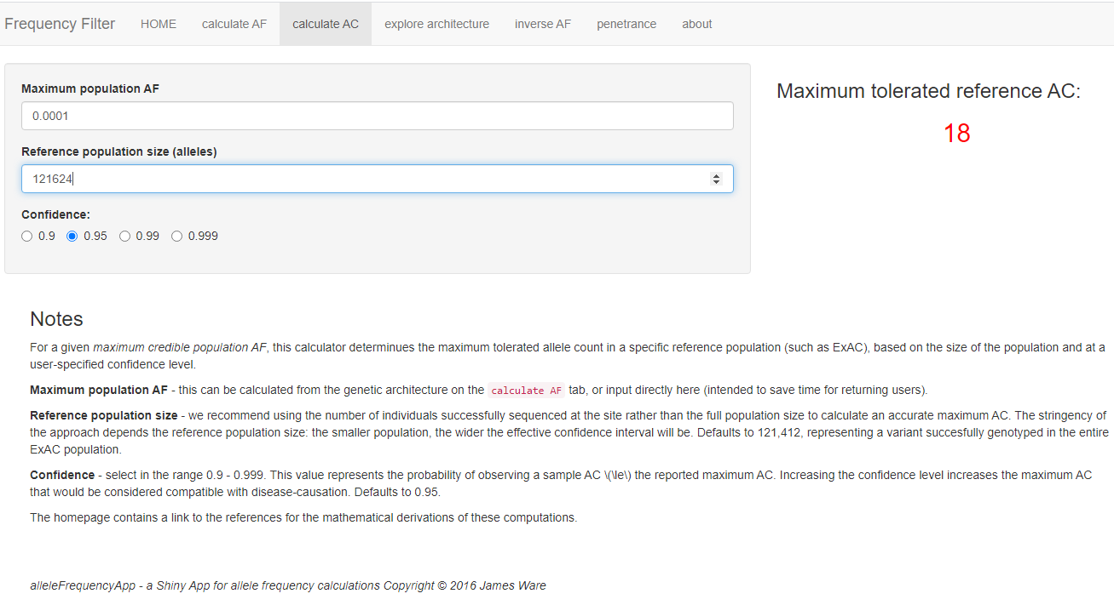
Calculating maximum AC from cardio.db/allelefrequencyapp/
Use this maximum allele count to check gnomAD data to see if you can apply BS1 or not

