Slide 1
Variant
Reinterpretation and Reclassification
Dr Lucy Loong MRCP
Clinical Research Fellow
CanGene-CanVar
Institute of Cancer Research

Slide 2
Objectives
Overview of the different issues and current literature surrounding variant reinterpretation and reclassification.
Current clinical practice
Ethical considerations
Initiation of reinterpretation
Size of the problem
Current guidance
Survey feedback
Examples
Introduce CanVIG guidance on laboratory and clinical actions following a variant reinterpretation

Slide 3
Background
-
Current Practice

Slide 4
Background
Variant interpretation and reporting:
Binary cut-offs for actionability
Emergence of additional evidence
Evolving evaluations of strengths/weights of different pieces of evidence
Adoption of NGS increased volume of testing, and variants generated per test
< -10 -9 -8 -7 -6 -5 -4 -3 -2 -1 0 1 2 3 4 5 6 7 8 9 10 >
B
LB
VUS
LP
P
Non-actionable
Actionable

Slide 5
Background
Recontacting in mainstreaming genetics
Representation from: Medical sociology, clinical genetics, law
“Recontact: Establish a new contact—initiated by either former patient or clinician – with former patients, seen in the past, discharged from care, and no longer in an ongoing relationship with the specific healthcare professional involved.”³
New info about: condition, surveillance, treatment, improved diagnostic accuracy, previously uncertain test results⁴
Clinical, Legal, Ethical, and Economic Issues Surrounding Variant Reinterpretation
Notes:
Professor Susan Kelly professor of medical sociology Exeter – funded by economic and social research council.
Anneke Lucassen
W.Chung (Medical Geneticist, Columbia)
P.Appelbaum (Psychiatrist, Columbia)
J.Roberts (Director of Health Law in Policy, Houston)
J.Pagan (Health economist, NYU)
April 2021 ACMG Annual Meeting

Slide 6
Background
Survey of UK clinical genetic service leads
Year 2014/2015
20/23 responded (9 consultants, 7 principal GCs, 4 GCs)
Recontact occurs in UK clinical genetic practice
Ad hoc, non-systematic
Typically an event triggers file review
Small majority (11/20) unsure about whether routine recontacting systems should be implemented

Slide 7
Initiation of Reinterpretation
Variant found in ‘unrelated’ new proband
Reinterpreting in response to clinical developments
CSG Variant Identified
PGD/PND for proband
Risk reducing surgery
2nd inconsistent cancer diagnosed
Cancer Diagnosis
Cascade test for relative
Cascade test for relative
Cascade test for relative
Patient Journey
2017 “Leeds share some functional work”
2015 ACMG Variant interpretation Criteria
2018 Findlay et al. BRCA1 MAVE
2020 Bouwman et al. BRCA1 MAVE
??????
2021 CanVIG BRCA specific guidance
2020 CanVIG PHE Case – control data
Reactive Approach
Notes:
Reinterpreting at the request of a patient/ healthcare practitioner. Trigger for reinterpretation is explicit and many would feel more comfortable feeding information back to patients in this contact – it’s less “out of the blue”.

Slide 8
Background
Original presentation: W.Chung (Medical Geneticist, Columbia), P.Appelbaum (Psychiatrist, Columbia) , J.Roberts (Director of Health Law in Policy, Houston), J.Pagan (Health economist, NYU)

Slide 9
Background
Original presentation: W.Chung (Medical Geneticist, Columbia), P.Appelbaum (Psychiatrist, Columbia) , J.Roberts (Director of Health Law in Policy, Houston), J.Pagan (Health economist, NYU)

Slide 10
Ethical considerations

Slide 11
Clinician / laboratorian time
Monetary resource
Lack of infrastructure
Patient autonomy
Lack of guidance:
Defined responsibility
Defined triggers
Consent
Beneficence
Non-maleficence
Psychological reaction
Trust
Non-maleficence
Equity
Underrepresented-ethnicities in sequencing cohorts
Patients less able to proactively engage
Equity
Future vs historic patients
Concerns about setting professional practice
Negligence liability
Variant interpretation changes over time
Initial interpretation being perceived as a medical error
Ethical Desirability
Practical Difficulty
The ‘weight’ of many of these factors may change over time
Notes:
By virtue of ordering and conducting a test that is likely to produce data that can’t be definitively be interpreted today – but may be subject to reliable interpretation in the future – the medical care system incurs a duty to reinterpret when more reliable interpretation is available.

Slide 12
Ethics
Elements of a duty to reinterpret and who is best place to bear them:
Data Storage - Laboratory
Initiation – Laboratory (but physicians and patients retain the ability to trigger)
Reinterpretation - Laboratory
Recontact of patient –Ordering clinician
Strength of a duty
Increases when a variant is reclassified in a manner that has implications for a patient’s clinical care.
Penetrance, severity, preventability, treatability
Duration of a duty
?????
Efforts to recontact
At least some efforts to contact the patient would seem to be required, but should not be overly burdensome.

Slide 13
Ethics
“We believe that an ethical duty to reinterpret variants should be recognized, although we acknowledge that some aspects of such a duty, such as its precise dimensions and duration and the funding mechanism, will need to be worked out over time.”
“Patients should be told about the possibility of uncertain test results as part of an informed consent process to genetic testing.”
“If a duty to reinterpret variants becomes generally accepted, the possibility of being recontacted should also be part of the consent process, […] noted on initial laboratory reports […]”
“we believe that patients whose consent to testing did not include specific notice of the possibility of reinterpretation should not be precluded from benefiting from new interpretations.”

Slide 14
Patient perspectives
Interviews with 41 patients/parents of patients
“Overall, these findings indicate that patients tend to value the potential for recontact as an important means to bring the clinical and psychological benefits of biomedical research to families in a timely fashion.”
“…in certain circumstances receiving new information may trigger complex psychological reactions, irrespective of how bespoke or actionable the new information might be.”
“…a discussion between HCPs and patients about recontacting in the context of consent for testing may be beneficial. Such discussion may help patients to reflect on the issue of the evolving nature of genomic information, adjust their expectations […] and express their preferences.”

Slide 15
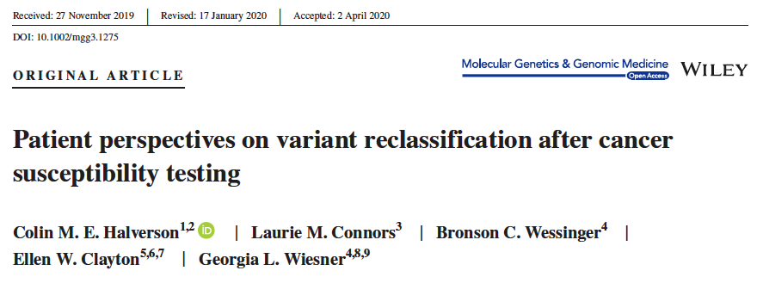
Patient perspectives
Telephone interviews with 20 patients who had received a reclassified genetic test result related to hereditary cancer. (10 upgrades, 10 downgrades, not necessarily over an actionability threshold and analysed on aggregate)
Conclude: “ Most of the participants did not express distress related to the variant reclassification and only a minority expressed a decrease in trust in medical genetics. However, recall of the new interpretation was limited […]”
50 year old with breast cancer LP TP53 variant underwent bilateral mastectomy. Variant downgraded to VUS.
“were pretty angry. […] It's easy to jump to ‘This was quite a mistake!’” However, she refused “living in a place of anger and resentment” and instead said that she respects the laboratory for its reclassification efforts and characterized her current feelings – now two years after the surgery – as ones of increased caution but not decreased trust. “[The reclassification] just highlighted to me how much is not known. […] I have a lot of respect for the field of medicine, [but] we can identify more than we can understand.”
30 year old strong FHx breast cancer P BRCA2 variant planned for mastectomy. Niece underwent genetic testing, different genetic lab classified as VUS. Niece informed patient shortly prior to mastectomy.
“It makes me feel unnerved,”

Slide 16
Initiation of Reinterpretation

Slide 17
Initiation of Reinterpretation
There is a divergence of expectations regarding who should initiate reinterpretation.
Original presentation: W.Chung (Medical Geneticist, Columbia), P.Appelbaum (Psychiatrist, Columbia) , J.Roberts (Director of Health Law in Policy, Houston), J.Pagan (Health economist, NYU)

Slide 18
Initiation of Reinterpretation
Variant found in ‘unrelated’ new proband
Reinterpreting in response to clinical developments
CSG Variant Identified
PGD/PND for proband
Risk reducing surgery
2nd inconsistent cancer diagnosed
Cancer Diagnosis
Cascade test for relative
Cascade test for relative
Cascade test for relative
Patient Journey
2017 “Leeds share some functional work”
2015 ACMG Variant interpretation Criteria
2018 Findlay et al. BRCA1 MAVE
2020 Bouwman et al. BRCA1 MAVE
??????
2021 CanVIG BRCA specific guidance
2020 CanVIG PHE Case – control data
Reactive Approach
Notes:
Reinterpreting at the request of a patient/ healthcare practitioner. Trigger for reinterpretation is explicit and many would feel more comfortable feeding information back to patients in this contact – it’s less “out of the blue”.

Slide 19
Initiation of Reinterpretation
Reinterpreting in response to new information
CSG Variant Identified
Cancer Diagnosis
Patient Journey
2017 “Leeds share some functional work”
2015 ACMG Variant interpretation Criteria
2018 Findlay et al. BRCA1 MAVE
2020 Bouwman et al. BRCA1 MAVE
??????
2021 CanVIG BRCA specific guidance
2020 CanVIG PHE Case – control data
Automated Approach
Notes:
Approach taken by large Commercial North American Diagnostic Labs.

Slide 20
Initiation of Reinterpretation
Reinterpreting at regular intervals
CSG Variant Identified
Cancer Diagnosis
Patient Journey
2017 “Leeds share some functional work”
2015 ACMG Variant interpretation Criteria
2018 Findlay et al. BRCA1 MAVE
2020 Bouwman et al. BRCA1 MAVE
??????
2021 CanVIG BRCA specific guidance
2020 CanVIG PHE Case – control data
Interval-based Proactive Approach

Slide 21
Size of the problem

Slide 22
Size of the problem
All individuals who had genetic testing for hereditary cancer risk between 2006 – 2016
(direct variant tests and founder testing excluded)
Myriad Genetic Laboratories Inc.
Subset analysis for patients seen at University of Texas Southwestern Medical Center
(i.e. enriched for suggestive personal and family history over commercial testing ‘all-comers’)
Myriad use an automated system to monitor daily for new evidence in the literature, statistical methods, functional data, lab specific data.
Upon identification of additional information, variant classification was re-evaluated immediately. If variant reclassification was appropriate, the testing laboratory sent an amended report indicating the new classification to the clinician.

Slide 23
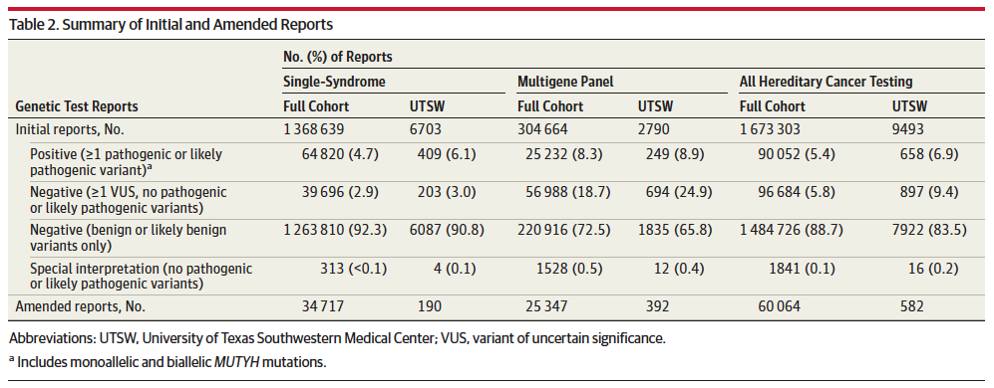
Size of the problem

Slide 24
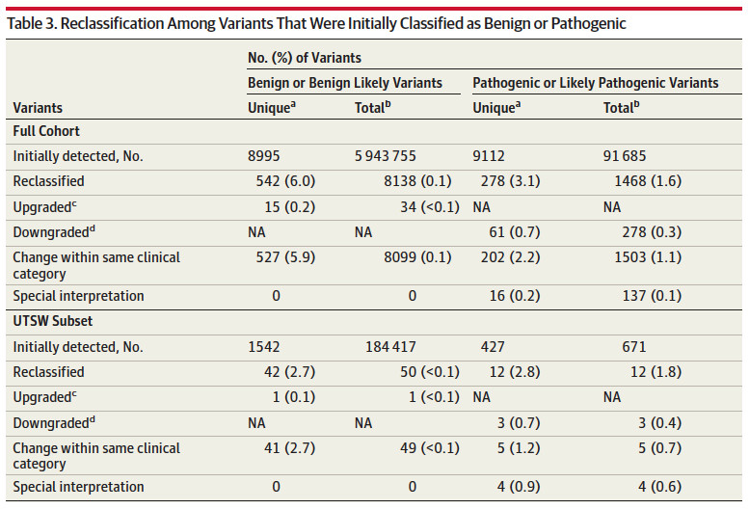
Size of the problem
c No variants were upgraded directly from benign or likely benign to pathogenic or likely pathogenic.
d No variants were downgraded directly from pathogenic or likely pathogenic to benign or likely benign
Notes:
Abbreviation: NA, not applicable;
UTSW, University of Texas
Southwestern Medical Center.
a Unique variants refer to the number
of specific genetic variants.
b Total variants refer to the total
number of observed variants, which
includes multiple observations of
the same unique variant.
c No variants were upgraded directly
from benign or likely benign to
pathogenic or likely pathogenic.
d No variants were downgraded
directly from pathogenic or likely
pathogenic to benign or likely
benign

Slide 25
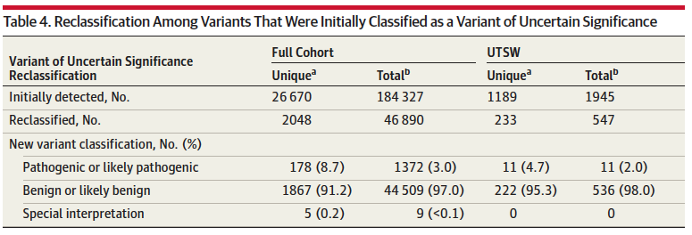
Size of the problem

Slide 26
Size of the problem
Very few variants are reclassified from LP / P or LB / B to VUS
A high standard of evidence, and evidence from multiple sources, is required to attain those classifications in the first place.
Most VUS reclassifications are down classifications, a minority are up classifications.
< -10 -9 -8 -7 -6 -5 -4 -3 -2 -1 0 1 2 3 4 5 6 7 8 9 10 >
B
LB
VUS
LP
P
Non-actionable
Actionable
Notes:
The move from qualitative combining criteria in Richards et al. 2015 ACMG criteria, to a more quantitative framework Tavtigian et al. gives you more of a sense of it.
Odds of pathogenicity – are conditional probabilities for use in a Bayesian classifier

Slide 27
Current Guidance

Slide 28
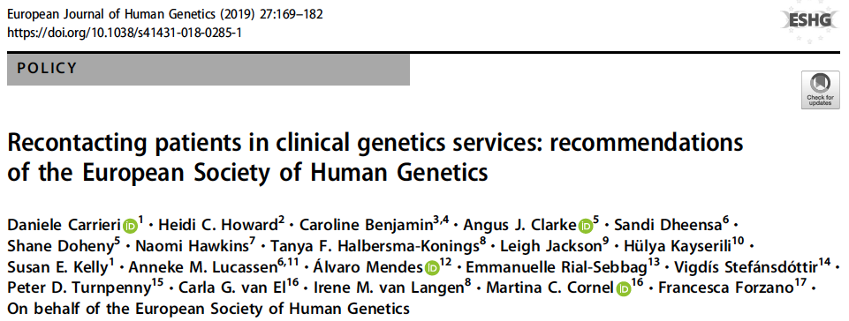
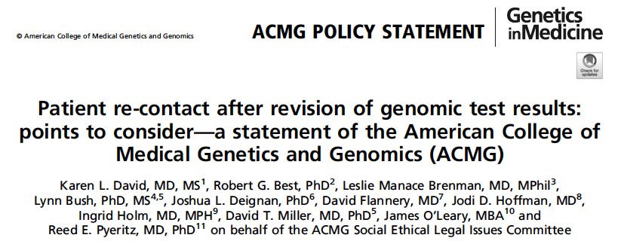
Current Guidance
Note this is a different ‘group’ to Wendy Chang et al. ‘s NIH funded group.
Notes:
Both published in 2019
The ACMG points to consider is much more ‘procedural’:
Contents of informed consent
Documentation
Responsibilities
Patient
Lab
Geneticist
Ordering physicians
Patient’s right to decline recontact
Ordering physician should make reasonable efforts to recontact

Slide 29
Current Guidance
If possible, recontact should take place for findings with clinical or established personal utility, even though currently there is no duty to do so
The decision to recontact should be based on the best interests of the patient/family
Recontacting should be sustainable for the health care system and its workforce
The allocation of dedicated resources for activities on recontacting should be considered
Recontacting should strive to be equitable for patients from all socioeconomic backgrounds and contexts
There is a need for professional consensus about what constitutes good practice regarding consent for recontacting
Recontacting should be a shared responsibility with patients
Recontacting should be a shared responsibility with the genetic laboratories
Data sharing should be promoted
Other stakeholders should also share responsibility for recontacting
Do the best you can with limited resources
Each country should define its own organizational policy on the recontact process
More research is needed to inform responsible recontacting processes

Slide 30
CanVIG guidance on variant reinterpretation in CSGs

Slide 31
Covers all possible scenarios encountered in a reactive approach to reinterpretation.
Some scenarios are likely to be very rare.
Suggested laboratory and clinical management
Divided in three by type of evidence which led to reclassification

Slide 32
Where evidence leading to reclassification is new and non-conflicting, management is the same as per an initial variant classification, except for:
Recommendation that a reclassification alert is sent nationally via CanVIG, for reclassifications across the VUS/LP actionability threshold
Recommendation that down classifications are discussed in a multicentre MDT review
In view of their rarity and repercussions
To establish whether there is any lab-specific evidence which could ‘restore’ initial classification
Recommendation for systematic proactive contact of historic patients with reclassification across the VUS/LP actionability threshold

Slide 33
New classifications based on revisions of evidence strengths, are more likely to be susceptible to future further revision.
Conflicting evidence highly unlikely to result in a change of evidence points of 4 (equivalent to a single strong piece of evidence).

Slide 34
“Potentially changeable…”
because the evidence is conflicting, or classification arising from new evidence strengths
“…classification at the actionability threshold”
< -10 -9 -8 -7 -6 -5 -4 -3 -2 -1 0 1 2 3 4 5 6 7 8 9 10 >
B
LB
VUS
LP
P
Non-actionable
Actionable

Slide 35
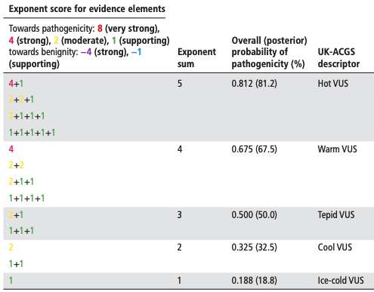
For upgrades: recommend caution and careful counselling especially with regards to irreversible therapies e.g. risk reducing mastectomy.
For downgrades: have not recommended systematic recontact of historic patients, in best interests of the patient. This is to reduce the potential for harm, bearing in mind that posterior probability of pathogenicity is still 50 – 81 %
Garrett et al. ¹⁰
Notes:
Withdrawal of treatment (e.g. screening) is difficult in any scenario but especially so when the posterior probability of pathogenicity is still 50-80%

Slide 36
Current Guidance
If possible, recontact should take place for findings with clinical or established personal utility, even though currently there is no duty to do so
The decision to recontact should be based on the best interests of the patient/family
Recontacting should be sustainable for the health care system and its workforce
The allocation of dedicated resources for activities on recontacting should be considered
Recontacting should strive to be equitable for patients from all socioeconomic backgrounds and contexts
There is a need for professional consensus about what constitutes good practice regarding consent for recontacting
Recontacting should be a shared responsibility with patients
Recontacting should be a shared responsibility with the genetic laboratories
Data sharing should be promoted
Other stakeholders should also share responsibility for recontacting
Do the best you can with limited resources
Each country should define its own organizational policy on the recontact process
More research is needed to inform responsible recontacting processes

Slide 37
Conclusion
Areas that need addressing:
Consent
Equity
Dedicated resources
Research
Current clinical practice
Ad hoc, reactive approach, concerns about liability for initiation of reinterpretation and recontact
Ethical considerations
Balance between ethical desirability and practical feasibility
Initiation of reinterpretation
Different models: reactive to clinical events, automated, time-interval-based
Current guidance
ESHG recommendations on recontacting patients
Size of the problem
VUS much more likely to be reinterpreted and more often down than up
Introduce CanVIG guidance on laboratory and clinical actions following a variant reinterpretation
Systematises current practice
Utilises national CanVIG network for data sharing and patient benefit
Maximises clinical benefit to patients and minimizes harm
Builds in caution surrounding conflicting or re-weighted evidence, especially around actionability threshold
Maps to ESHG recommendations on recontacting

Slide 38
References
Hirschhorn, K., L. D. Fleisher, L. Godmilow, R. R. Howell, R. R. Lebel, E. R. McCabe, M. J. McGinniss, et al. "Duty to Re-Contact." [In eng]. Genet Med 1, no. 4 (May-Jun 1999): 171-2. https://doi.org/10.1097/00125817-199905000-00010.
http://socialsciences.exeter.ac.uk/sociology/research/projects/mainstreaminggenetics/about/
Carrieri, D., H. C. Howard, C. Benjamin, A. J. Clarke, S. Dheensa, S. Doheny, N. Hawkins, et al. "Recontacting Patients in Clinical Genetics Services: Recommendations of the European Society of Human Genetics." Eur J Hum Genet 27, no. 2 (Feb 2019): 169-82. https://doi.org/10.1038/s41431-018-0285-1. https://www.ncbi.nlm.nih.gov/pubmed/30310124.
Carrieri, D., A. M. Lucassen, A. J. Clarke, S. Dheensa, S. Doheny, P. D. Turnpenny, and S. E. Kelly. "Recontact in Clinical Practice: A Survey of Clinical Genetics Services in the United Kingdom." [In eng]. Genet Med 18, no. 9 (Sep 2016): 876-81. https://doi.org/10.1038/gim.2015.194.
Appelbaum, P. S., E. Parens, S. M. Berger, W. K. Chung, and W. Burke. "Is There a Duty to Reinterpret Genetic Data? The Ethical Dimensions." Genet Med 22, no. 3 (Mar 2020): 633-39. https://doi.org/10.1038/s41436-019-0679-7. https://www.ncbi.nlm.nih.gov/pubmed/31616070.
Carrieri, D., S. Dheensa, S. Doheny, A. J. Clarke, P. D. Turnpenny, A. M. Lucassen, and S. E. Kelly. "Recontacting in Clinical Practice: The Views and Expectations of Patients in the United Kingdom." [In eng]. Eur J Hum Genet 25, no. 10 (Oct 2017): 1106-12. https://doi.org/10.1038/ejhg.2017.122.
Halverson, C. M. E., L. M. Connors, B. C. Wessinger, E. W. Clayton, and G. L. Wiesner. "Patient Perspectives on Variant Reclassification after Cancer Susceptibility Testing." [In eng]. Mol Genet Genomic Med 8, no. 7 (Jul 2020): e1275. https://doi.org/10.1002/mgg3.1275.
David, K. L., R. G. Best, L. M. Brenman, L. Bush, J. L. Deignan, D. Flannery, J. D. Hoffman, et al. "Patient Re-Contact after Revision of Genomic Test Results: Points to Consider-a Statement of the American College of Medical Genetics and Genomics (Acmg)." Genet Med 21, no. 4 (Apr 2019): 769-71. https://doi.org/10.1038/s41436-018-0391-z. https://www.ncbi.nlm.nih.gov/pubmed/30578420.
Mersch, J., N. Brown, S. Pirzadeh-Miller, E. Mundt, H. C. Cox, K. Brown, M. Aston, et al. "Prevalence of Variant Reclassification Following Hereditary Cancer Genetic Testing." [In eng]. Jama 320, no. 12 (Sep 25 2018): 1266-74. https://doi.org/10.1001/jama.2018.13152.
Garrett, A., M. Durkie, A. Callaway, G. J. Burghel, R. Robinson, J. Drummond, B. Torr, et al. "Combining Evidence for and against Pathogenicity for Variants in Cancer Susceptibility Genes: Canvig-Uk Consensus Recommendations." J Med Genet 58, no. 5 (May 2021): 297-304. https://doi.org/10.1136/jmedgenet-2020-107248. https://www.ncbi.nlm.nih.gov/pubmed/33208383.

