Slide 1




MULTIFACTORIAL CLASSIFICATION SYSTEMS
Dr Clare Turnbull
Professor in Translational Cancer Genomics, Institute of Cancer Research,
NHS consultant in Cancer Genetics (Honorary), Royal Marsden NHS Trust
Consultant in Public Health Medicine (Honorary), Public Health England

Slide 2
ACMG 2015

Slide 3
TAVTIGIAN 2018
Tavtigian SV et al Genetics in medicine 2018;20(9):1054-60

Slide 4
GARRETT 2020/TAVTIGIAN 2020

Slide 5
ACMG/SVI 2022?
?discrete evidence categories in continuous scale

Slide 8
EP==LLR

Slide 9
EP=ln(LR)

Slide 10
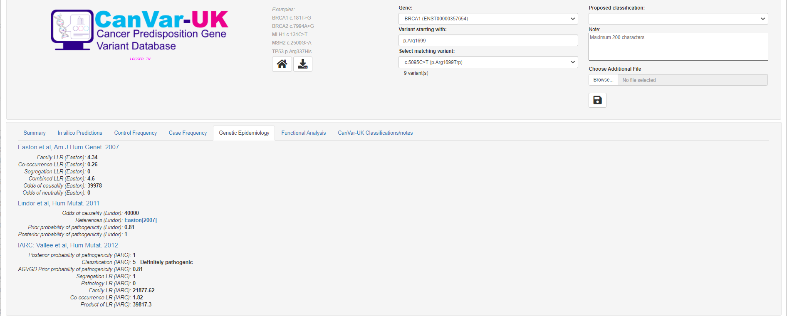
STRONG

Slide 11

MODERATE

Slide 12
If Easton LLR=4.5, this is strong because >4 points
If Parsons LR=4,5, this is mod, as LR to earn mod is 4.3 (which converts to 2 points)

