Slide 1
BRCA reclassification examples
Miranda Durkie
CanVIG-UK
11th Feb 2021

Slide 2
1. Classification change - Benign to Pathogenic
Notes:
Linear regression model

Slide 3
BRCA1: c.5207T>C p. (Val1736Ala)
Easton assessment: neutral
Family LLR (Easton): | -1.5
Co-occurrence LLR (Easton): | -2.1
Segregation LLR (Easton): | 0.25
Combined LLR (Easton): | -3.35
Odds of causality (Easton): | 0
Odds of neutrality (Easton): | 2219

Slide 4
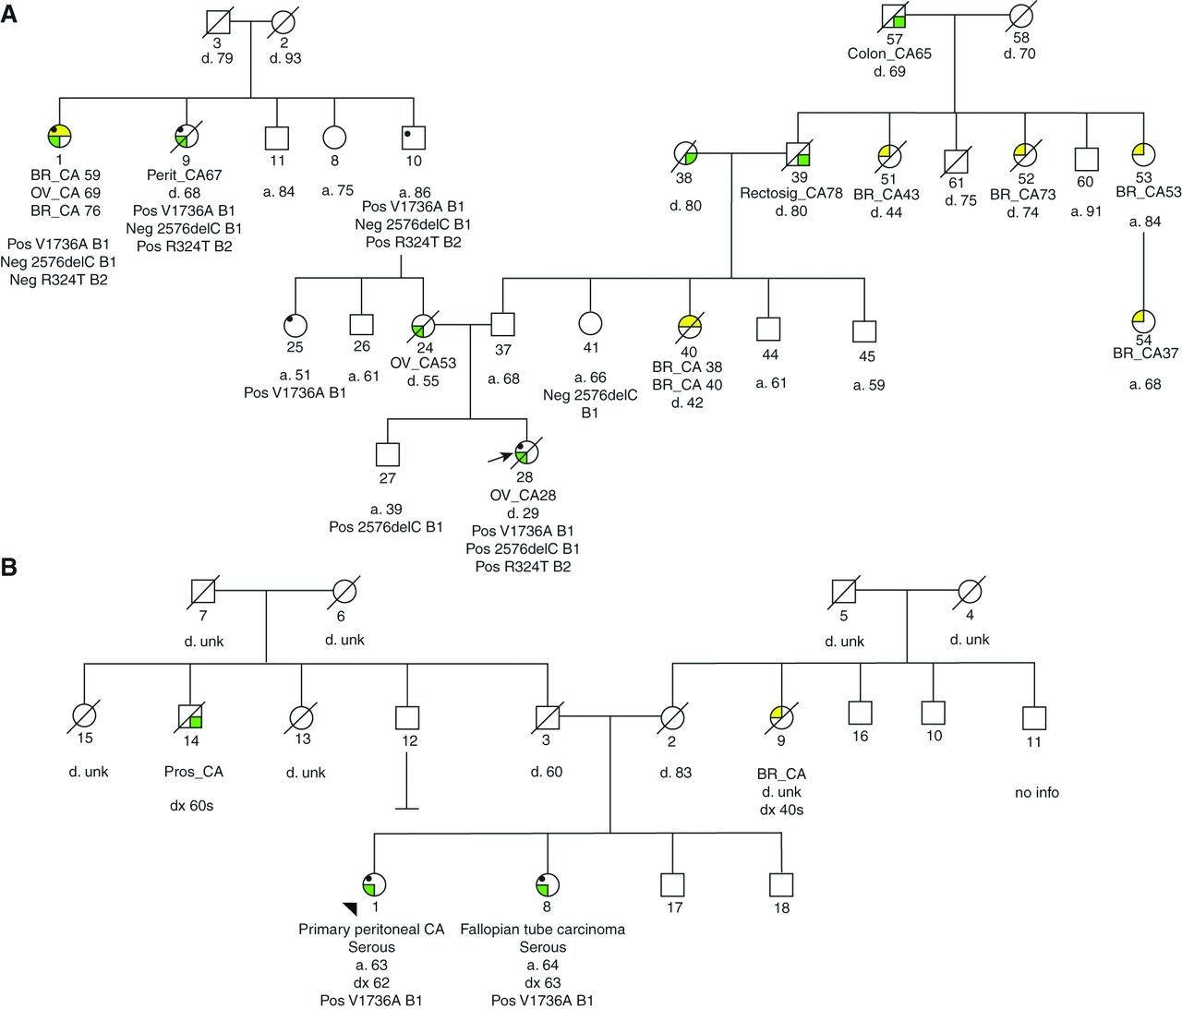
Co-occurrence caused Fanconi –like syndrome - Domchek et al 2013
Microcephaly
Short stature
DD
dysmorphic
Extreme toxicity to platinum therapy
Notes:
stage IV papillary serous ovarian carcinoma. Medical records revealed a history of microcephaly, short stature (adult height of 150 cm) and developmental delay with limited speech at age 4 years. Review of pictures provided by the family demonstrates coarse features with low anterior hairline, macrognathia, a prominent nasal bridge and small alae nasi. She did not have obvious abnormalities of her thumbs and had a normal complete blood count at the time of her cancer diagnosis. Neither ataxia nor telangiectasias were documented.

Slide 5
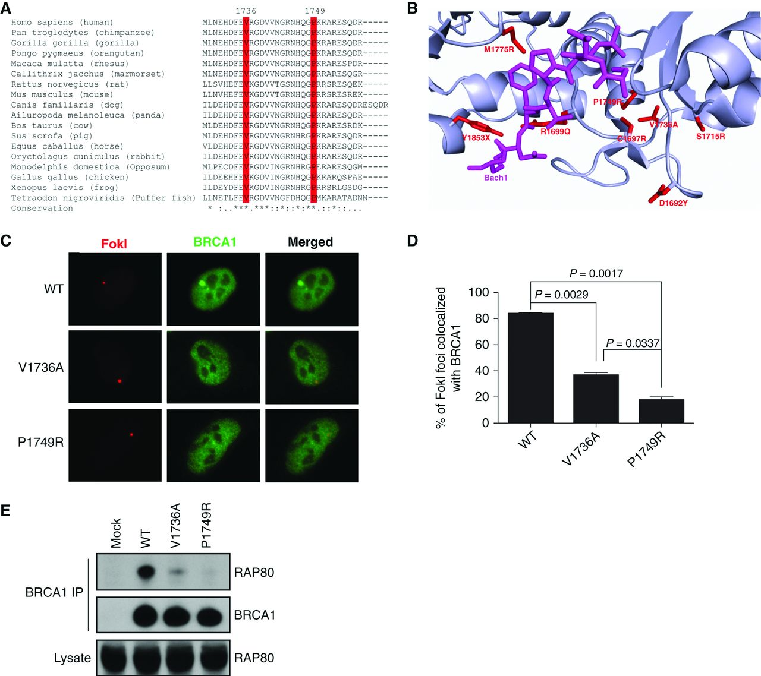
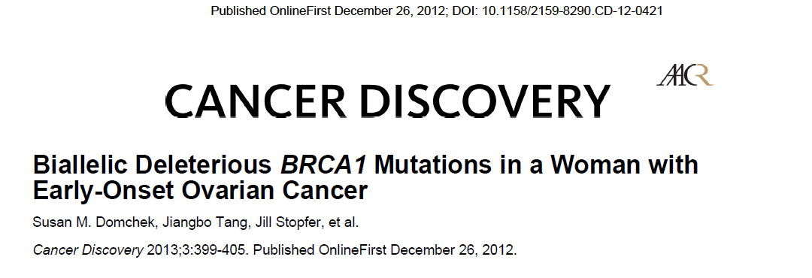
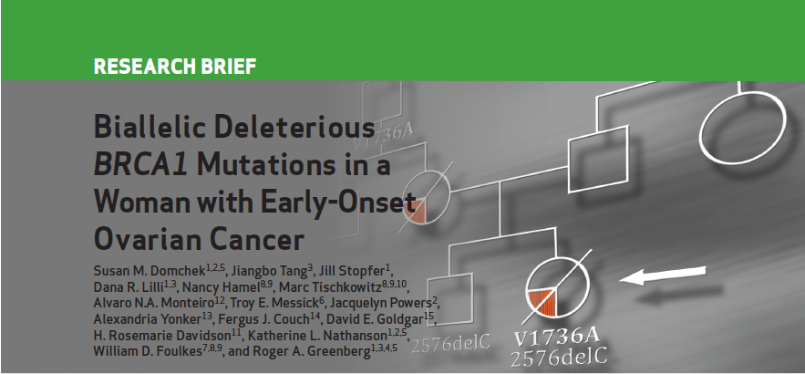
Shown to be hypomorphic with respect to biochemical & cellular function but no evidence of reduced penetrance with respect to cancer susceptibility in 11 additional families

Slide 6
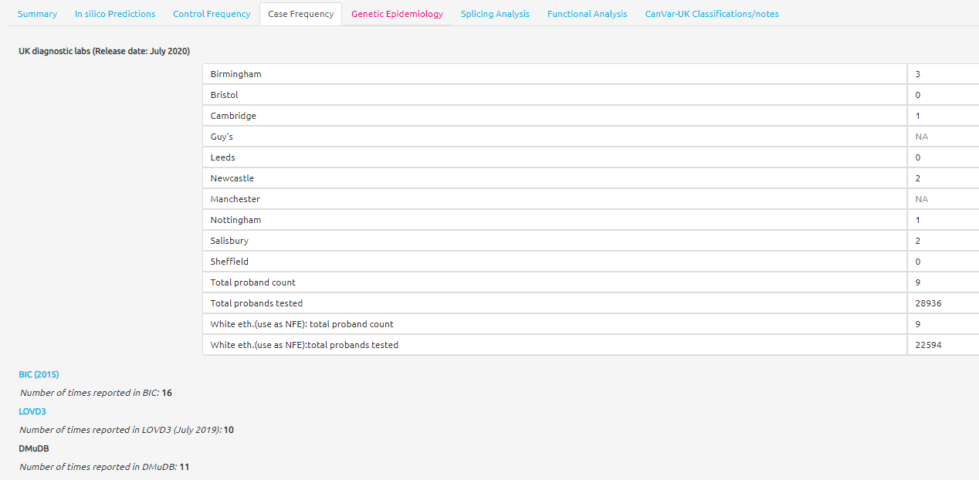
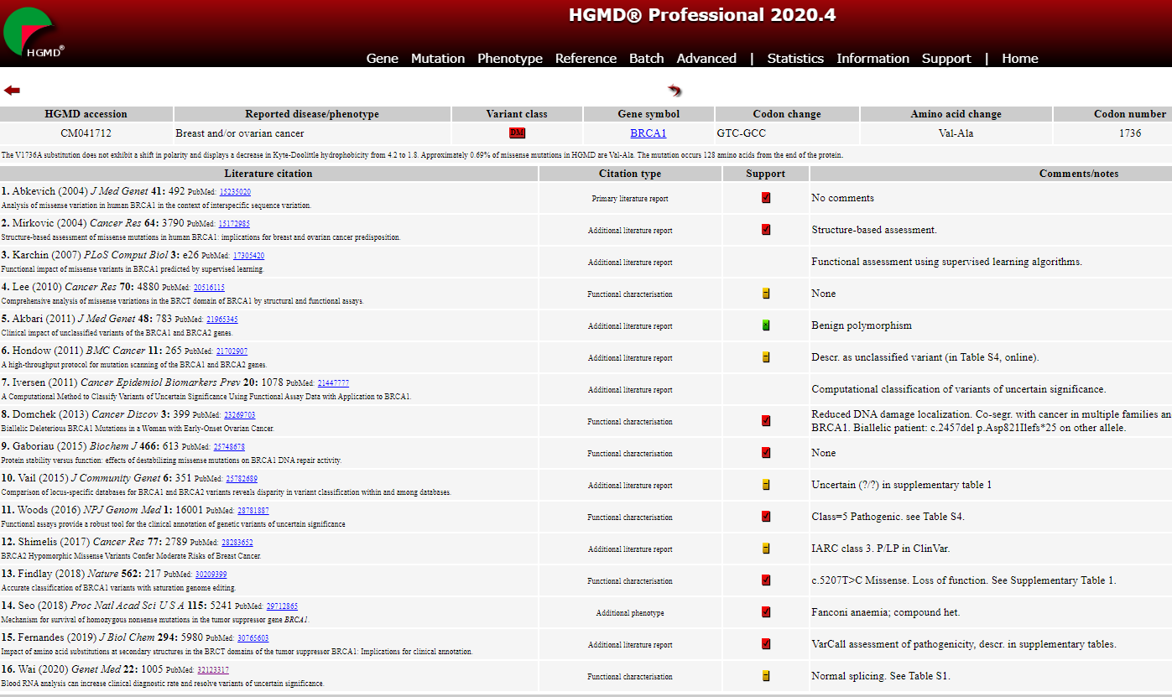
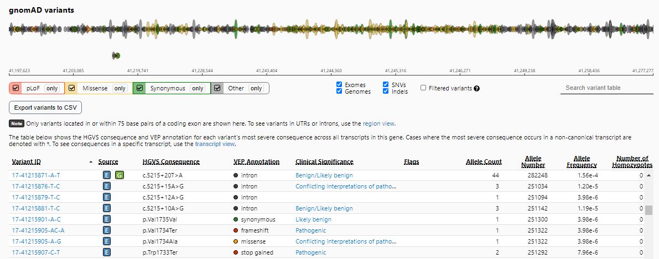
Consistent with case-control data
= not present

Slide 7
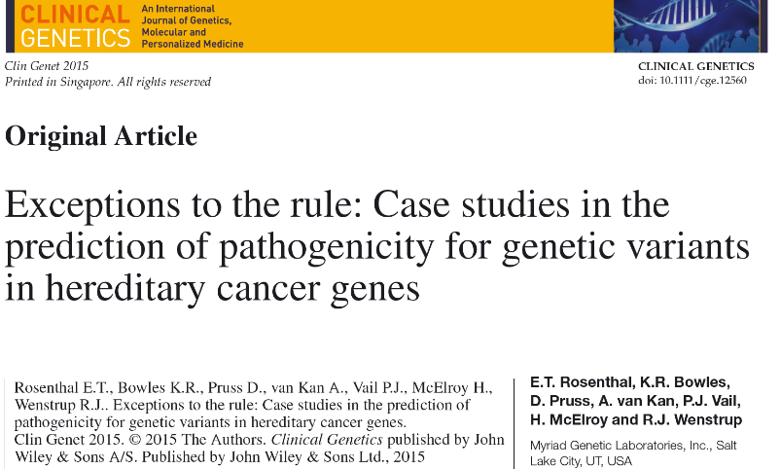
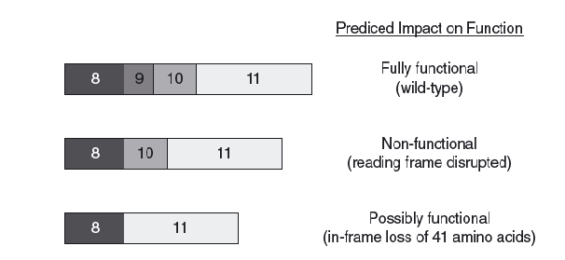
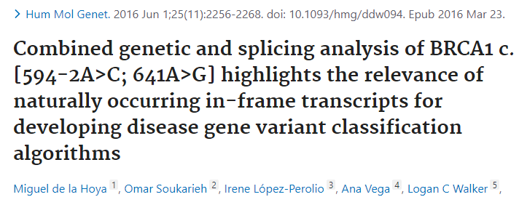
2. Classification change - Pathogenic to Benign
BRCA1: c.594-2A>C
(IVS9-2A>C)
FHx & co-occurrence data = not consistent with pathogenic variant
Always in cis with c.641A>G causes Exon 10 skipping– out of frame but
20-30% naturally occurring 8,11 isoform rescues phenotype

Slide 8
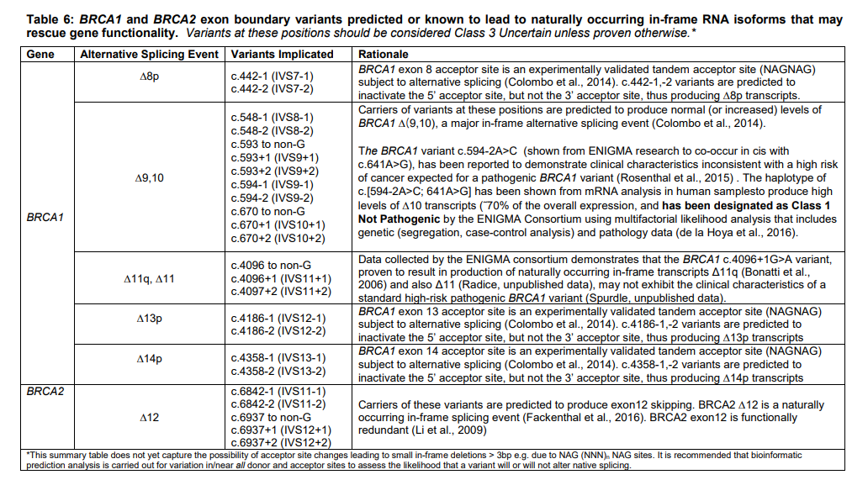
ENIGMA classification criteria Version 2.5.1 29 June 2017

Slide 9
3. Classification change - Likely Pathogenic to VUS (change in evidence / guidelines)
BRCA2: c.73G>A, p.(Gly25Arg)
[pedigree showing proband with metastatic BrCa aged 39, mother with OvCa aged 59, maternal grandmother with BrCa aged 70 and 2 maternal cousins with BrCa aged 61 and 73. Plus 5 predictive tests in the family who had inherited this variant]

Slide 10
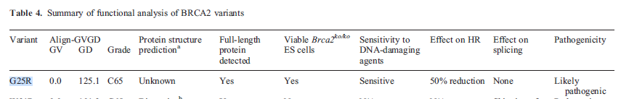
BRCA2: c.73G>A p.(Gly25Arg)
Classified as class 4 likely pathogenic independently by both Sheffield & Leeds in 2018 based on:
  Functional studies by 1) Xia et al 2006 (50% HR/DSBR activity & greatly diminished PALB2 binding), 2) Biswas et al 2012 (sensitive to DNA-damaging agents & HR repair 50%)
  & 3) Hartford et al 2016 (mouse model with high tumorigenesis).
  Note these papers did suggest could be hypomorphic: PS3_mod
  on UNIPROT listed as pathogenic due to abolished interaction with PALB2 (Xia 2006)
  Reported BIC x1, ClinVar x2 (GeneDx), LOVD x3: PS4_mod
  Seen once in gnomAD: PM2
  Non-conservative change affecting 100% conserved aa: PP3
  Exponent score 7 = likely pathogenic

Slide 11
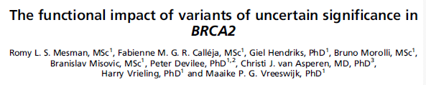
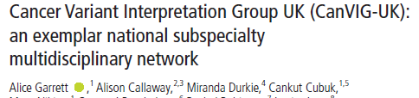
New evidence / new guidelines
HDR activity >50% classed as similar to non-pathogenic class 1/2 variants
Can-VIG specification 2020: PS3 can only be used if activity <25% wild-type
PM2 – 1 allele on gnomAD now supporting
PS4 – downgrade to supporting (limited phenotypic data)
So now only have PS4_sup, PM2_sup, PP3_sup = 3 points (tepid VUS)

Slide 12
BRCA2: c.73G>A, p.(Gly25Arg) - Affect on clinical management
[pedigree removed]
Based on our re-issued reports planned risk reducing mastectomies were cancelled for 2/3 heterozygotes.
During pre-surgery screening, proband’s sister with the variant, was found to have rapidly growing breast tumour

Slide 13
4. VUS or LP? – user application of guidelines
Jan 2021 CanVIG variant of the month:
BRCA1 c.5071A>G p.(Thr1691Ala)

Slide 14
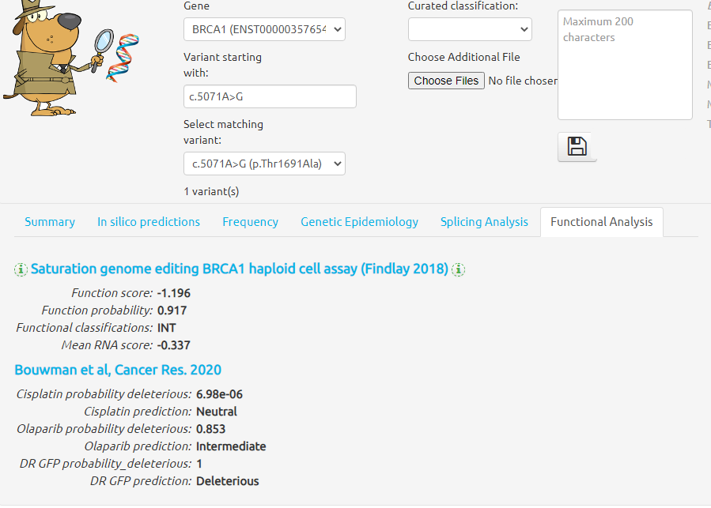

Slide 15
BRCA1 c.5071A>G p.(Thr1691Ala)
Reported on ClinVar x6 = VUS
Reported on LOVD x5 = VUS
Reported on UMD/BRCA Share x8 = VUS
Reported by Caputo et al 2012
Reported by Coulet et al 2010
Over 20 cases
Can’t be sure no overlap however still fairly compelling case-control evidence with 0 cases in gnomAD
Can you use PM5 if you have functional data?
Use of PP4 allowed by CanVIG specification
Therefore guidelines can “get” to class 4 even though it “feels” like a class 3 VUS

Slide 16
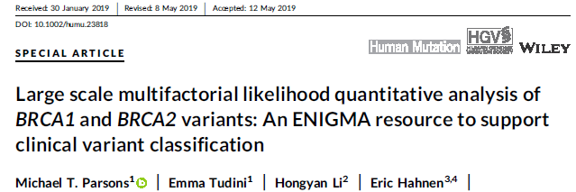
5. LP to LB??
BRCA2: c.8351G>A p.(Arg2784Gln)
Can-VIG March 2019 classified as LP class 4 based on functional studies by Guidigli 2013, Guidigli 2018, Hart 2018 & Mesman 2019. Also UK cases x3; LOVD x27; ClinVar x13 & x1 gnomAD non-cancer females
However ENIGMA multifac paper – Parsons et al 2019 classified as likely benign (based on co-segregation LR of 0.00011 and co-occurrence LR of 0.05 giving combined LR (odds causality) 8.7E-06)
Hypomorphic or moderate-risk?
Active project group in ENIGMA for this variant now – please send cases!

Slide 17
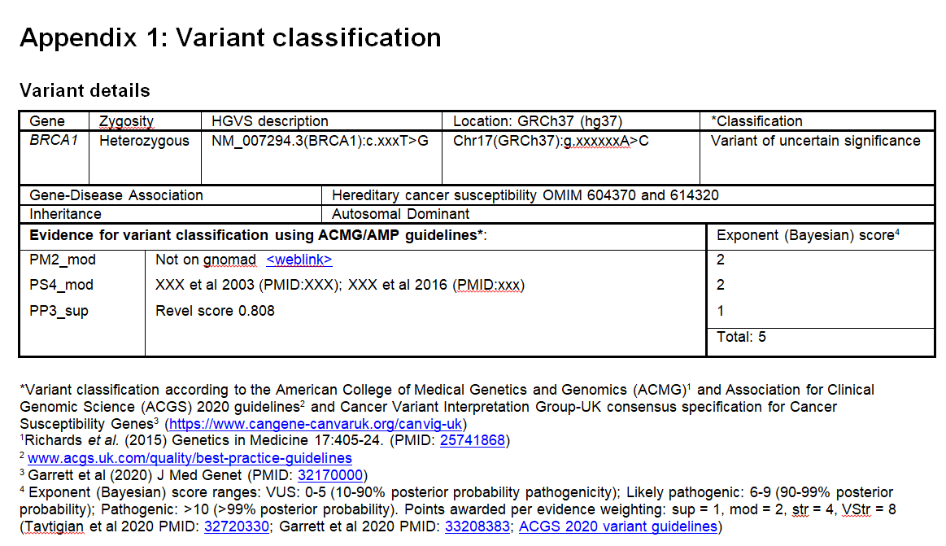
Proposed change to ACGS report template

Slide 18
Logistics of variant reclassification
Use CanVIG email group to identify other centres with families with same variant
Alert clinicians involved in patient care
Proposal:
  CSTAG to develop simple form to summarise reclassification including evidence and ACMG criteria
  To be reviewed by another lab/CSTAG
  CanVIG to email reclassification alert to all members

