Slide 1
Can-VIG BA1/BS1 for BRCA1 and BRCA2
Miranda Durkie

Slide 2
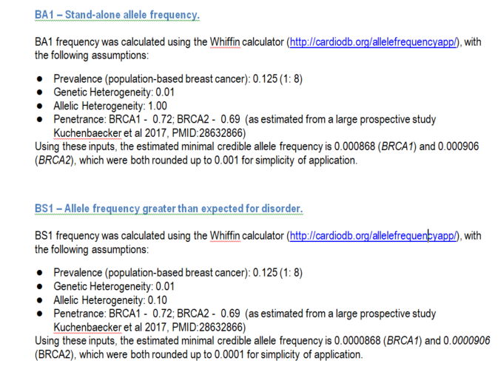
ENIGMA Whiffin calculations

Slide 3
BA1/BS1
Compare against female non-cancer control alleles only (~120,000 in gnomAD v2.2.1 vs >250,000 for BRCA1/2 total)
Implement female non-cancer controls for PS4 calculations too
Need update to canvaruk.org website and PHE data
Current CanVIG guidelines BA1: 0.5%-1% BS1: n/a
ENIGMA/CanVIG:
BA1 round up to 0.001 (0.1%) for BRCA1/2
BS1 round up to 0.0001 (0.01%) for BRCA1/2
= Maximum credible population AF in cardiodb.org/allelefreqencyapp/ (not the same as gnomAD MAF!)
Use cardiodb.org/allelefrequencyapp/ to calculate max tolerated allele count for gnomAD
TP53: BA1 0.1%; BS1 0.03%
PTEN: BA1 1%; BS1 0.1%
CDH1: BA1 0.2%; BS1 0.1%
AD hearing loss: BA1 0.1%; BS1 0.02%

Slide 4
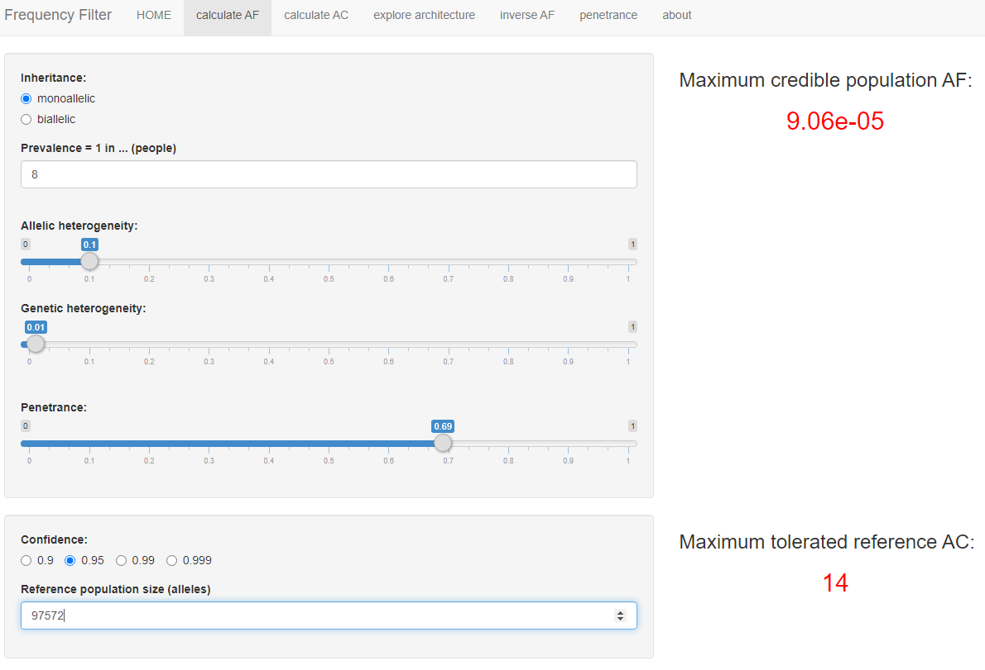
BRCA2 https://www.cardiodb.org/allelefrequencyapp/

Slide 5
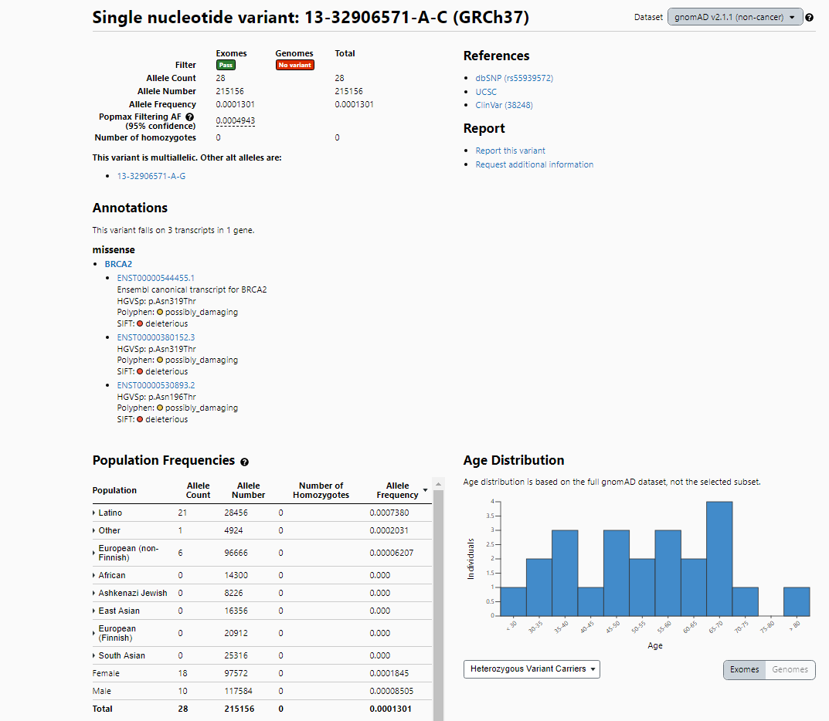

Slide 6
Founder mutation exceptions
BRCA1 c.5266dup – 55 alleles (0.2% Ashkenazi Jew; 0.019% NFE)
BRCA1 c.68_69dup – 58 alleles (0.4% Ashkenazi Jew; 0.0085% NFE)
BRCA2 c.5946del – 78 alleles (0.59% Ashkenazi Jew; 0.011% NFE)
Next most common (Rebbeck 2018)
BRCA1 c.181T>G – 0.004%
BRCA2 c.6275_6276del (UK) – 0.003%
BRCA1 c.4065_4068del (UK) – 0.002%

Slide 7
Other genes…
CanVIG Steering & Advisory Group (CSTAG) agreed 09/07 to use similar approach for Lynch syndrome
Based on
incidence of colorectal cancer for MLH1/MSH2 and endometrial cancer for MSH6 & PMS2
Data to follow
Can expand this to other CSGs…

