Slide 1
“Lynch like Syndrome”… what’s in a name?
Dr Terri McVeigh
Consultant Clinical Geneticist, The Royal Marsden NHS Foundation Trust
UKCGG/CanGene-CanVar National MDT 17th November 2022

Slide 2
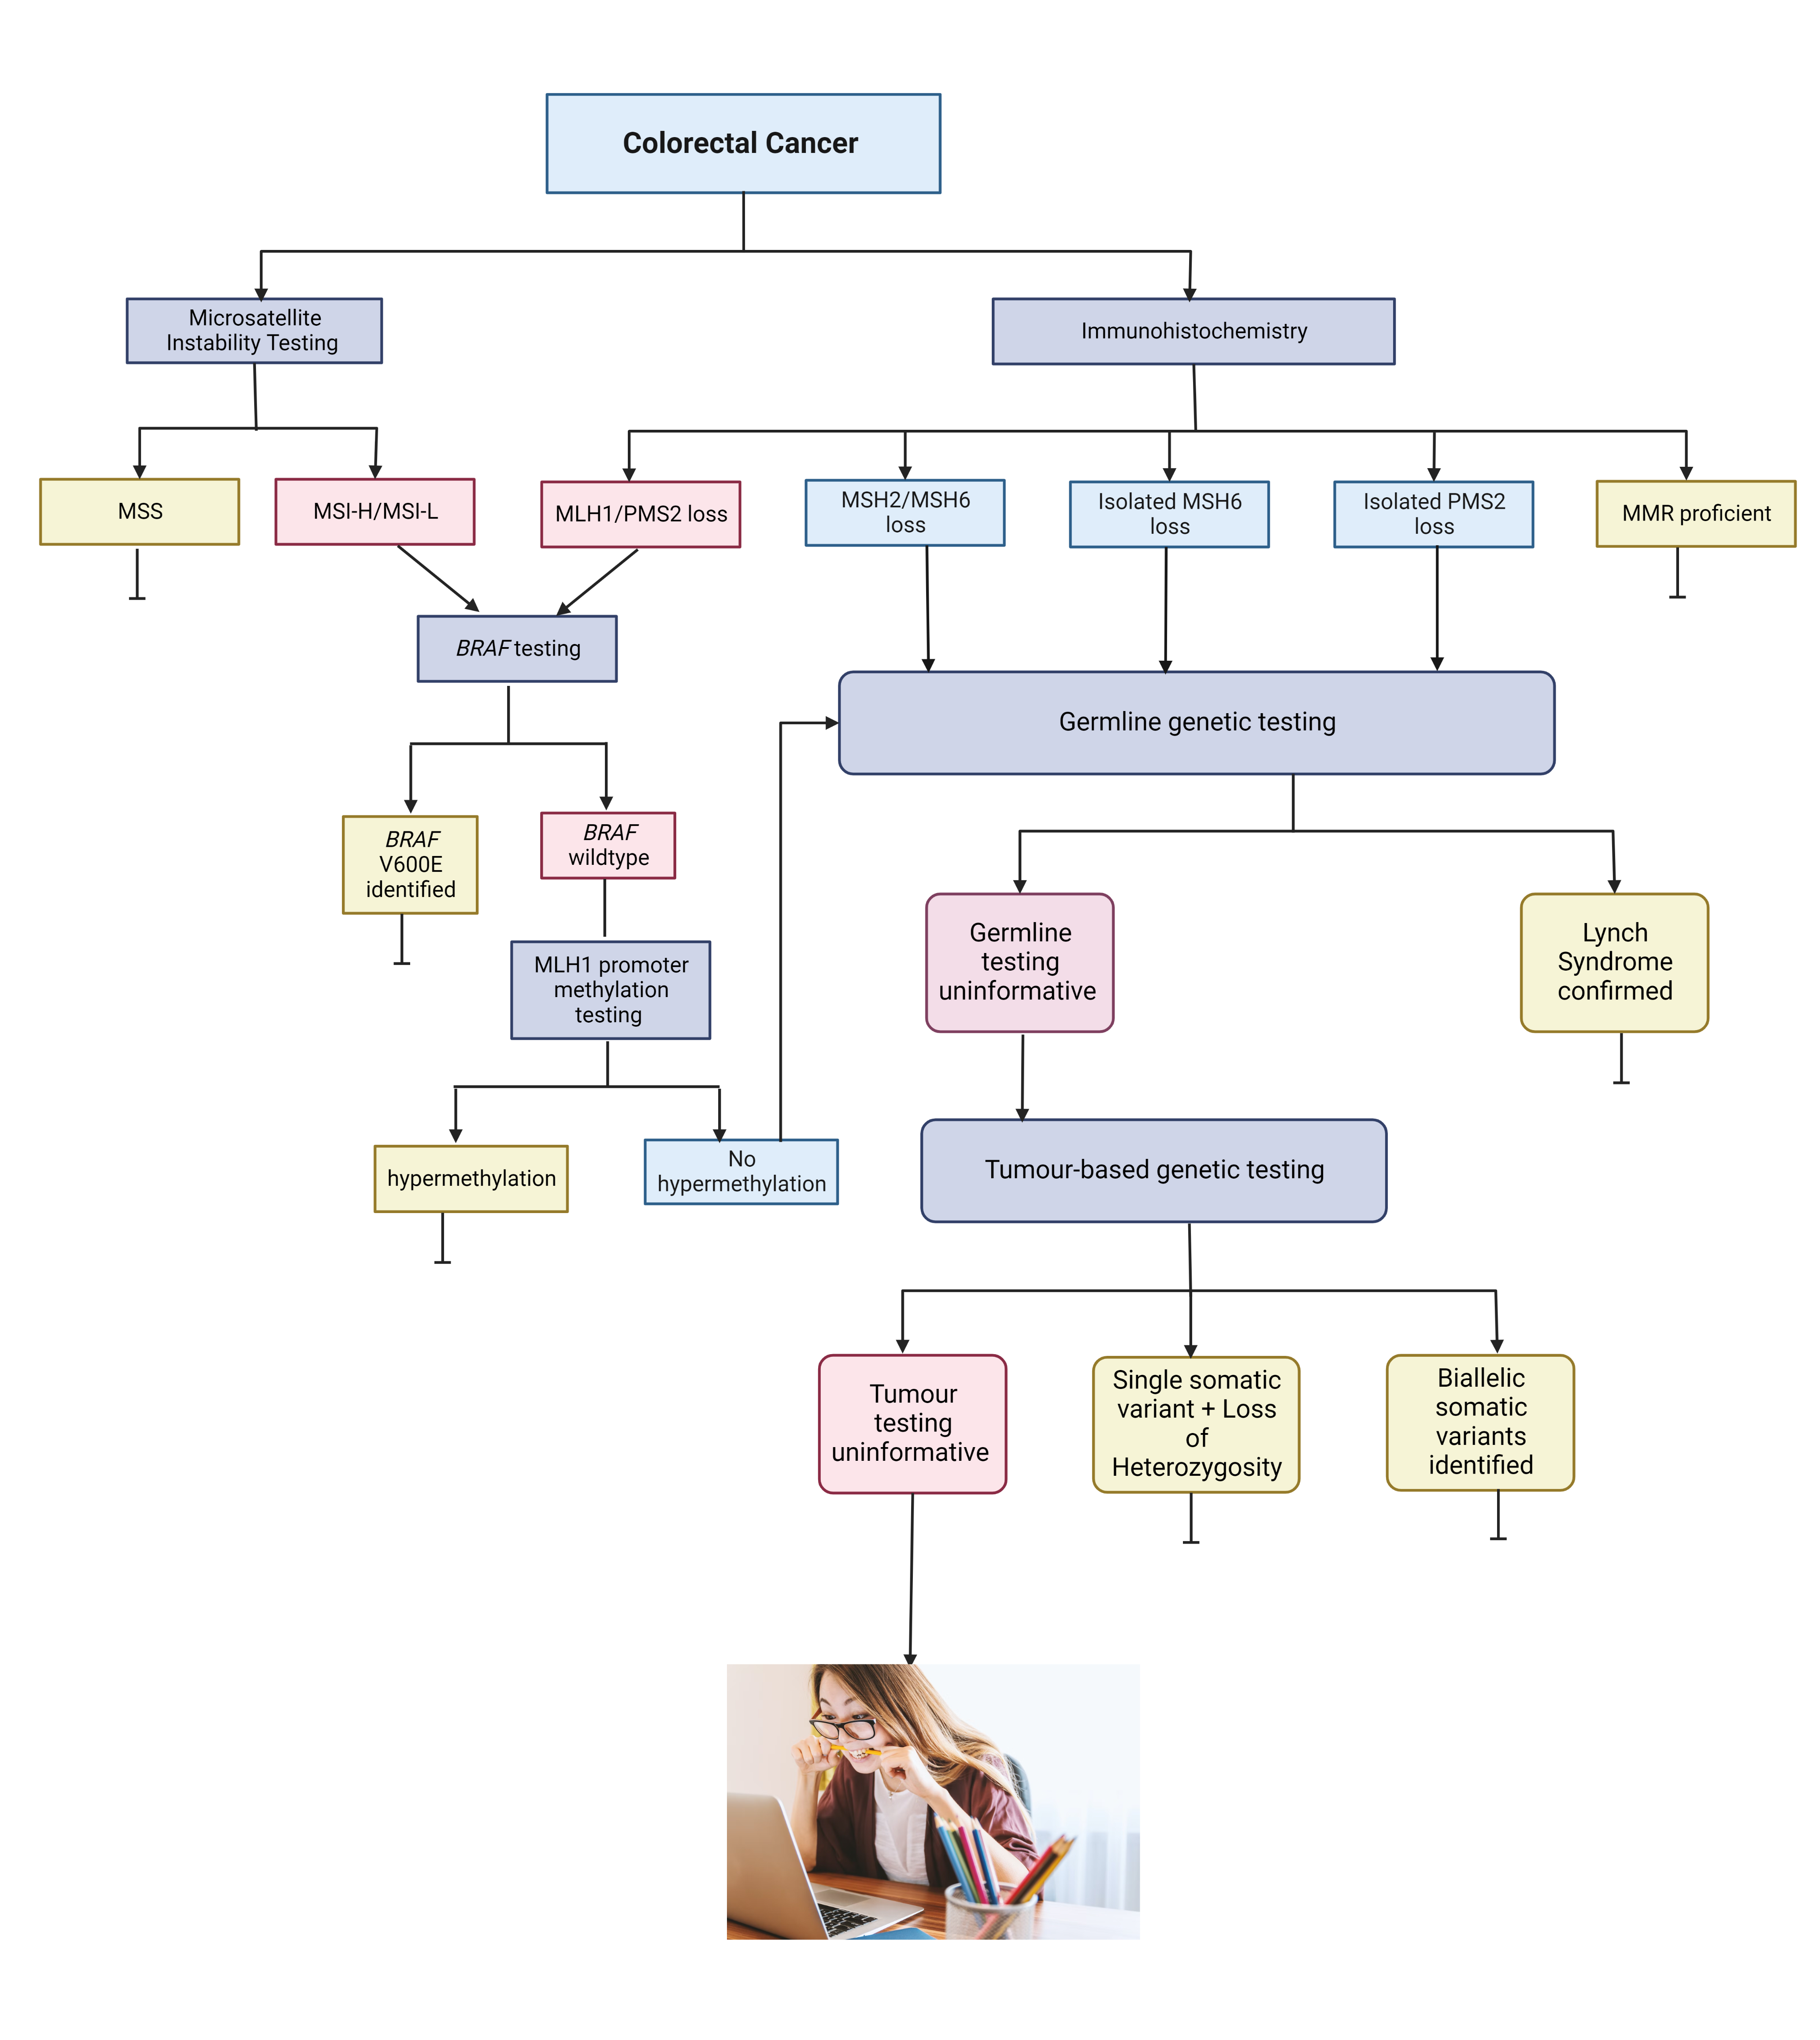
Molecular testing strategies for Lynch syndrome in people with colorectal cancer [NICE DG27]
Molecular testing strategies for Lynch syndrome in people with colorectal cancer. NICE Diagnostics guidance [DG27]Published: 22 February 2017. Available from https://www.nice.org.uk/guidance/dg27

Slide 3
A priori probability of identifying constitutional MMR gene variant higher in patients:
Diagnosed at younger ages
MMRD rectal ca
MSH2+/-MSH6 or isolated PMS2 loss
With positive fhx (Amsterdam/modified Amsterdam/Bethesda)
“Lynch-like Syndrome”
Predisposition to MMR deficient cancer not explained by Lynch Syndrome
MMR deficiency not explained by Lynch Syndrome, MLH1 promoter hypermethylation (or biallelic somatic events)
Molecular testing strategies for Lynch syndrome in people with colorectal cancer. NICE Diagnostics guidance [DG27]Published: 22 February 2017. Available from https://www.nice.org.uk/guidance/dg27

Slide 4
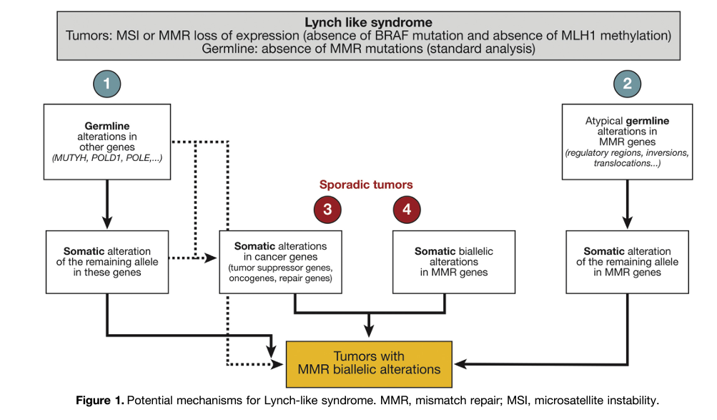
What mechanism is missing?
Colorectal cancer risk associated in relatives of individuals with “LLS” intermediate – lower than patients with LS but higher than in familial crc
? Heterogeneous group – some with a heritable component, most with sporadic cancer
Picó MD, et al. Clinical and Pathological Characterization of Lynch-Like Syndrome. Clin Gastroenterol Hepatol. 2020
Martínez-Roca A, et al. Lynch-like Syndrome: Potential Mechanisms and Management. Cancers (Basel). 2022
Bucksch, K., et al. Cancer risks in Lynch syndrome, Lynch-like syndrome, and familial colorectal cancer type X: a prospective cohort study. BMC Cancer 20, 460 (2020)

Slide 5
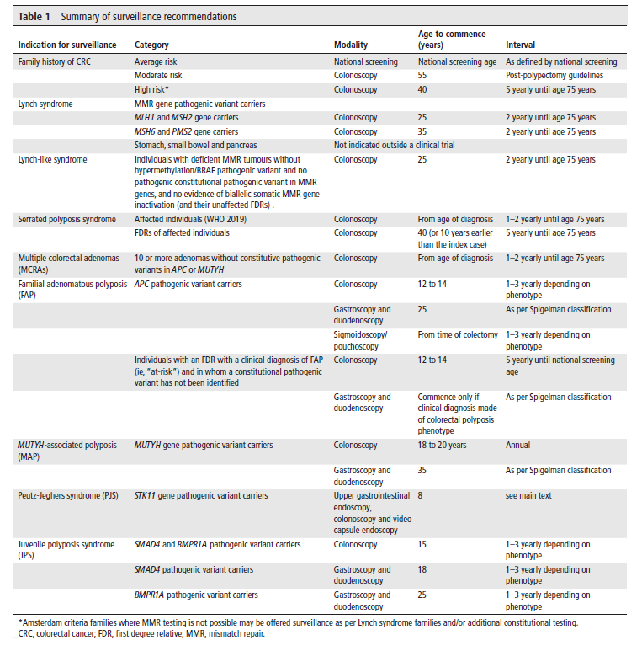
Why does it matter?
Colorectal screening for LLS (defined by MMRD not fhx) is more intense than familial CRC – equivalent to LS
Universal MMR IHC/MSI testing increasingly available for non-colorectal cancers
Endometrial [NICE DG42]
Ovarian
Upper urinary
Pancreatic
Oesophageal …..
Monahan KJ, et al Hereditary CRC guidelines eDelphi consensus group. Guidelines for the management of hereditary colorectal cancer from the British Society of Gastroenterology (BSG)/Association of Coloproctology of Great Britain and Ireland (ACPGBI)/United Kingdom Cancer Genetics Group (UKCGG). Gut. 2020

Slide 6
Points to consider
How far do we need to go to exclude Lynch Syndrome?
Should screening for patients with cancer be guided only by “unexplained” MMRD status or modified based on fhx?
Factors to consider:
Availability and extent of somatic testing (technology and samples)
Colorectal –v- endometrial –v- non-CRC/EC primary
Age at diagnosis
FHx (or lack thereof) of CRC/EC/other cancer
Pattern of protein loss(?)
One –v- no somatic variant identified

Slide 7
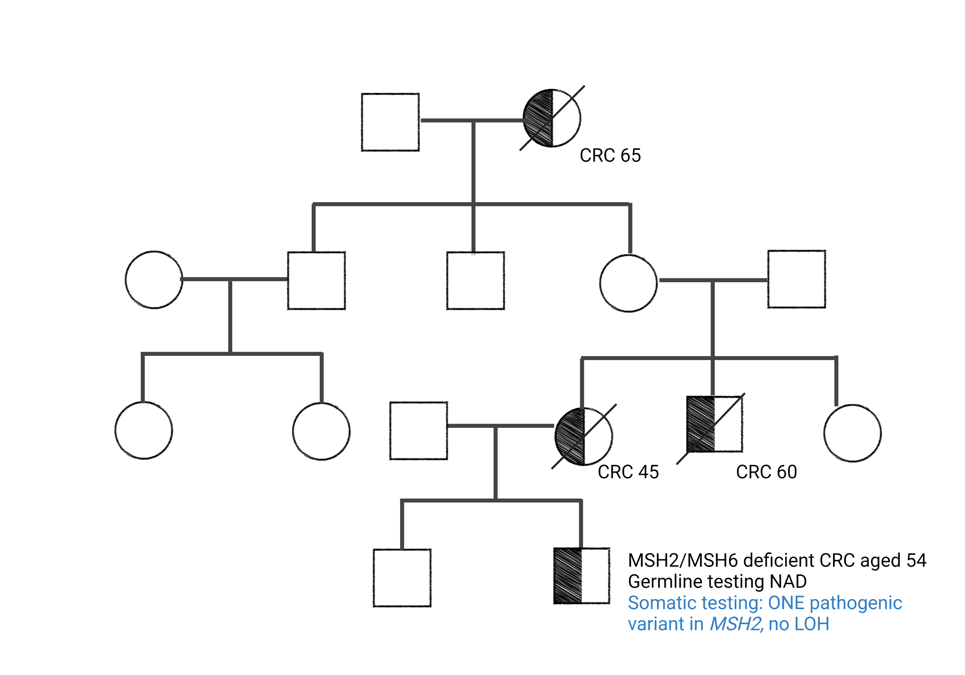
When (if ever) should “Lynch-like Syndrome” be diagnosed?
Lynch Like Syndrome

Slide 8
When (if ever) should “Lynch-like Syndrome” be diagnosed?
Lynch Like Syndrome..?

Slide 9
When (if ever) should “Lynch-like Syndrome” be diagnosed?
Lynch Like Syndrome..??

Slide 10
When (if ever) should “Lynch-like Syndrome” be diagnosed?
Lynch Like Syndrome..????

Slide 11
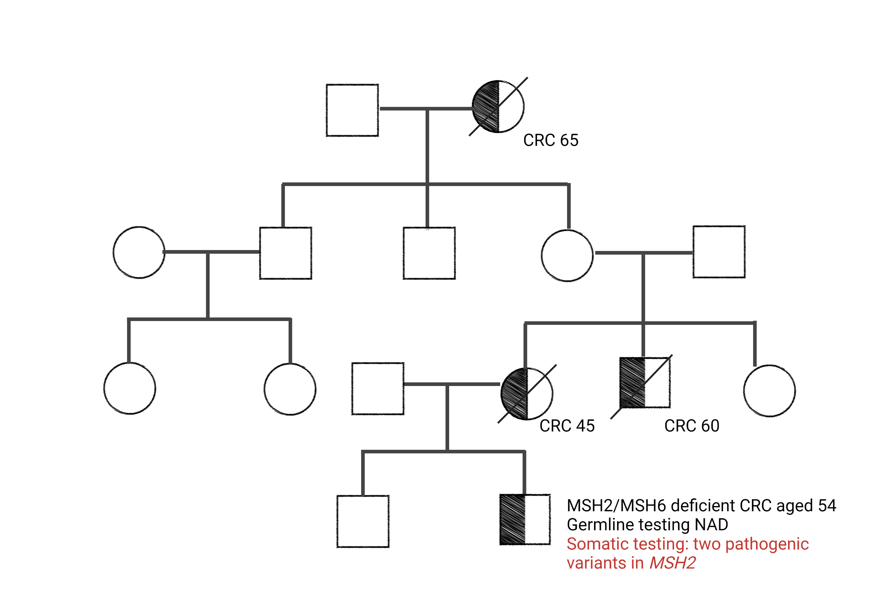
When (if ever) should “Lynch-like Syndrome” be diagnosed?
Familial Colorectal Cancer

Slide 12
“Lynch like Syndrome”… what’s in a name?
Dr Terri McVeigh
Consultant Clinical Geneticist, The Royal Marsden NHS Foundation Trust
UKCGG/CanGene-CanVar National MDT 17th November 2022

