Slide 1
Clinical likelihood ratios and balanced accuracy for 44 in silico tools against multiple large-scale functional assays of cancer susceptibility genes
Dr Clare Turnbull MD PhD MFPH
Professor in Translational Cancer Genetics, Institute of Cancer Research
NHS Consultant in Cancer Genetics, Royal Marsden NHS Trust, GSTT
Honorary consultant in Public Health Medicine, Public Health England
Notes:
Instructions:
Please edit and use this title slide for your presentation.
You may show your organizations logo on the last slide. However, it cannot be a logo from an ACCME defined Commercial Interest. The logo needs to be modest in size.
The remainder of the template is optional to use however you cannot “brand” your presentation to your organization with background colors or represented themes.

Slide 3
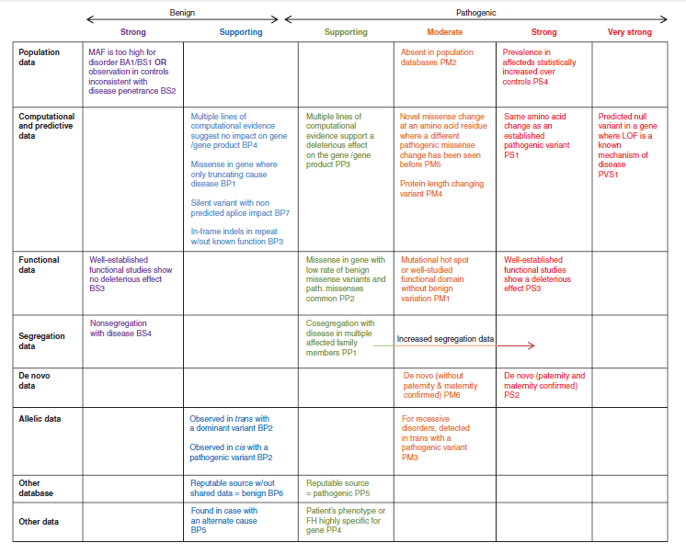

Slide 4
Functional Assays on 5 genes

Slide 5
Assay Truthset

Slide 6
Correlation between functional assays and ClinVar

Slide 7
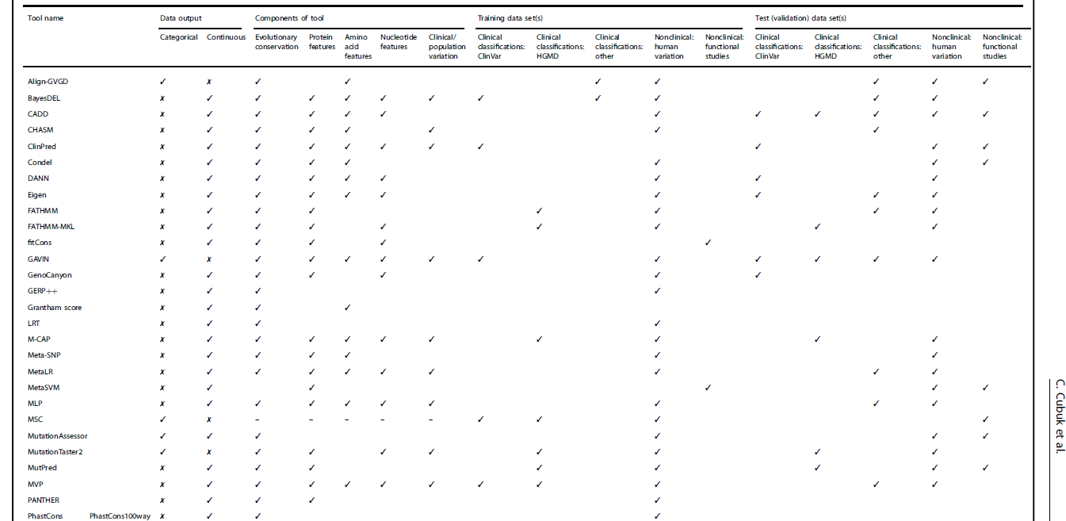
45 tools (44 eligible)
70 thresholds
14 combinations
Tool Attributes

Slide 8
Measures of Effect

Slide 9
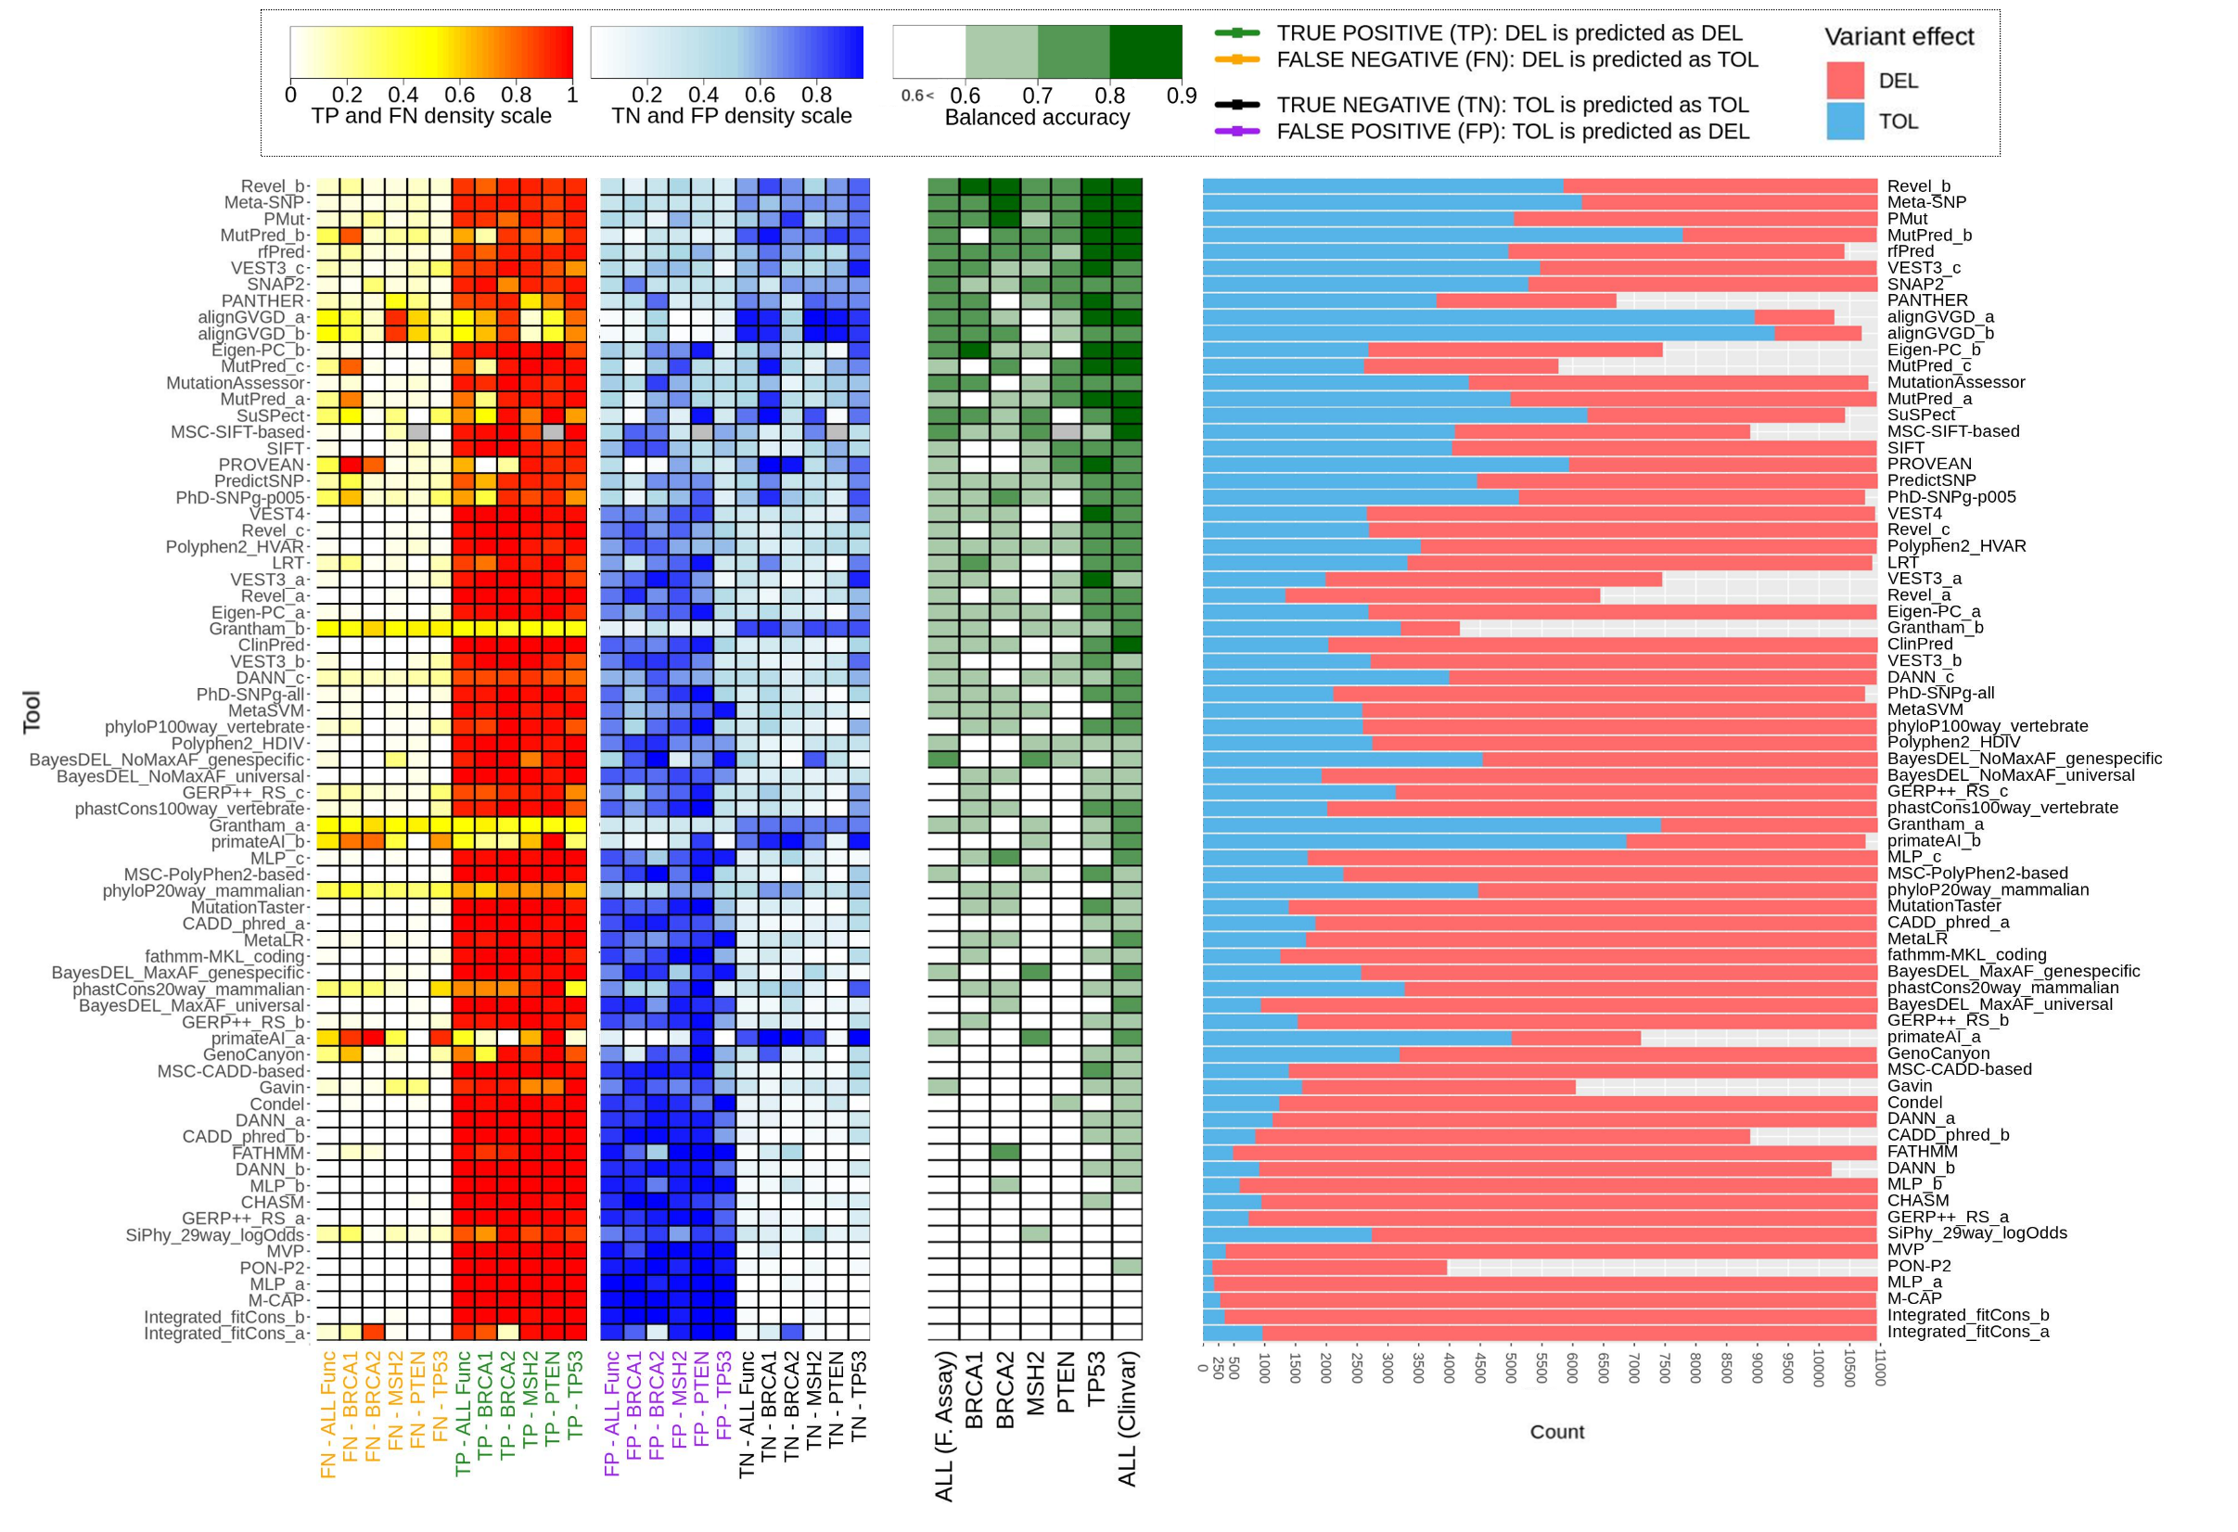

Slide 10
MEAN/ALL/PER GENE metrics

Slide 11
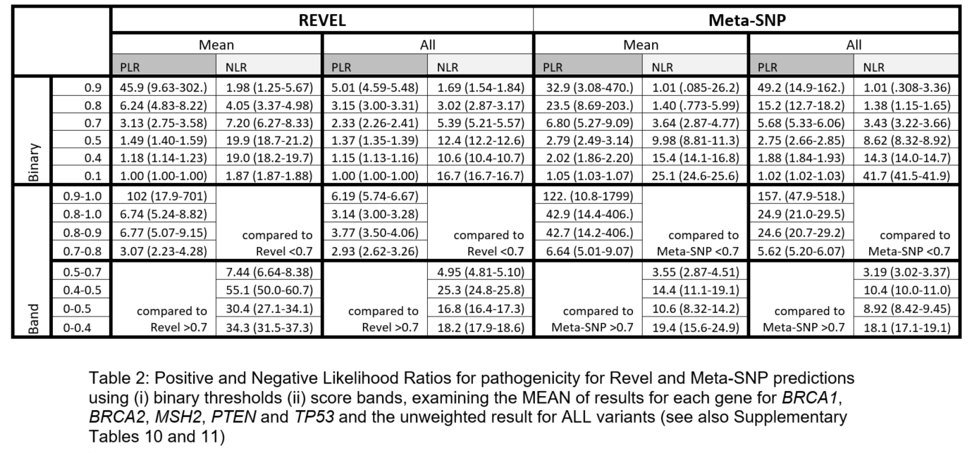
Positive/Negative Likelihood Ratios

Slide 12
Optimised Thresholds

