Slide 1
Developing a sustainable national infrastructure for assessment and management of genomic variation predisposing to haematological malignancies
Germline variant analysis and leveraging CanVIG/NDRS
James Drummond, Lead Clinical Scientist, CUH, East GLH

Slide 2
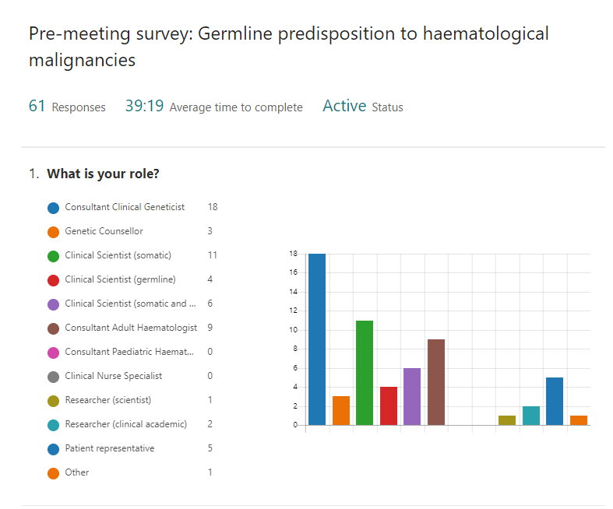
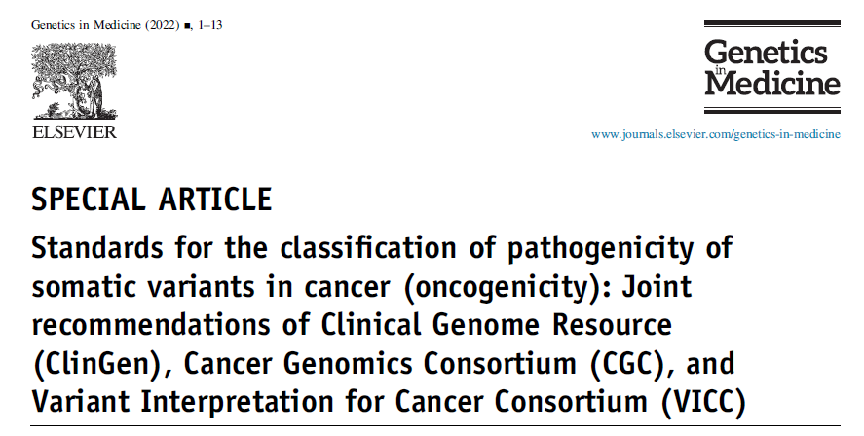

Slide 3
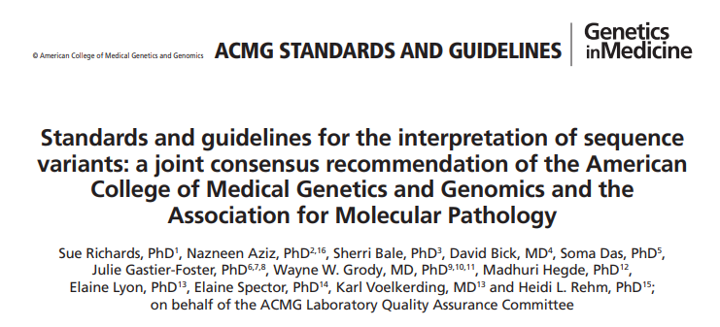
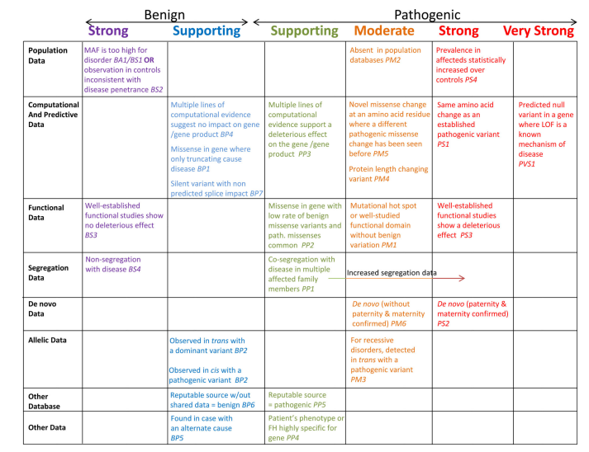
Introduced 5 tier classification system:
Pathogenic/Likely Pathogenic/VUS/Likely benign/Benign
Systematic classification system based on a standardised scoring system
“Domains” defined with differing strengths applicable
Generic guidance for all rare disease
Notes:
All current germline variant interpretation is based on the ACMG guidance from 2015 published in Richards et al. based on consensus meetings that started in 2013.
Use of this was subsequently ratified by the UK rare disease community and has been progressively refined over the following years to provide up to date generic guidance for RD germline variant interpretation.
Subsequent iterations of guidance and control of guidelines is the work of ClinGen

Slide 4
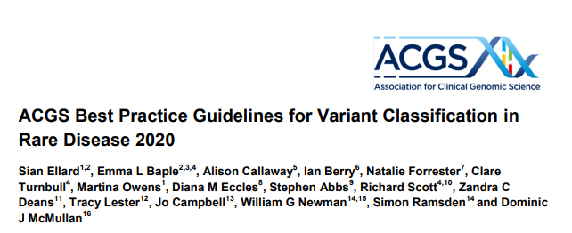
Notes:
Following a national training programme on the ACMG guidance which included representation from all labs and was run by the ACGS, there were further refinements / guidance published by ACGS to provide guidance to UK labs in using the ACMG RD guidelines.
Nationally agreed updates have been sequential published with the latest in 2020 (more due later this year).

Slide 5
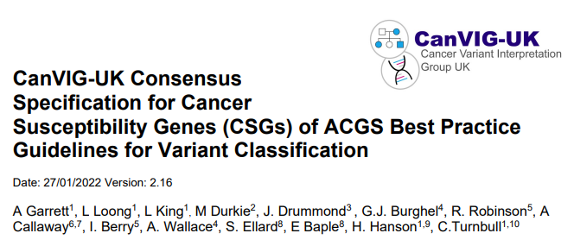
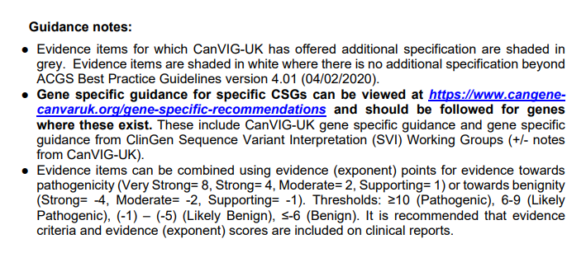
Notes:
It was also noted that cancer specific modifications to guidance would be extremely helpful and therefore in the UK a national team (CanVIG-UK) has worked with representation from all the NHS diagnostic labs who perform germline cancer testing to produce BPGs for the cancer genes. These are based on the UK ACGS guidelines with clearly highlighted modifications.
These have been regularly updated to keep up with current thinking on various criteria including permitted combinations of evidence.
For generic CSG guidance the latest release is from January this year.

Slide 6
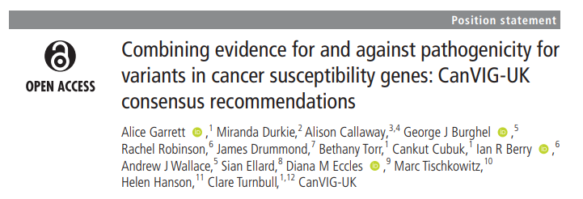
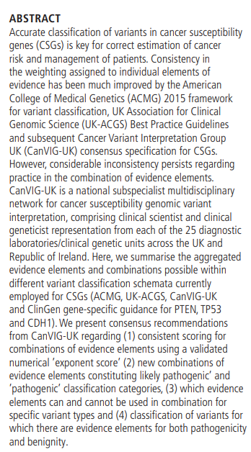
Notes:
In addition, our Cancer variant analysis scoring is based on numerical evidence points where classification is achieved via a combination of points awarded for evidence strength. Summarised in CanVIG publication by Garrett et al. 2020

Slide 7
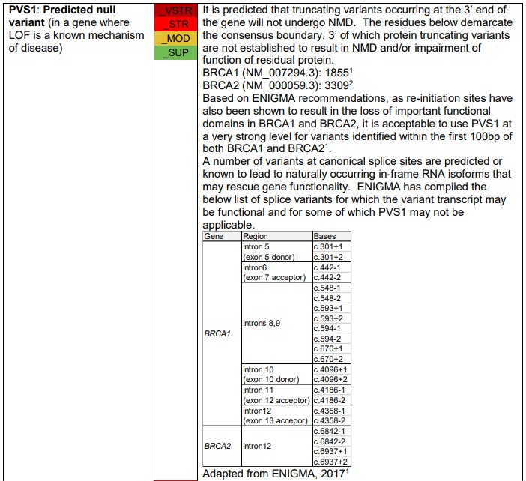
Notes:
CanVIG also supports gene specific classification criteria, although none pertinent to the haem-onc genes (yet). These provide very detailed gene level guidance based on more focussed specific knowledge of the gene.
Usually these are in place to support a UK need prior to gene specific ratified guidance from ClinGen (eg BRCA/ENIGMA, Lynch InSiGHT) or as an addendum to them (eg TP53).
International ClinGen guidance is highly curated and very specific but can take a long time to ratify and get published so UK gene level guidance from CanVIG has helped to address this gap in the interim.

Slide 8
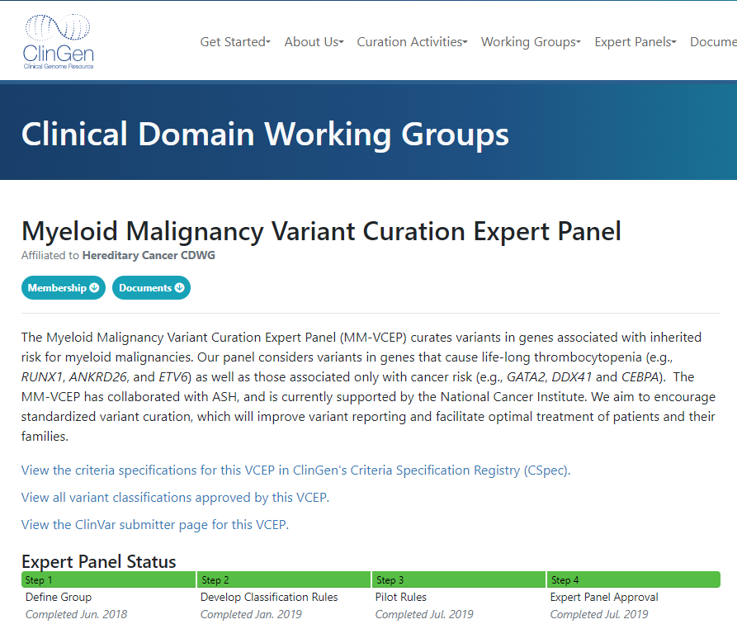
Notes:
Finally, we have gene specific guidance from ClinGen which is based on Variant Classification Expert Panels (VCEPs) who are specialists in a given disorder. These constitute the most specific guidance and these supersede all other generic classification methods.
The Myeloid Maligancy VCEP should cover all the genes we are considering today, however to date they have only issued guidance for RUNX1. As you can see from the timeline this takes some time to do so interim UK gene specific guidance via CanVIG might be helpful in this situation (as it has been in BRCA & Lynch whilst waiting for their VCEPs).
Generally, we can increasingly expect gene specific guidance for highly studied CSGs, particularly those with functional data and large cohorts of studied patients that allow application of clear guidance.

Slide 9
Notes:
So looking at the specific guidance for the RUNX1 gene, these can substantially differ from generic guidance when considering strength of evidence used. This is clearly flagged within the guidance (shown above and on next slide).
Example here is for criteria PVS1 which demonstrates significant strength modification based on a ClinGen PVS1 paper by Tayoun et al 2018 but tailored specifically to this gene. The table here outlines the changes from generic guidance.

Slide 10
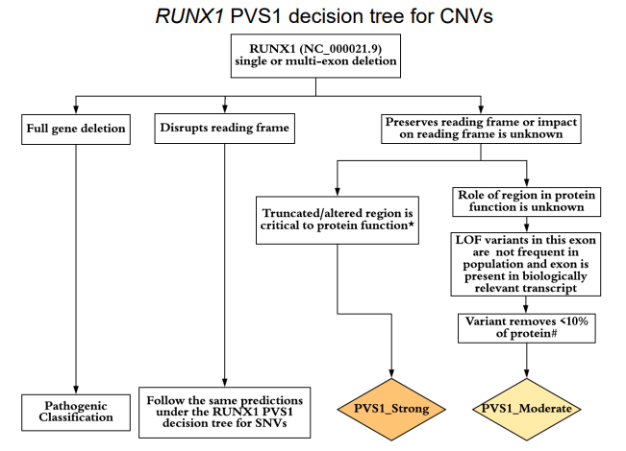
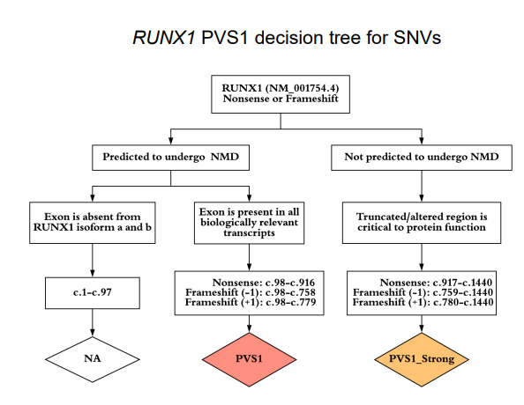
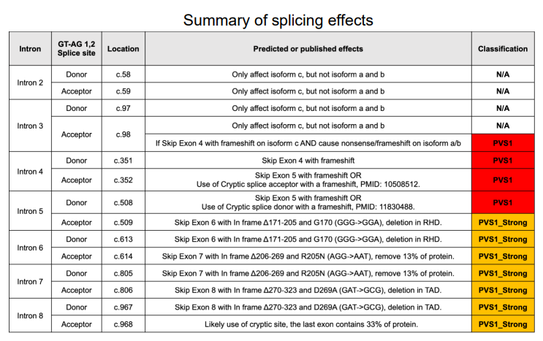
Notes:
You can see this makes interpretation of variants identified very clear and consistent as there is less room for misinterpretation, as the guidance is prescriptive and precise.

Slide 11
Notes:
In addition, there are modifications down to residue level of specificity (see PM4) and some lines of evidence that are not permitted given specific features of this gene (see PP2 & BS2 above).

Slide 12
Using these sources of guidance for all germline classification criteria:
ClinGen VCEP gene specific guidance should be used where available.
For CSGs where no gene specific guidance is available from ClinGen then use CanVIG guidance (with gene specific guidance where available).
Generic CanVIG CSG guidance is based on the main ACGS rare disease guidance with additional specifications where appropriate. These guidelines should be used in conjunction with one another (ie refer to ACGS where there is no additional CanVIG specification).
Important to have analysts who have experience of germline analysis for all variants in these genes to guide/check classification
RUNX1
DDX41
CEBPA
ANKRD26
ETV6
GATA2
Notes:
So then there are a range of guidance resources available to assist with classification each of which is based on the others with progressively more specificity (rare disease>CSGs>gene specific).
It s critical to use the most appropriate and up to date guidance to ensure variant classification consistency and to record the guidance used in your reporting for future reference and to allow other labs to determine how classification has been performed. Partic important if discordant classes noted between centres. Cancer community very luck to have so much specific guidance compared to much of rare disease.
ClinGen gene specific guidance tend to be stand alone but may also reference main guidance – should be clear where this is the case.

Slide 13
Reclassification of clinically-detected sequence variants: Framework for genetic clinicians and clinical scientists by CanVIG-UK (Cancer Variant Interpretation Group UK) - ScienceDirect
Notes:
NB Evidence is constantly evolving and changing…eg these changes all occurred between version 1 and 2 of the RUNX1 guidance. V1 was approved July 2019, update approved Sept 2021 (~2 years)
Key point here is Classification is not static and variant class can change both up and down – CanVIG support points based scoring system to ensure boundary cases can be identified. However, these require good guidelines to ensure they are accurate and prevent too much rapid change (plug here for Loong paper in press by CanVIG regarding reclassification and how to deal with it).

Slide 14
Notes:
A reminder of all the domains germline variant analysis spans which are integrated to produce a final classification for a variant.
Population prevalence, in silico data, functional studies, segregation with disease, de novo occurrences with phenotype, allelic data, disease databases for occurences, phenotype etc…
Obviously detailed consideration of these domains for the genes being discussed here is beyond scope of this meeting, but some general points can be made.

Slide 15
Generic issues in variant interpretation:
Pop freq cutoffs: PM2, BS1, BA1 based on disease prevalence (which disorder, phenotype specificity), genetic heterogeneity, allelic heterogeneity, penetrance, knowledge of the population your patient is from.
Phenotype specificity: PP4 (haem-onc specialist knowledge)
Variant level info based on prior occurrence: literature is often unclear if acquired or germline (may not be defined) very much haem-onc issue as blood often comparator for germline in other cancer settings. Case control PS4
Defining hotspots: OK to base on somatic? Example would be TP53 where it is. PM1, PM5. Clear in RUNX1 but what about GATA2 for example?
Single exon gene issue (CEBPA) regarding NMD escape. PVS1 - can be upgraded if appropriate but needs consensus and evidence to do this.
Recurrent initiation codon variants in DDX41: PVS1 modification strength seems appropriate.
As we have already seen, these are addressed in ClinGen VCEP guidance (such as RUNX1) where strength modifications to these lines of evidence away from the generic guidance have been made.
Notes:
Here are examples of some areas that I feel would benefit from gene specific guidance for the genes we are considering today as they are lines of evidence I have personally found problematic when doing analysis.
PVS1 in particular as strength can vary highly depending on guidance and is often critical when additional available evidence for a variant is limited, so accurate specification and usage is critical.

Slide 16
Germline variant classification for haematological malignancies
Areas that CanGene-CanVar/CanVIG may be able to help:
Rapidly develop more specific guidance for variant interpretation of the haem-onc genes.
Add the genes into CanVIG website to allow use of the excellent tools already developed there, including population data, in silico predictions, database links and national communication pathways (messaging).
National promotion of materials created to ensure consistent classification prior to ClinGen guidance for the core genes. Education sessions in their use (somatic scientists).
Reporting templates / exemplar wording to ensure national consistency.
Areas that NDRS may be able to help:
Data amalgamation - in particular capturing both germline and somatic data (DDX41 exemplar).
Clinical presentation & outcomes data.
Provision of the data to CanVIG to allow case control analysis.
Accurate recording of confirmed germline vs somatic?
Other:
Reporting dual classification? Conflicts (somatic Path/germline VUS)? Cross team working. GTAB.
Notes:
Using CanVar database for evidence, interpretation and variant discussion. VCEP already extant to cover these genes (check this) so just interim guidance needed (analogous to situation in cancer for Breast Ca and Lynch syndrome, ENIGMA and InSiGHT respectively). Interim UK based group to share data and ensure consistent approach to use of evidence/guidelines.
Key to good outcomes is participation: CanVIG engagement and NDRS submissions.

Slide 17
Approaches to variant interpretation in haematological malignancy susceptibility genes
James Drummond (Cambridge) & Rachel Robinson (Leeds)
CanVIG June 10th 2022
Notes:
So having set the scene, today’s presentation by Rachel and I will focus on germline variant interpretation in the haem-onc genes

Slide 18
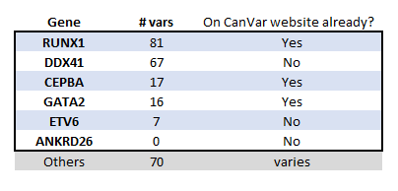
Overview
To be covered here:
Showcasing use of RUNX1 guidance briefly
Main focus on DDX41
Additional cases that highlight considerations for CEBPA & GATA2 will be in the slide deck but not presented
Will not be covering ETV6 or ANKRD26 as limited experience of these
For summary of info on these genes see excellent talk by Jude Fitzgibbon, Ana Rio-Machin & Austin Kulasekararaj from the consensus meeting. Slides available here:
https://www.ukcgg.org/information-education/ukcgg-consensus-meetings/
Also the pre-meeting background reading available here:
https://www.ukcgg.org/information-education/ukcgg-consensus-meetings/
Notes:
Consensus meeting had plenty of discussion of VAF and when to confirm variants/ how to confirm variants, pathway issues, reporting and information on these genes as well as intro to SVIG guidance and case studies of germline variants. We will not be covering any of this today we will just be addressing germline variant interpretation in these genes.
Furthermore, it became clear that the relative impact of each of these genes was not equal so today we will touch on RUNX1 for which there is already great guidance before focussing on DDX41.
As you can see from the table CUH experience of germline classification for these genes is based on a limited number of cases but some points of clarification have already become clear based on this work.
To keep presentation as straightforward as possible generally assume the patient has appropriate clinical phenotype and that where no evidence is found, unless relevant to interpretation it will not be list as absent.

Slide 19
Notes:
Slide from Paula Page (West Midlands) and Nick Parkin’s (Viapath/Kings) talk at the consensus meeting – We would like to concur regarding the importance of consistent germline variant interpretation and start to address this here.

Slide 20
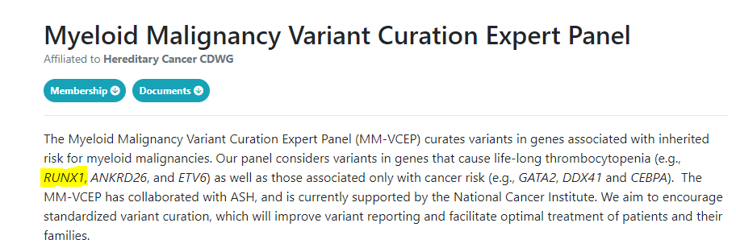
RUNX1
As already discussed this gene has clear, well structured VCEP guidance
Briefly cover 5 variants here to highlight their use, to illustrate when it may be necessary to refer back to generic guidance and to demonstrate how very similar variants can classify quite differently.
https://clinicalgenome.org/affiliation/50034/
First case is the frameshift variant that was one of the variants of the month
Notes:
So we will start with RUNX1, as already discussed there are VCEP guidelines for germline variant interpretation (currently on their second iteration).
This section will be a quick look at:
their use in a straightforward case (variant of the month)
A pair of similar C terminal variants that highlight limitations of the guidance
A pair of similar variants in the Runt Homology domain that illustrate how very similar variants can classify quite differently due to paucity of evidence in one (not unusual in germline analysis but again highlighting differences with somatic)
Lets start with the variant of the month.

Slide 21
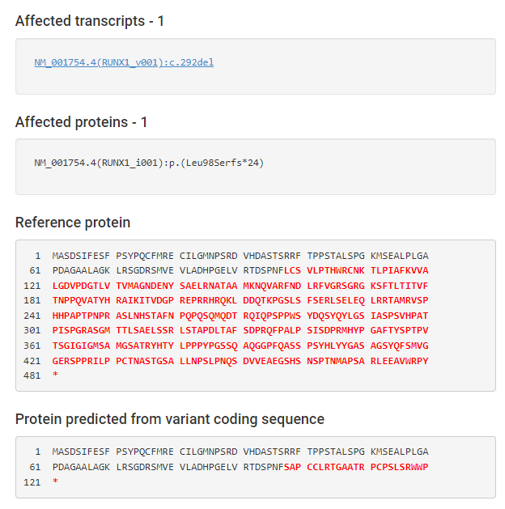
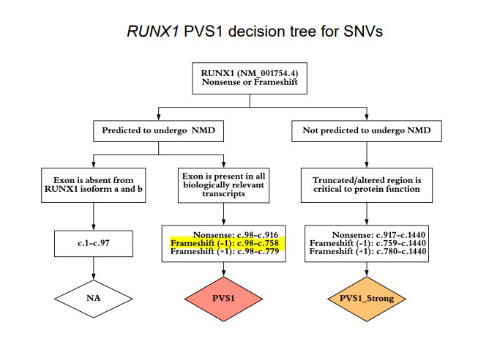
Variant 1: NM_001754.4, RUNX1: c.292del p.(Leu98SerfsTer24) VAF=46%
Myeloid NGS panel on bone marrow aspirate
Frameshift & premature termination (PVS1_vs)
Notes:
Myeloid NGS on bone marrow aspirate identified a RUNX1 frameshift variant with a VAF consistent with possible germline origin.
You can see this variant leads to a frameshift and PTC within a region that would be predicted to undergo NMD so PVS1_vs is applicable

Slide 22
Variant 1: NM_001754.4, RUNX1: c.292del p.(Leu98SerfsTer24) VAF=46%
Additional points for frameshift downstream of c.98 (PM5_sup)
Notes:
The guidance also allow allocation of PM5 at a supporting level where there is a frameshift downstream of c.98

Slide 23
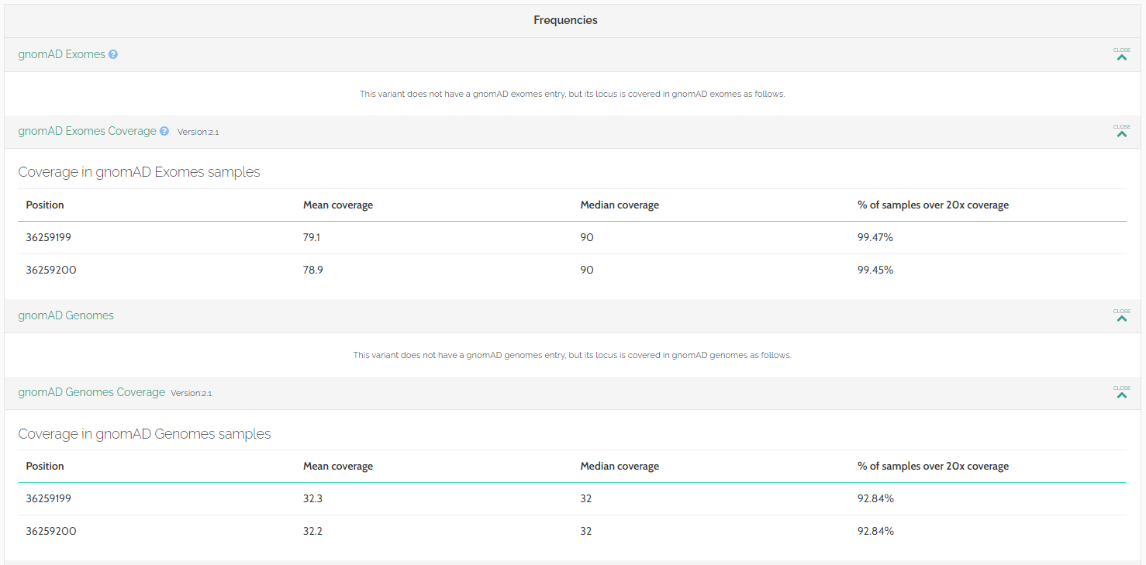
Variant 1: NM_001754.4, RUNX1: c.292del p.(Leu98SerfsTer24) VAF=46%
Absent from gnomAD despite good cover (PM2_sup)
Notes:
Finally absence in gnomAD allows application of PM2 at a supporting level.

Slide 24
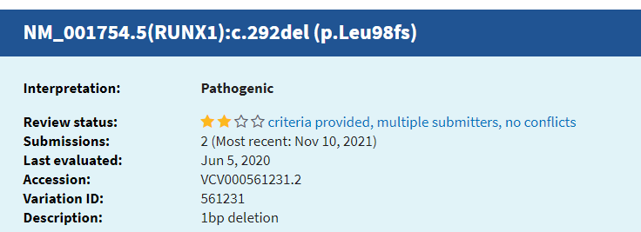
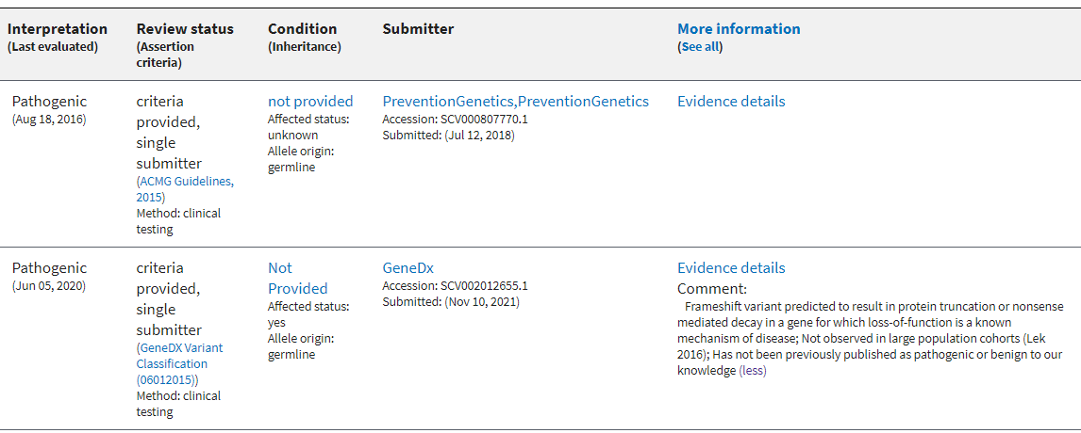
Variant 1: NM_001754.4, RUNX1: c.292del p.(Leu98SerfsTer24) VAF=46%
ClinVar classed “Pathogenic” based on 2 entries
Notes:
Additional unused evidence publically available is info from ClinVar…not PP5, as laid out in the guidelines
NB no clinical info at all from Prevention Genetics (would not use in PS4) – could possibly use GeneDx entry in PS4 but no phenotype info to match to the acceptable criteria in the guidance

Slide 25
PS4_sup (our index) /mod (our case & previous)?
Notes:
Here is that PS4 guidance – including phenotypic info. I did not use as no clear info in ClinVar entries on phenotype.
Could have used for our case?

Slide 26
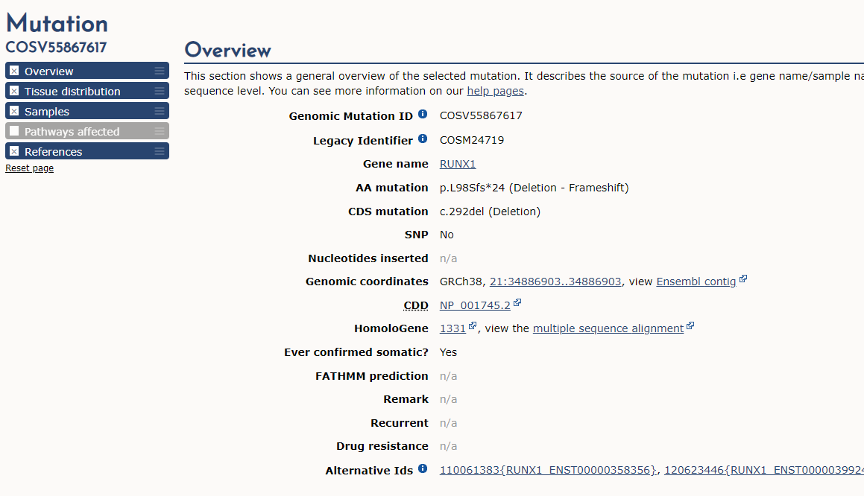
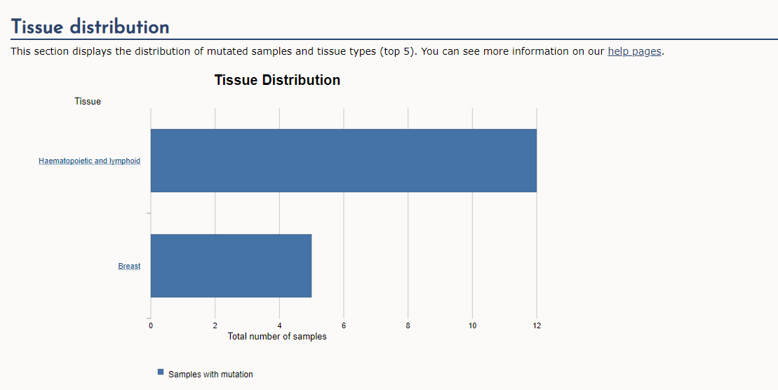
Variant 1: NM_001754.4, RUNX1: c.292del p.(Leu98SerfsTer24) VAF=46%
COSMIC (COSV55867617) – seen in 12 cases Haem malignancies
Not on HGMD
No germline cases identified in literature for segregation/phenotype and no functional data identified
Notes:
COSMIC/GENIE data not used for germline variant interpretation usually (TP53 exception) but illustrates recurrence in haem malignancies – tumour recurrent

Slide 27
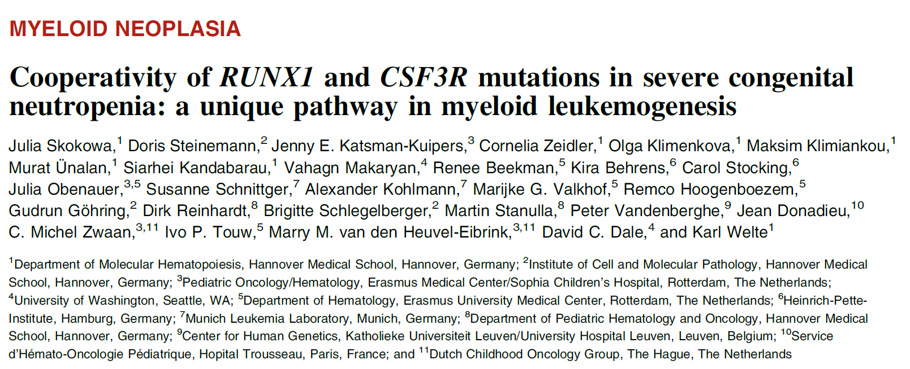
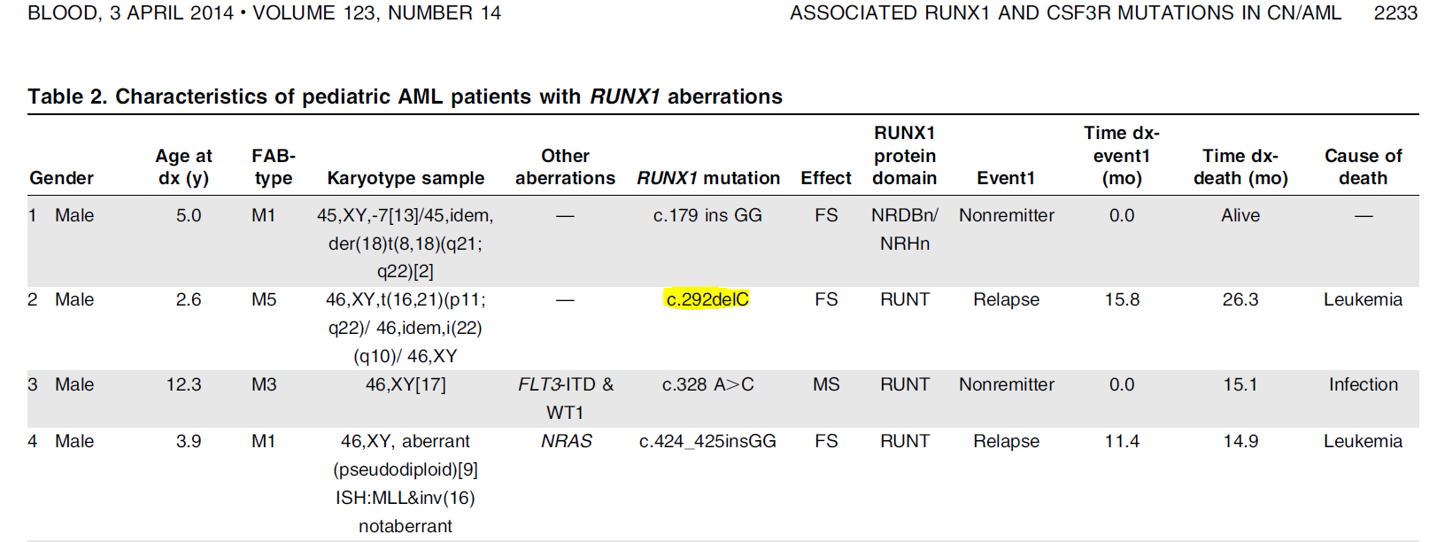
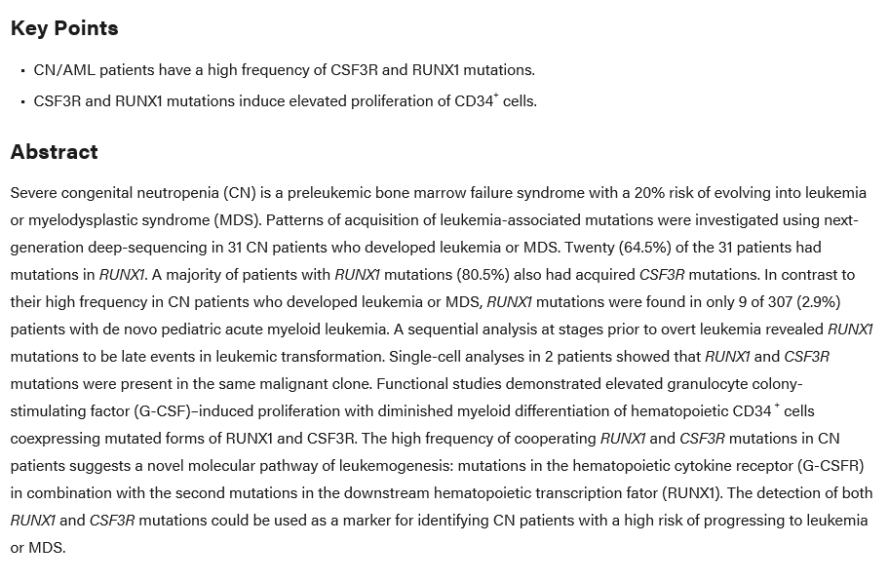
Variant 1: NM_001754.4, RUNX1: c.292del p.(Leu98SerfsTer24) VAF=46%
Assumed acquired case
Notes:
Literature – only an acquired case so doesn’t add anything here that we can use in classification – highlights issue with literature:
Often not clear/not determined if variants are germline or acquired so not used in PS4

Slide 28
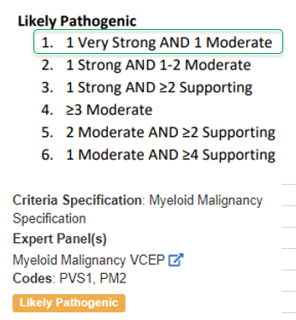
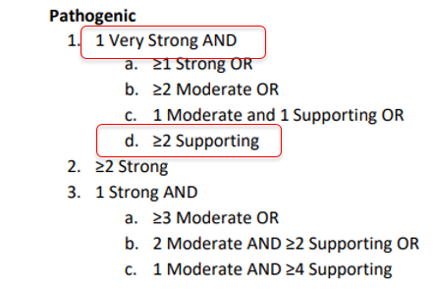
Variant 1: NM_001754.4, RUNX1: c.292del p.(Leu98SerfsTer24) VAF=46%
PS4_sup/mod may be ok, but not required
10 points
10 points
Notes:
NB LP VCEP class is for different variant but highlights the combo of evidence strengths is LP.
Also previous VCEP classified variants have not been reclassified using new evidence.
Additional point regarding the evidence combo system they use not being strictly numerical “al la Tavtigian” as we standardly use for CanVIG guidance (as outlined in Garrett et al).

Slide 29
Submissions
Notes:
All noted as clinically actionable

Slide 30
PVS1_V.S.: This variant would undergo NMD, following RUNX1 guidelines. Based on CanVIG-UK guidelines, the stop codon is outside 100bp.
PM2_sup: As per RUNX1 specification
PS4_mod: Took into consideration the cases reported on ClinVar (3 submissions as germline and assumed that patients have a RUNX1 phenotype).
Use of PM5_supp along with PVS1 suggested in RUNX1 specification
PM1: CanVIG-UK guidelines does not permit the use of PVS1 with PM1. RUNX1 guidelines does not specify this criteria.
Notes:
Main points were concordant (PVS1_vs & PM2_sup) – key point all agreed clinically actionable.
Most people missed the PM5_sup

Slide 31
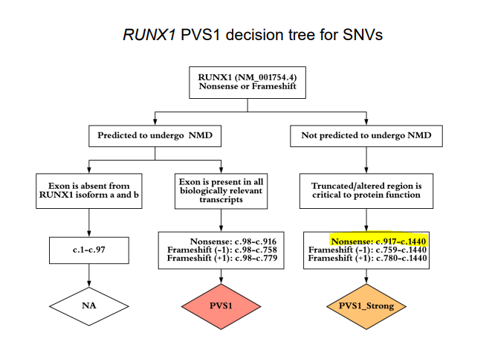
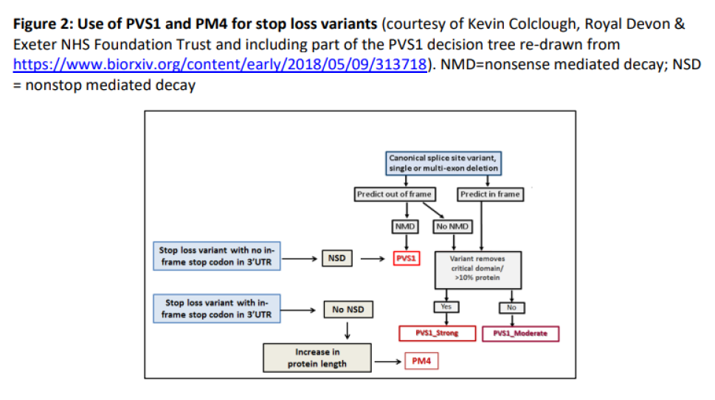
Variant 2: NM_001754.4, RUNX1 c.1441T>G p.(Ter481GlyextTer52) VAF=48%
First base of Termination codon is altered so you have read through and extension of native protein
Frameshift and extension, is NSD likely to occur (null where PVS1_vs would be applicable)?
After c.1440, so PVS1_str is n/a
Notes:
Moving onto a couple of variants that affect the 3’ end of the gene to illustrate that generic guidance may still be applicable in these cases, as not explicitly covered by VCEP guidance.
NB these will be rare but as you can see we already have a couple of cases from CUH.

Slide 32
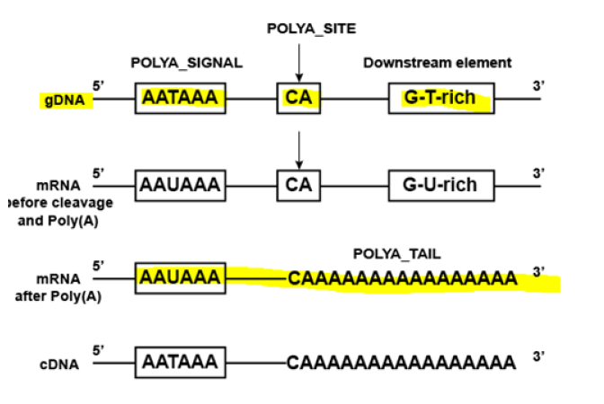
Variant 2: NM_001754.4, RUNX1 c.1441T>G p.(Ter481GlyextTer52) VAF=48%
Native Termination codon
New in frame termination codon
PTC in 3’UTR upstream of the PolyA site so ribosome can dissociate and NSD unlikely to occur (PVS1_vs is n/a).
In this scenario it is an extension of the native protein whose consequence is undetermined so PM4 is applicable.
NB: PM4 in VCEP guidance only relates to the RHD.
Summary: PM4_mod & PM2_sup (absent gnomAD): VUS
Notes:
Important to take care when using VCEP guidance and if gaps occur you may need to default back to generic guidance.
VAF was actually 68% changed for presentation to focus on var interp – aneuploidy? Chr21

Slide 33
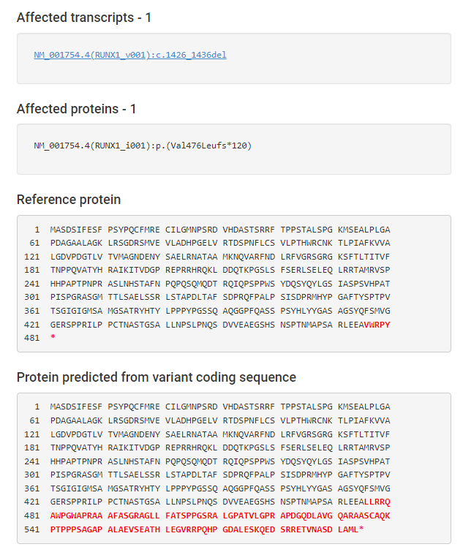
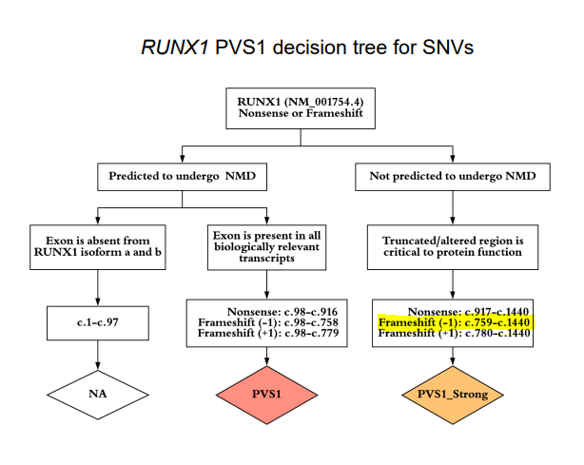
Variant 3: NM_001754.4, RUNX1 c.1426_1436del p.(Val476LeufsTer120) VAF=40%
In this case you have a frameshift and extension beyond normal termination codon
Before c.1440, so PVS1_str, however if NSD occurs then PVS1_vs may be applicable (null)

Slide 34
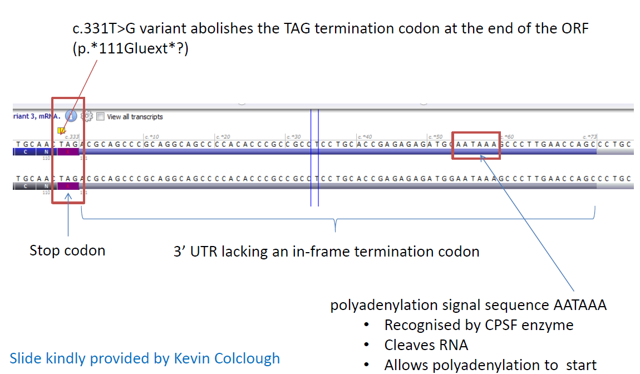
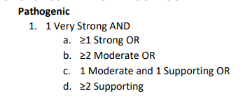
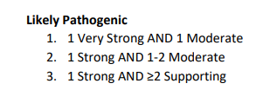
Variant 3: NM_001754.4, RUNX1 c.1426_1436del p.(Val476LeufsTer120) VAF=40%
In this case the new in frame termination codon overlaps the PolyA signal – effect? Ribosomal stalling & transcript degradation?
Either PVS1_str or PVS1_vstr
In this scenario even using conservative estimate (PVS1_str) then with absence from gnomAD (PM2_sup) & frameshift downstream of c.98 (PM5_sup) then this variant will be Likely Pathogenic.
Notes:
So even well defined guidance can have gaps

Slide 35
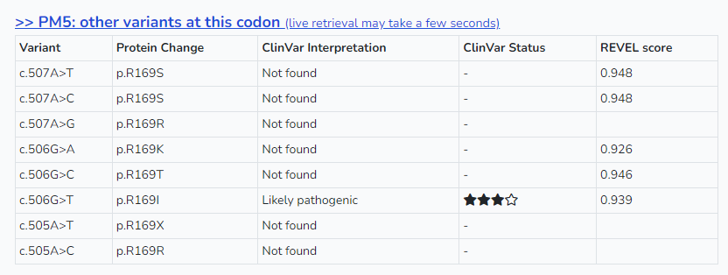
Variant 4: NM_001754.4, RUNX1 c.505A>G p.(Arg169Gly) VAF=39% &
Variant 5: NM_001754.4, RUNX1 c.524T>A p.(Leu175Gln) VAF=37%
PM1_mod
PM5_sup
Notes:
Move onto a case with two RUNX1 missense variants both very close to one another in the RHD identified in one patient.
Highlights where evidence of previous occurrence can make a big difference in classification

Slide 36
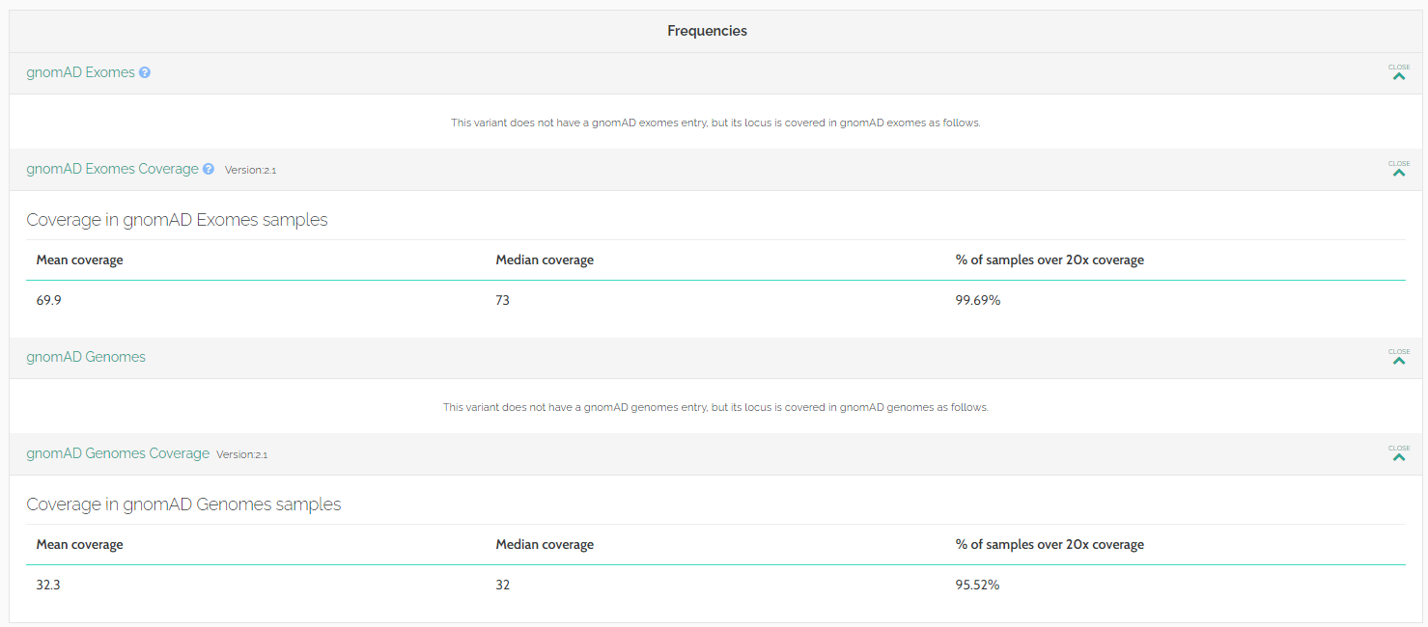
Variant 4: NM_001754.4, RUNX1 c.505A>G p.(Arg169Gly) VAF=39% &
Variant 5: NM_001754.4, RUNX1 c.524T>A p.(Leu175Gln) VAF=37%
PP3_sup
PM2_sup

Slide 37
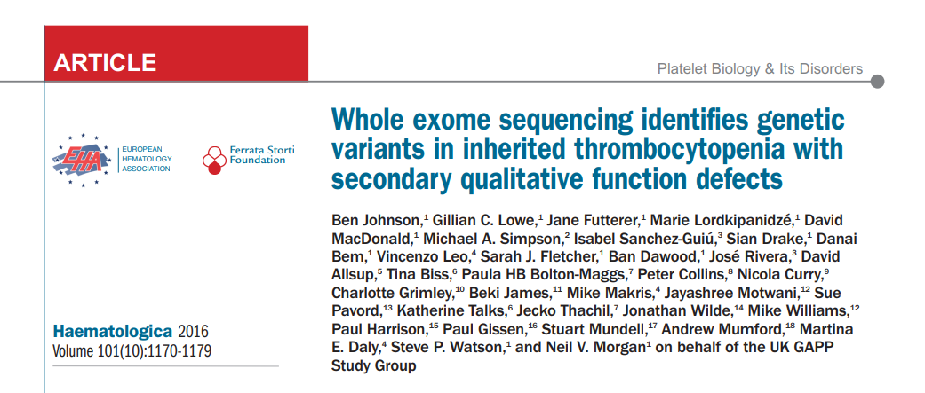
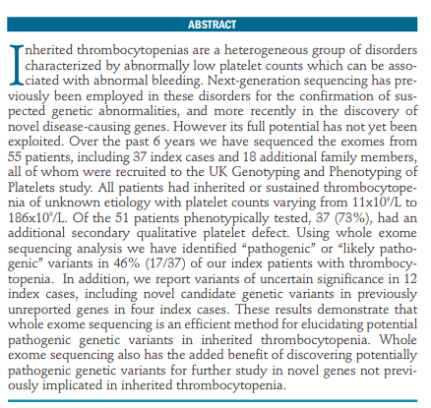
Variant 4: NM_001754.4, RUNX1 c.505A>G p.(Arg169Gly) VAF=39% &
Variant 5: NM_001754.4, RUNX1 c.524T>A p.(Leu175Gln) VAF=37%
PS4_sup
Notes:
One case report with variant identified in germline with phenotype that meets specified RUNX1 criteria.
No additional literature identified.
NB we have had cases with PS4 at moderate where cases were from VCEP contributor labs so not publically available – this hidden data is common between UK diagnostic labs and can lead to discrepancies in variant classification – data sharing important (particularly linked to phenotype data).

Slide 38
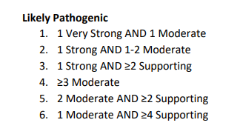
Variant 4: NM_001754.4, RUNX1 c.505A>G p.(Arg169Gly) VAF=39% &
Variant 5: NM_001754.4, RUNX1 c.524T>A p.(Leu175Gln) VAF=37%
No additional information identified:
Not on ClinVar, not on HGMD, no segregation, functional or case control data identified
PM1_mod: specified residue in RHD
PM5_sup: LP variant VCEP classified at same codon
PP3_sup: In silico
PM2_sup: Absent gnomAD
PS4_sup: previously identified in germline case with relevant phenotype (GTAB)
Likely Pathogenic
Notes:
So PM5 & PS4 both possible due to previous case report – moves this from VUS to LP

Slide 39
Variant 4: NM_001754.4, RUNX1 c.505A>G p.(Arg169Gly) VAF=39% &
Variant 5: NM_001754.4, RUNX1 c.524T>A p.(Leu175Gln) VAF=37%
PM1_sup
PP3_sup
Notes:
So moving to the other variant which is also located in the RHD just 6 aa away
This is not at one of the specified residues so scores less for it’s location.

Slide 40
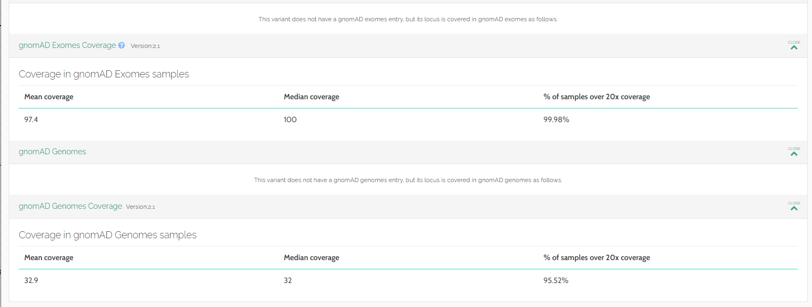
Variant 4: NM_001754.4, RUNX1 c.505A>G p.(Arg169Gly) VAF=39% &
Variant 5: NM_001754.4, RUNX1 c.524T>A p.(Leu175Gln) VAF=37%
PM2_sup

Slide 41
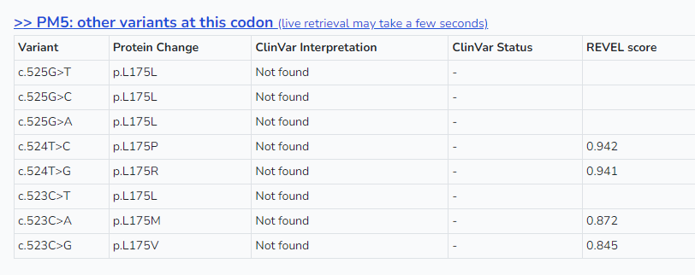
Variant 4: NM_001754.4, RUNX1 c.505A>G p.(Arg169Gly) VAF=39% &
Variant 5: NM_001754.4, RUNX1 c.524T>A p.(Leu175Gln) VAF=37%
PM1_sup: residue within RHD
PP3_sup: In silico
PM2_sup: Absent gnomAD
VUS
Not on ClinVar
Not on HGMD
No literature where variant is clearly germline
No segregation, de novo, functional or case control data available
No other path vars at this location in ClinVar (PS1/PM5 n/a)
Co-occurrence? Phase (different exons)? Down weighting. Possibly both acquired based on other vars in patient
Notes:
So in this case slightly less clear-cut residue in RHD, no previous germline cases to link to phenotype and classification , so still VUS

Slide 42
DDX41
Main focus of rest of talk
Recurrence
Co-occurrence
Presence / absence in population databases
Phenotype
Data sharing
Aim:
To generate discussion and leverage specialist input from the community to create interim guidance pre-VCEP
Notes:
So moving on to DDX41 which is what the rest of this presentation will focus on.
There are themes here which we will introduce and discuss with a view to coming to community consensus and ideally we can start to pull together some interim CanVIG guidance for germline DDX41 whilst awaiting VCEP guidelines.
Analogous to the BRCA/ENIGMA and Lynch/Insight situation, diagnostic labs require guidelines immediately and VCEP guidance takes time, so filling the gap with some sensible and consistent approaches seems appropriate.

Slide 43
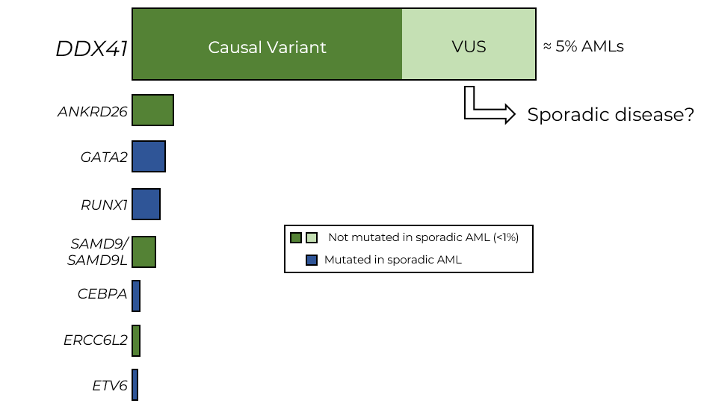
Germline predisposition to Haematological Malignancies Consensus Mtg ( Day 2) – Prof Fitzgibbon, Dr Rio Machin, Dr Kulasekararaj
DDX41 is DEAD-box helicase involved in pre-mRNA splicing
Discovered as predisposing gene in 2015 (Polprasert et al)
DDX41 germline mutations are the most common mutations predisposing to MDS/AML in adults (≈ 5% all AMLs)
AML with germline DDX41 variants could be considered a unique clinicopathological entity, typically with late‐onset, normal karyotype, with the acquisition of a second DDX41 mutation, male gender skewing (2.7:1) and favorable outcome.
(Rio-Machin & Fitzgibbon, Blood, 2022, in press)

Slide 44
Notes:
Thanks to Austin for this slide
Highlights the importance of accurate germline variant interpretation in DDX41 due germline variants high relative contribution to disease.
This slide also indicates that weighting phenotypic specificity may be applicable in this gene (PP4). Needs discussion, similar to RUNX1 guidelines, on how to do this and will require expert haematology input which I most definitely do not have.

Slide 45
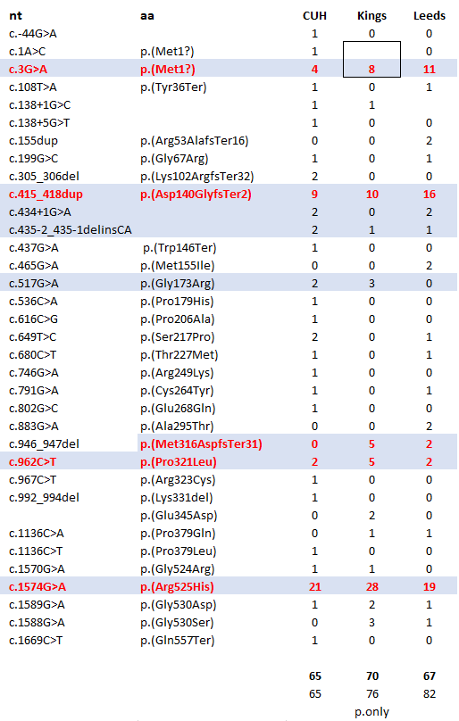
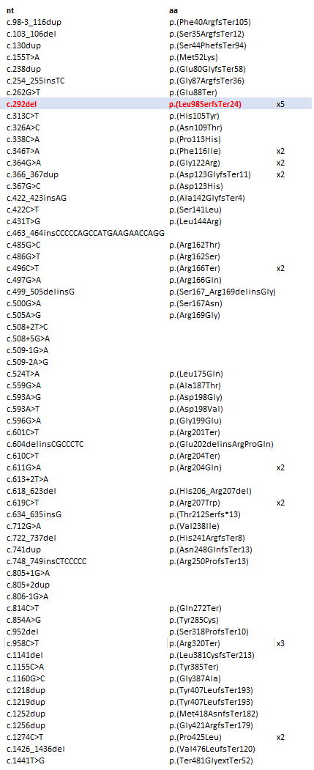
DDX41: NM_016222.4
RUNX1: NM_001754.4 @ CUH
DDX41 –recurrent variants
Thanks to Steve Best @ Viapath/Kings & Phil Dean @ Leeds for data
Notes:
NB only recurrent vars from other labs shared here so actual dataset from them is larger.
Highlighted = more than 5 occurrences across 3 labs

Slide 46
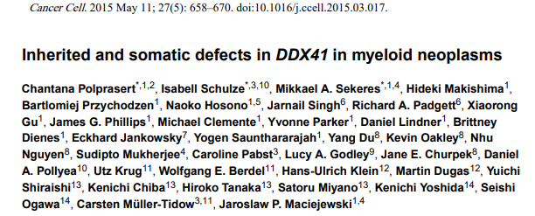
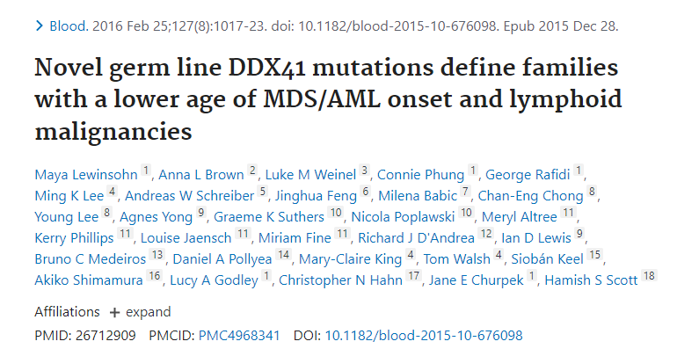
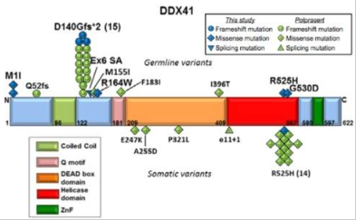
NB p.Arg525His can be germline too
Notes:
Early papers showed recurrence of certain variants –
2015 Polprasert first publication
2016 Lewinsohn which neatly summarised all findings form these two studies on one image!

Slide 47
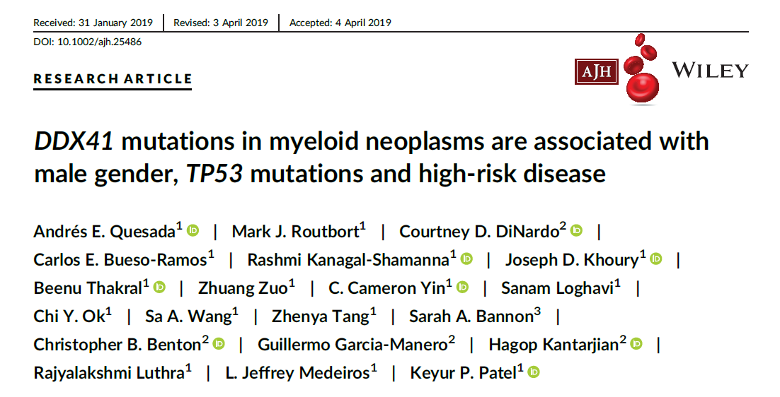
Notes:
2019 papers increased numbers of variants detected and again highlighted recurrence and co-occurrence of variants

Slide 48
Recurrence:
So national data submission of cases including VAF to capture recurrence and allow ethnic matching.
Germline confirmation and how to incorporate this into data submission?
This will allow case control and correct evidence weighting (exemplar would be BRCA and Lynch variants via CanVIG):
BRCA2 c.6275_6276del p.(Leu2092ProfsTer7)
PS4_vstr

Slide 49
NM_016222.4, DDX41 c.517G>A p.(Gly173Arg) VAF=49% &
NM_016222.4, DDX41 c.1574G>A p.(Arg525His) VAF=6%
This variant has been reported 6 times in Sebert et al 2019. French study (NFE)
This variant is present once in gnomAD genomes (NFE) so have used PM2_sup
Notes:
So moving onto a real case that has a germline variant and the hugely recurrent R525H at low VAF so assumed acquired. This exact combo is in Sebert twice.
Pseudo case control using Sebert cohort (assuming NFE) and comparing to gnomAD NFE

Slide 50
NM_016222.4, DDX41 c.517G>A p.(Gly173Arg) VAF=49% &
NM_016222.4, DDX41 c.1574G>A p.(Arg525His) VAF=6%
PS4_vs & PM2_sup (Likely Pathogenic)
Control data from gnomAD genomes only: absent from exomes, so actual significance will be higher, but given this is a fudge based on assumed ethnicity anyway this adds an element of down weighting.
To do this properly we need ethnically matched national dataset to fully power analysis based on recurrence
Notes:
Using recurrence

Slide 51
NM_016222.4, DDX41 c.517G>A p.(Gly173Arg) VAF=49% &
NM_016222.4, DDX41 c.1574G>A p.(Arg525His) VAF=6%
Can the Co-occurrence with common somatic pathogenic variant also be used as weighting?
Notes:
Brings us onto the key issue of using co-occurrence and how to use this? So for the same variant if we now look at the co-occurrence we can see that this same germline variant has been seen multiple times with co-occurring somatic variants.
Clearly used already by some labs in interpretation – see Varsome entry form Kings.

Slide 52
Can we adapt a similar principle to this into guidance?
How do we delineate this?
Need to consider for germline variant:
Frequency in the population databases
Recurrence in disease cohort?
Other co-occurences with somatic variants?
Patient phenotype
Need to consider for the somatic variant:
Recurrence and previous co-occurrence
Patient phenotype
For example, if germline variant absent from population databases, non-recurrent but co-occurs with R525H?
What if it has been seen recurrently (2/3/4 times) before co-occurring with well defined recurrent somatic variants?
What if co-occurring somatic variant isn’t recurrent?
How do we set an acceptable cut off or appropriate weighting?
What evidence code should this come under? PS4, PP5, PP4 or PM3?
Notes:
Balance between ascribing pathogenicity erroneously just due to co-occurrence by chance and not counting the evidence at all as not currently a mechanism
PS4 case counting – problematic if PM2 not resolved (see p.M1? Cases below with pop prevalence 19). Using publications. Better to use proper UK case data and ethnically matched controls but in interim can we use this and scale higher than moderate?
PP5 reputable source – for using publications instead of ClinVar entries?
PP4 phenotype specificity – outside usual remit of this evidence type.
PM3 in trans/hom in recessive – adjust to fit second hit model?
NB neither PP5 nor PP4 are allowed in RUNX1 guidance and PM2 is based on total absence in gnomAD.
Does using any of these prevent any other relevant evidence being used?

Slide 53
How would we use it for this example?
NM_016222.4 DDX41 c.992_994del p.(Lys331del) VAF = 48%
NM_016222.4 DDX41 c.1574G>A p.(Arg525His) VAF = 25%
NM_016222.4 DDX41 c.992_994del p.(Lys331del) VAF = ~50%
NM_016222.4 DDX41 c.1589G>A p.(Gly530Asp) VAF = ~11%
NM_016222.4 DDX41 c.649A>G p.(Thr232Ala) VAF = ~7% (one rpt only)
In frame del of single amino acid in DEAD box domain. PM1_sup & PM4_sup?
Recurrence (x5): Top case is CUH, bottom RMH/Kings and also in Sebert x3. PS4_?
Co-occurrence (x4): Somatic second hits – 2x p.Arg525His, 1x p.Thr227Met, 1x p.Gly530Asp and once with no second hit. These are all recurrent somatic second hits. PM3_?
Both CUH & Kings classified as Likely Pathogenic but not convinced by use of ACMG! Clearly seems as though this evidence should be used and in a consistent manner.
Without decent case control: recurrence weighted further by co-occurrence?
Present 4 hets in gnomAD (NonCancer and full). PM2_sup? See next slide relating to population freq

Slide 54
PM2 cut off?
Related to this BA1/BS1 and PP1
Notes:
Relatively high pop freq may be possible as this is late onset generally – how to set cut-off for PM2
Slide from excellent talk by Jude Fitzgibbon, Ana Rio-Machin & Austin Kulasekararaj from the consensus meeting.

Slide 55
Moving to second variant of the month which also exemplifies this:
 | Diagnosis | Gene | Ref Seq |  |  | VAF
Case 1 | AML: 61 yr old female, pancytopenia, ?aplastic anaemia (AML) | DDX41 | NM_016222.4 | c.628C>A | p.Gln210Lys | 0.532
 |  |  |  | c.1589G>A | p.Gly530Asp | 0.114
Case 2 | 81 yr old female AML No personal or FH | DDX41 | NM_016222.4 | c.628C>A | p.Gln210Lys | 0.51
 |  |  |  | c.1574G>A | p.Arg525His | 0.14
 |  | SRSF2 | NM_003016.4 | c.284C>G | p.Pro95Arg | 0.15
Myeloid NGS panel on bone marrow aspirate
DDX41 c.628C>A identified in two independent cases (Leeds & Kings)
VAF >0.4; germline status not confirmed in either case
Co-occurrence with LP driver DDX41 variant

Slide 56
NM_016222.4, DDX41 c.628C>A p.(Gln210Lys)
Co-occurring somatic variants detected in cases 1 & 2

Slide 57
NM_016222.4, DDX41 c.628C>A p.(Gln210Lys)
Quesada et al
Distribution of DDX41 variants detected following NGS panel screen in 34/1002 patients with known or suspected myeloid neoplasms (AML, n = 404;MDS, n = 323; MPN, n = 229; MDS/MPN, n = 46).

Slide 58
NM_016222.4, DDX41 c.628C>A p.(Gln210Lys)
Conserved region of protein
DEAD/DEAH box helicase domain
No predicted impact on splicing
REVEL: 0.432

Slide 59
NM_016222.4, DDX41 c.628C>A p.(Gln210Lys)
Notes:
?Missense in region very limited (3x VUS in ClinVar on Varsome browser) so PM1_sup seems ok. No obvious missense constraint on gene or region.

Slide 60
NM_016222.4, DDX41 c.628C>A p.(Gln210Lys)
Absent gnomAD, Good coverage; Gene not constrained

Slide 61
NM_016222.4, DDX41 c.628C>A p.(Gln210Lys)
Databases/literature:
Absent from:
HGMD
ClinVAR
DDX41 not represented in Cancer hotspots
COSMIC
No functional evidence
No published cases in literature for segregation/phenotype
No evidence of pathogenic changes at same site

Slide 62
NM_016222.4, DDX41 c.628C>A p.(Gln210Lys)
PM2_mod
? PM1_SUPP – DEAD helicase domain, variant at boundary of germline distribution reported by Quesada at al,
Presumed germline mutations are more likely to be located upstream of the Deadbox (73% vs 4%, P < .0001), and helicase 2 (93% vs 22%, P < .0001) domains as compared with somatic mutations
?PS4: recurrence
? PS4_SUPP– 2 reported UK cases where VAF indicates potential germline origin + somatic pathogenic variant
? PS4_MOD if confirmed germline
Reports suggest germline mutations occur N-terminal region of the gene to cause loss of one allele and a truncated protein. No clear evidence for LOF for c.628C>A
? PM3: co-occurrence
Notes:
Other cases in UK – recurrence & co-occurrence? Variant is in Makishima figure too.
Not sure about using N terminal location as evidence (see Makishima diagram – ethnic matching key).
PS4? – recurrence (unweighting for germline confirmed)
PM3? – co-occurrence with second

Slide 63
Summary of Responses

Slide 64
We would ask if the 2 cases reported by Leeds & Kings are related and if confirmed germline. If germline and unrelated, we would also apply PS4_Mod, and variant would be likely pathogenic, class 4.
PS4_mod given observed in 2 x unrelated patients with AML
PM1 given Sebert et al. 2019 shows range of germline causal variants within DEAD BOX domain

Slide 65
PS4_sup: Based on RUNX1 guidelines; uncertain about this as phenotype not very specific
PM3_mod - as present in 2 cases with a somatic driver?

Slide 66
NM_016222.4, DDX41 c.3G>A p.(Met1?) VAF = 48%
NM_016222.4, DDX41 c.1574G>A p.(Arg525His) VAF = 6%
NM_016222.4, DDX41 c.962C>T p.(Pro321Leu) VAF = 5%
One additional modification regarding PVS1 (required or not based on recurrence / co-occurrence data)?
Using standard PVS1 guidance then initiation codon variants max out at moderate strength
Commonly modified in VCEP guidance depending on gene specific data
Notes:
One final case for DDX41 regarding he highly recurrent initiation codon variant.

Slide 67
NM_016222.4, DDX41 c.3G>A p.(Met1?) VAF = 48%
NM_016222.4, DDX41 c.1574G>A p.(Arg525His) VAF = 6%
NM_016222.4, DDX41 c.962C>T p.(Pro321Leu) VAF = 5%
Alternative in frame initiation codon at aa127 (retains ~80% of protein)
Loss of first 126 aa would remove NLS
Supported by data in Lewinsohn:

Slide 68
NM_016222.4, DDX41 c.3G>A p.(Met1?) VAF = 48%
NM_016222.4, DDX41 c.1574G>A p.(Arg525His) VAF = 6%
NM_016222.4, DDX41 c.962C>T p.(Pro321Leu) VAF = 5%
ClinVar – multiple entries Pathogenic/Likely Pathogenic:

Slide 69
NM_016222.4, DDX41 c.3G>A p.(Met1?) VAF = 48%
NM_016222.4, DDX41 c.1574G>A p.(Arg525His) VAF = 6%
NM_016222.4, DDX41 c.962C>T p.(Pro321Leu) VAF = 5%
Some segregation data:
Relatively prevalent in gnomAD (NFE in particular):
c.1A>C?!
So once again recurrence and co-occurrence would get this across line. Population freq a concern (PM2 delineation based on late onset & incomplete penetrance). Related to this segregation PP1.
Notes:
ADD AGE DISTRIBUTION FROM gnomAD

Slide 70
DDX41 summary:
Recurrence – PS4?
Co-occurrence – PM3?
Presence / absence in population databases – PM2/BA1/BS1 to define
Phenotype – PP4 (usable?)
Modifications to PVS1?
Data sharing critical to add germline and somatic cases and help inform classification based on recurrence and co-occurrence
Starting point in developing germline guidance for variant interpretation in this gene.
Transplantation
Notes:
Data to share BUT not present as time limited on following slides.

Slide 71
Next steps?
Questions?
We will stop here but slides for CEBPA & GATA2 are included below for reference.

Slide 73
CEBPA
Notes:
CEBPA – pattern of variants
Out of frame 5’ variants that cause usage of an alternative start site p30 that lacks the transactivation domain 1 and has dominant negative effect over full length p42 protein.
C-terminal mutations are generally in-frame insertions/deletions in the DNA-binding or leucine zipper domains that disrupt binding to DNA or dimerization.
Patients can have one or two mutations. The latter generally involves N- plus C-terminal alterations that are presumed to be biallelic, although homozygous mutations have also been described.
Query germline or acquired

Slide 74
CEBPA
Notes:
Germline clustering at N terminal
Acquired clustering at C terminal

Slide 75
CEBPA: NM_004364.5
Lots of N terminal frameshift variants in our local data and in ClinVar
In frame dups/ins in C terminal region

Slide 76
NM_004364.5, CEBPA c.83_84insGG p.(Ser28ArgfsTer133) VAF = 47% &
NM_004364.5, CEBPA c.898C>T p.(Arg300Cys) VAF = 48%
Tawana et al. 2017
CUH cases
In this case only 28aa of the 359aa is wt.

Slide 77
NM_004364.5, CEBPA c.83_84insGG p.(Ser28ArgfsTer133) VAF = 47% &
NM_004364.5, CEBPA c.898C>T p.(Arg300Cys) VAF = 48%
Single exon gene, NMD not applicable, without agreed gene specific guidance max strength is PVS1_str
Often the only evidence available, as for this variant, is the frameshift at N-terminal and absence from gnomAD (PVS1_str & PM2_mod). Likely Pathogenic. Based on generic RD germline guidance.
Uprate PVS1 for N terminal fs removing TAD1?

Slide 78
NM_004364.5, CEBPA c.83_84insGG p.(Ser28ArgfsTer133) VAF = 47% &
NM_004364.5, CEBPA c.898C>T p.(Arg300Cys) VAF = 48%
PM1_mod: DNA binding domain, local missense constraint & no benign missense reported in region

Slide 79
NM_004364.5, CEBPA c.83_84insGG p.(Ser28ArgfsTer133) VAF = 47% &
NM_004364.5, CEBPA c.898C>T p.(Arg300Cys) VAF = 48%
PP3_sup: In silico (REVEL score >0.7)
No additional evidence identified
Summary:
PM1_mod, PP3_sup & PM2_mod
Hot VUS
Question: does combination with 5’fs var add any weight to classification?
This case AML with MDS related changes, BMA had similar VAF CBL, DNMT3A, GNAS & TET2 variants – probably acquired?
PM2_mod: Absent from gnomAD

Slide 80
GATA2
GATA2: NM_032638.5
In frame dup/del in same region of the gene

Slide 81
NM_032638.5, GATA2 c.1161_1166del p.(Met388_Lys389del) VAF = 46%
In frame deletion of two amino acids in non repeat region (PM4_mod)
Absent from gnomAD (PM2_mod)
Not on ClinVar: NB other in frame del (eg p.Lys389_Lys390del, p.Thr387_Lys389del are VUS on ClinVar – GeneDx & Invitae)
Not on HGMD

Slide 82
NM_032638.5, GATA2 c.1161_1166del p.(Met388_Lys389del) VAF = 46%
Somatic: recurrent in GENIE & published
Notes:
Can we use somatic recurrence to show functional significance? Often difficult to tell in literature is variant is acquired or germline (or they don’t know)

Slide 83
NM_032638.5, GATA2 c.1161_1166del p.(Met388_Lys389del) VAF = 46%
Region of high missense constraint & no benign missense in region (PM1_mod)
Summary:
PM4_mod, PM2_mod & PM1_mod
Likely Pathogenic
Query uprating for in frame ins/dels in GATA2 as recurrent?

Slide 84
Genes with limited experience of – no proposed alterations to generic guidance at this time:
ETV6: NM_001987.4
ANKRD26: Just added to the myeloid panel – not yet live at CUH

