Slide 1
Interpretation of splice variants Miranda Durkie Sheffield Diagnostic Genetics Service
CanVIG 11th October 2024

Slide 2
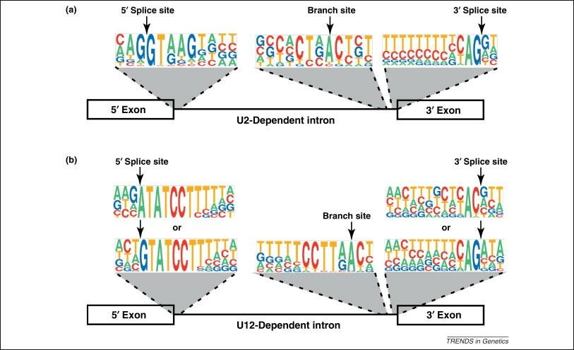
Splicing overview
Canonical splice sites
98.3% GT-AG
1.0% GC-AG
subset of +2T>C variants are functional
+2C>T increased efficiency
0.1% AT-AC = minor spliceosome
0.5% others
= major spliceosome

Slide 3
Splicing can be complex!
PLUS PSEUDOEXONIZATION
AND/OR
A COMBINATION OF
DIFFERENT EFFECTS!

Slide 4
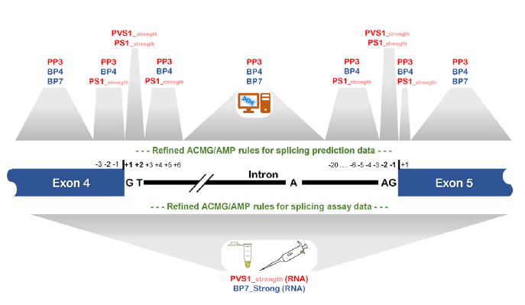

Slide 5
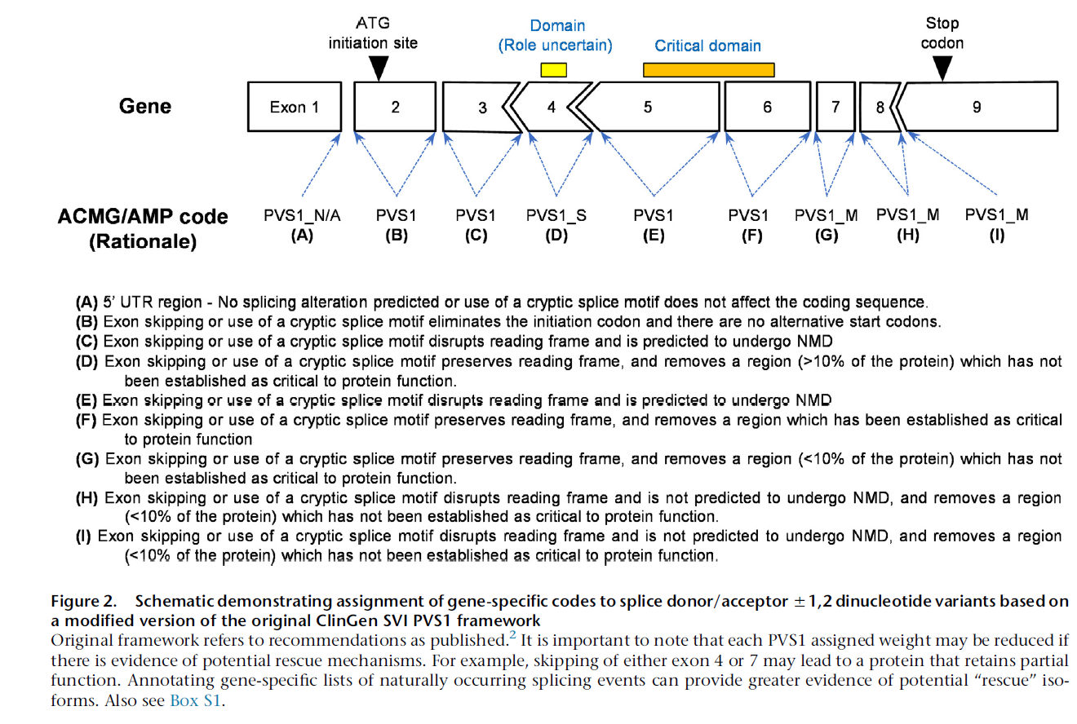
ClinGen SVI splicing paper: Walker et al., 2023
Canonical ±1,2 splice sites

Slide 6
ClinGen SVI splicing paper: Walker et al., 2023
Canonical ±1,2 splice sites

Slide 7
ClinGen SVI splicing paper: Walker et al., 2023
Canonical ±1,2 splice sites

Slide 8
ClinGen SVI splicing paper: Walker et al., 2023
Canonical ±1,2 splice sites

Slide 9
ClinGen SVI splicing paper: Walker et al., 2023
Canonical ±1,2 splice sites

Slide 10
ClinGen SVI splicing paper: Walker et al., 2023
Canonical ±1,2 splice sites

Slide 11
ClinGen SVI splicing paper: Walker et al., 2023
Canonical ±1,2 splice sites

Slide 12
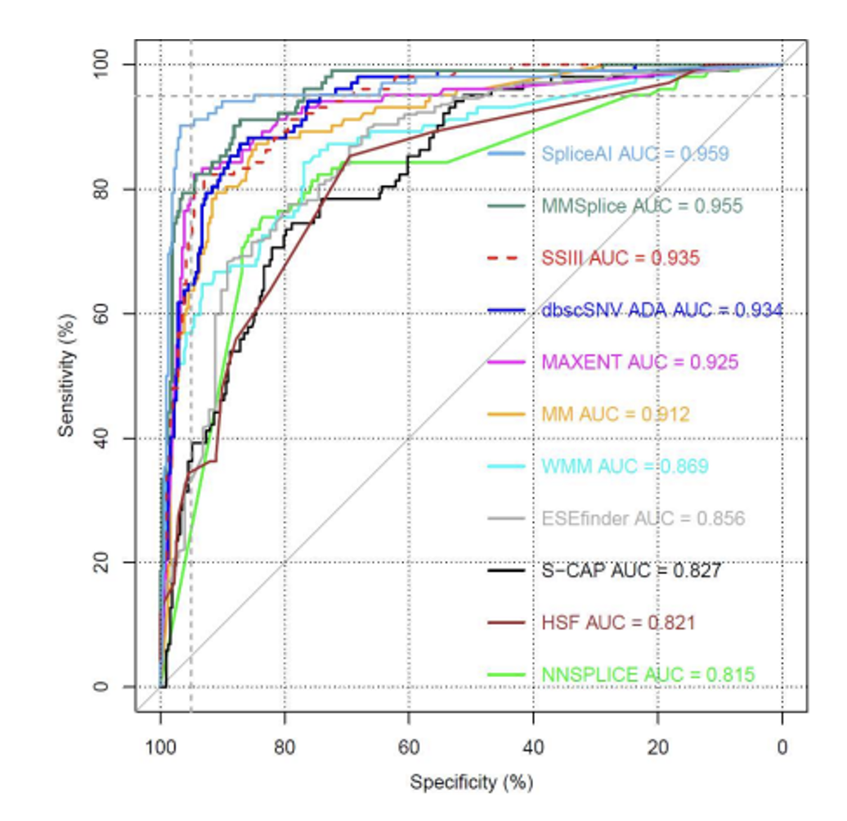
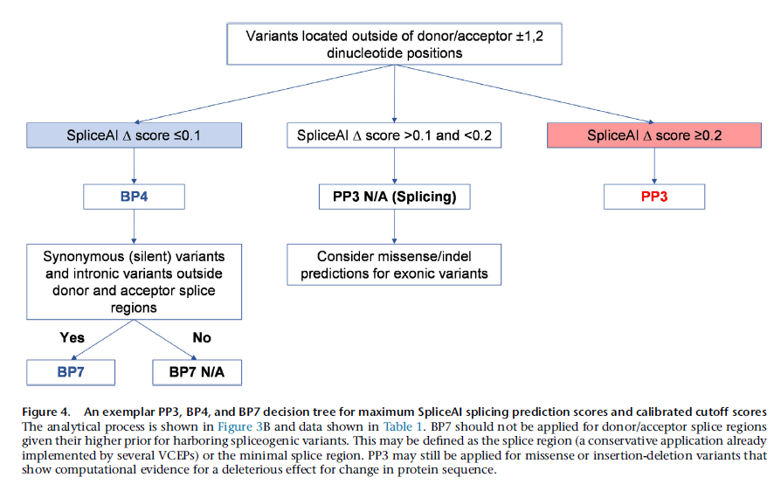
Use of in silico tools (PP3/BP4)
Compared 11 in silico tools for splicing using Findlay et al., 2021 BRCA1 data using 414 variants
Remember: PP3 cannot be used with PVS1 for splicing variants

Slide 13
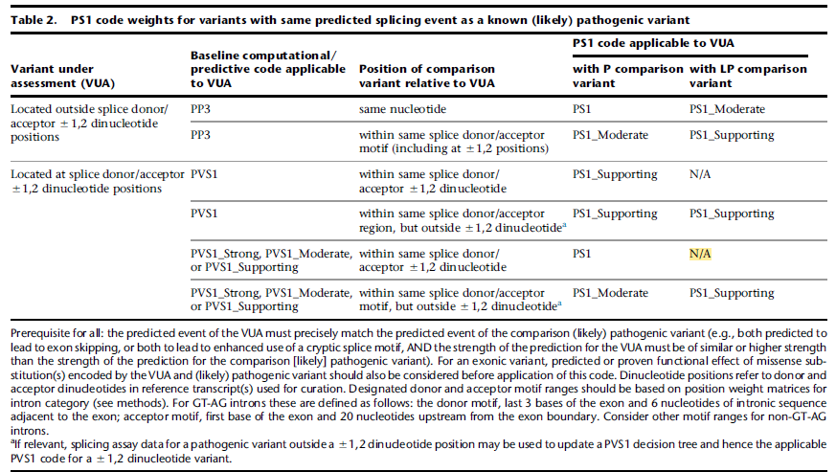
Use of PS1 for “same effect” variants in splice region

Slide 14
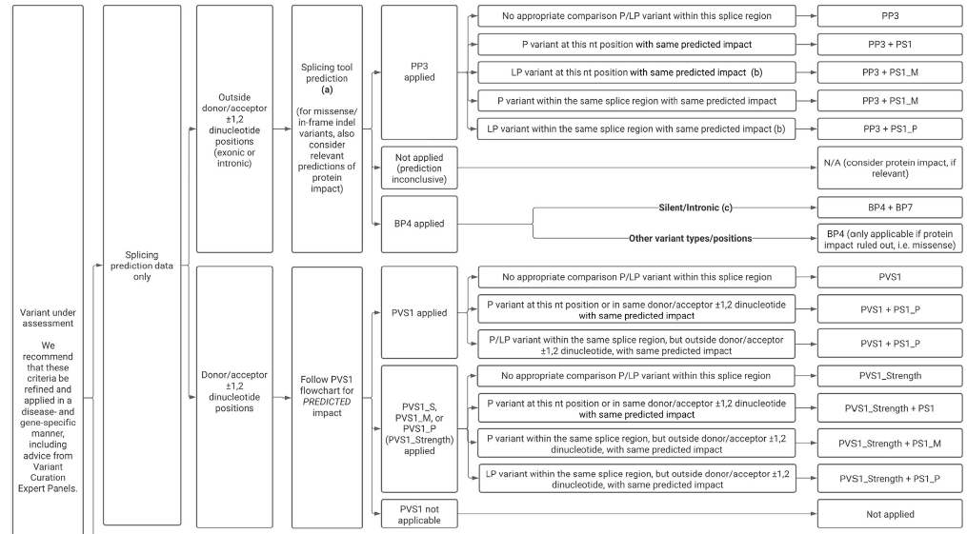
Fig 5: Decision tree

Slide 15
Fig 5: Decision tree

Slide 16
Use of RNA assay data
Use of RNA assay data: PVS1_RNA & BP7_RNA
PS3/BS3 codes to be used for well-established functional assays of protein effect
Use PVS1_RNA and BP7_RNA at variable strength for RNA splicing assays

Slide 17
Use of RNA assay data: PVS1_RNA & BP7_RNA
PS3/BS3 codes to be used for well-established functional assays of protein effect
Use PVS1_RNA and BP7_RNA at variable strength for RNA splicing assays

Slide 18
Use of RNA assay data: PVS1_RNA & BP7_RNA
PS3/BS3 codes to be used for well-established functional assays of protein effect
Use PVS1_RNA and BP7_RNA at variable strength for RNA splicing assays

Slide 19
Use of RNA assay data: PVS1_RNA & BP7_RNA
PS3/BS3 codes to be used for well-established functional assays of protein effect
Use PVS1_RNA and BP7_RNA at variable strength for RNA splicing assays

Slide 20
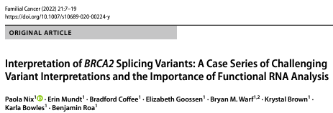
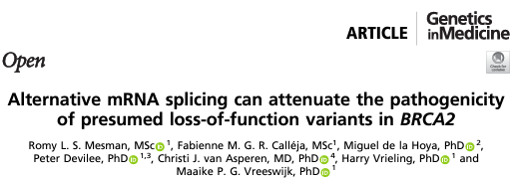
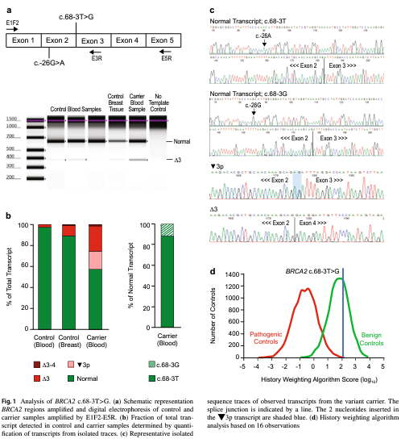
Incomplete or “leaky” splicing example

Slide 21
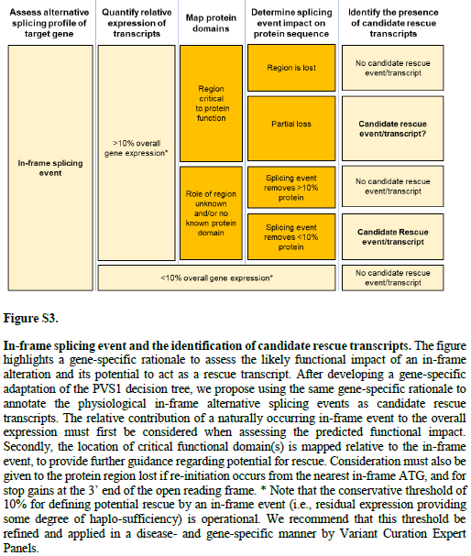
Rescue mechanisms
4 common rescue mechanisms affecting impact of LoF variants:
PTC at the 3’ end of the coding sequence - shorter functional protein
rescue of initiation codon variants by use of an alternative in-frame ATG
stop gains in or exon skipping of non-essential exons
in-frame deletions/duplications - functional protein (cryptic splice site)

Slide 22
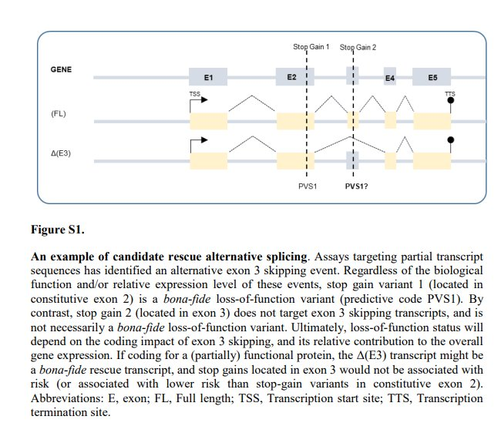
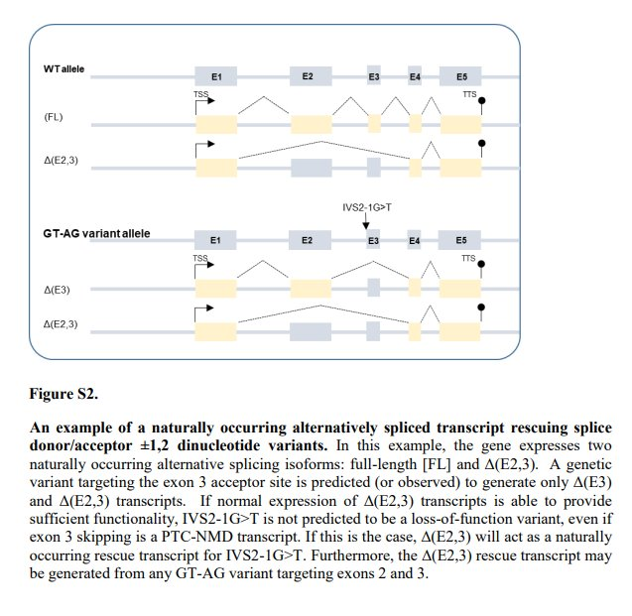
Rescue mechanism

Slide 23
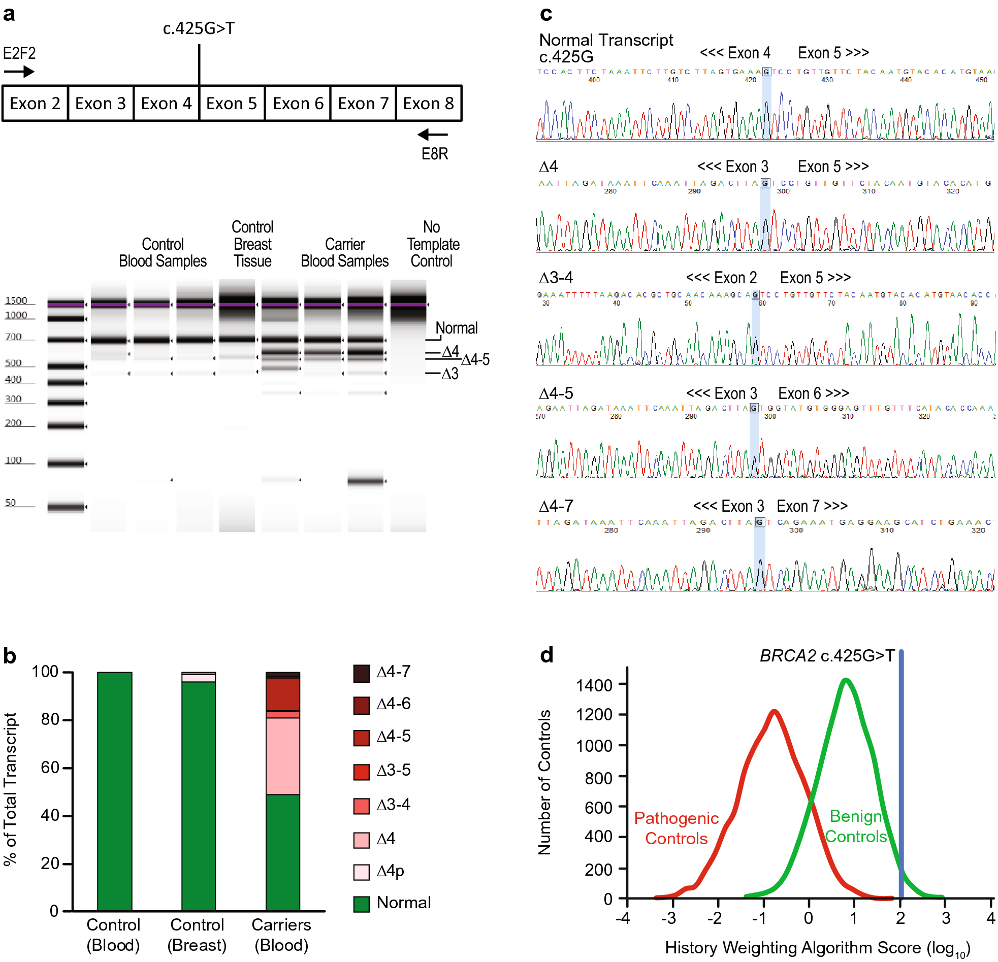
Rescue mechanism example
BRCA2:c.425G>T p.(Ser142Ile)
last base of exon 4
Mesman et al., 2020 (PMID: 32398771)​
Nix et al., 2021 (PMID: 33469799)​
Revel score 0.165
Splice AI ∆ score for donor loss is 0.97
Deletion of exon 4 is out-of-frame
Also get naturally occurring del4-5 and del4-7; total 30% of transcripts are in-frame
= normal HDR activity
“rescue mechanism”

Slide 24
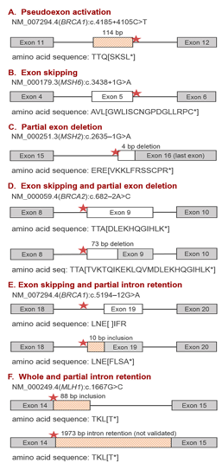
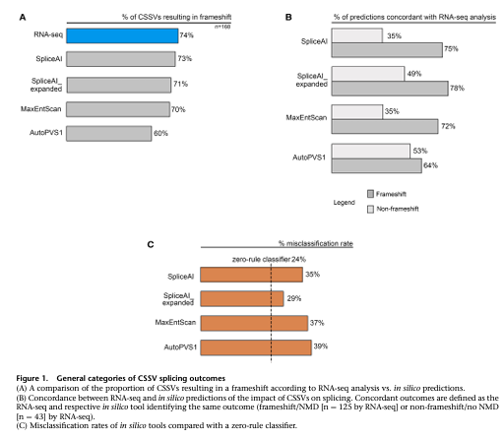
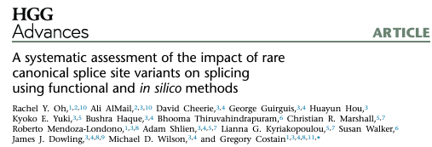
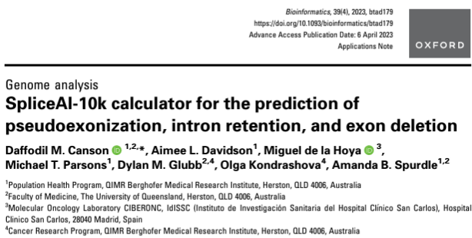
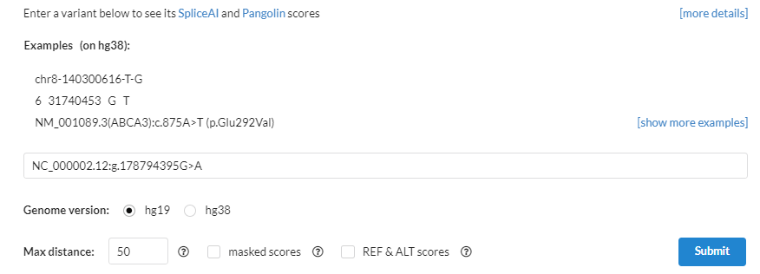
Expert tip…
Use SpliceAI with expanded window of 5000-10000bp

Slide 25
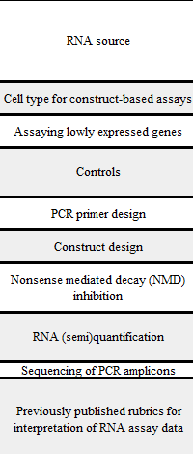
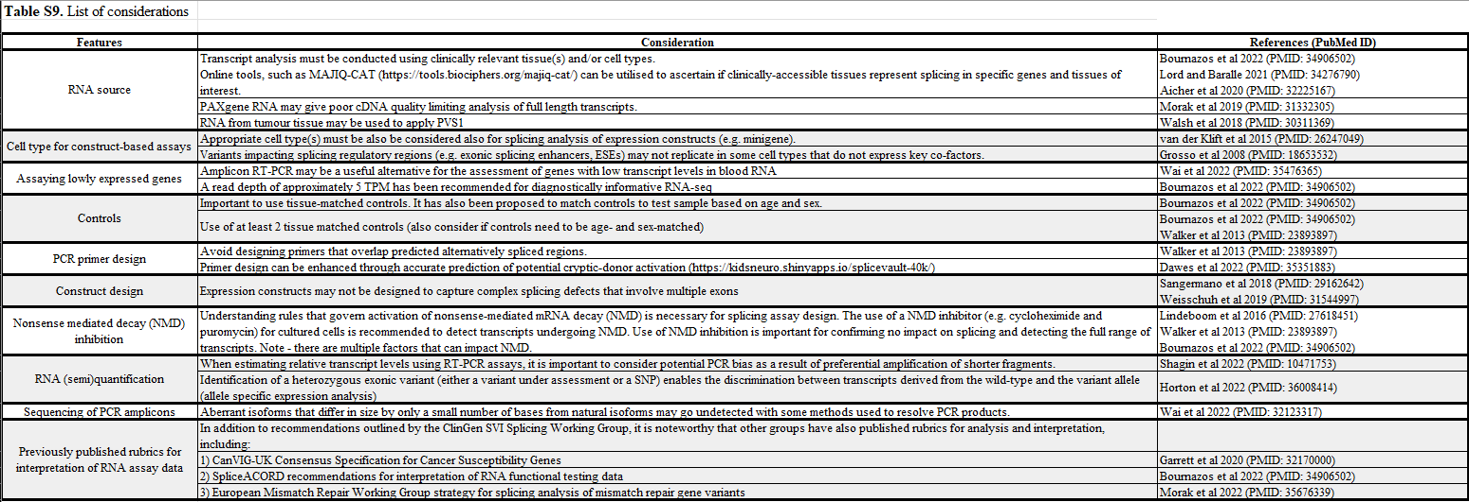
Considerations for robust splicing assays

Slide 26
ClinGen SVI splicing paper: key take-aways
Use PVS1_vstr for in-frame events encompassing undisputed clinically relevant residues
In silico tools: use SpliceAI for PP3 (∆score ≥0.2) and BP4 (∆score ≤0.1)
Use BP7 for synonymous variants (not 1st or last 3 bases of exon) or intronic variants at or beyond +7 and -21 where BP4 is also met
Use of PS1 for same effect splice variants in the same splice “region”
Repurpose the PVS1 and BP7 codes for RNA splicing assays using PVS1_RNA and BP7_RNA at variable strengths
Consider rescue isoforms!
Defined a process to develop gene-specific PVS1 decision trees

Slide 27
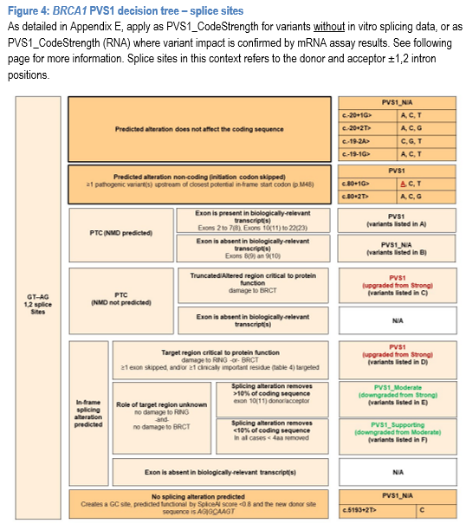
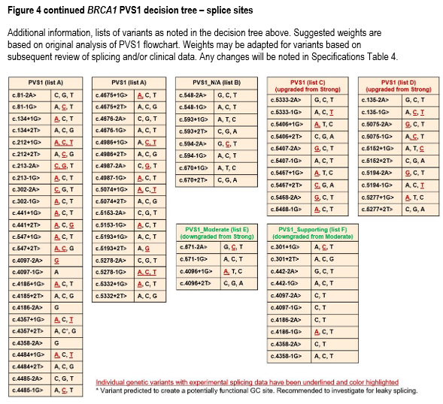
ENIGMA BRCA1 and BRCA2 guidelines

Slide 28
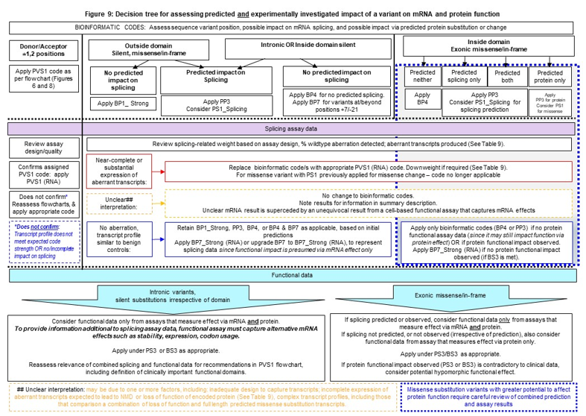
ENIGMA BRCA1 and BRCA2 guidelines

Slide 29
ENIGMA BRCA1 and BRCA2 guidelines

Slide 30
ENIGMA BRCA1 and BRCA2 guidelines

Slide 31
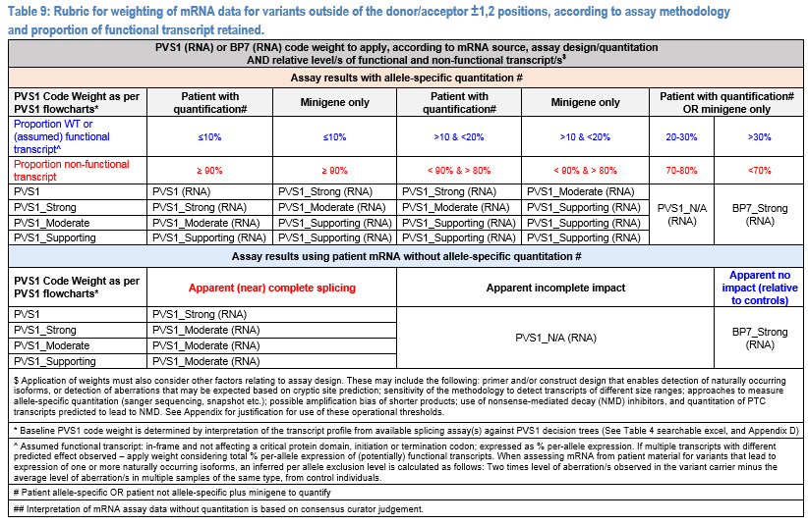
ENIGMA BRCA1 and BRCA2 guidelines

Slide 32
ENIGMA BRCA1 and BRCA2 guidelines

Slide 33
ENIGMA BRCA1 and BRCA2 guidelines

Slide 34
ENIGMA BRCA1 and BRCA2 guidelines

Slide 35
ENIGMA BRCA1 and BRCA2 guidelines

Slide 36
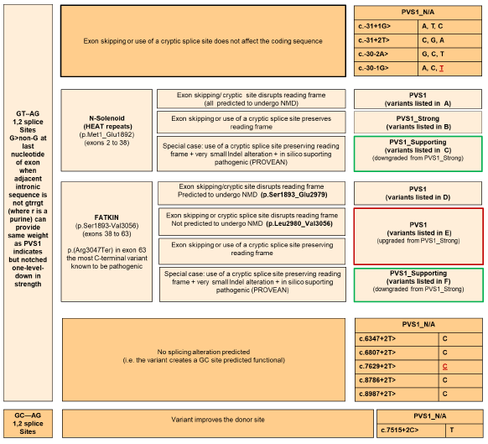
HBOP VCEP: ATM guidelines

