Slide 1
PVS1 guidance for CSGs: CanVIG updates and guidance
James Drummond & Alison Callaway
Presented to CanVIG 25/02/22
Notes:
Last presentation I gave on this to CanVIG was in Nov 2020. Since then there have been updated guidance on PVS1 from several sources:
1) several new ClinGen gene specific guidelines published/updated,
2) updates to generic CanVIG Cancer Susceptibility Gene guidance
3) specific gene guidance has been established by CanVIG (MMR & BRCA)
Alison and I have produced this presentation to highlight some of the updates and provide some guidance on using PVS1 and strength levels that are appropriate when investigating Cancer Susceptibility Genes (CSGs).
First I am going to start with an overview of the guidance that has evolved for these variants since 2015 from the generic to gene specific. We will then focus on some examples using these guidelines.
This talk is to highlight recent alterations/clarifications in the CanVIG guidance and present some insight into how to apply guidance - not designed to be an exhaustive guide.
I will cover the more complex decision trees for 3 parts that are most frequently encountered: nonsense/frameshift, exon level deletions & splice alterations.
A lot is covered and some will be at speed, the presentation will be available as a recording and slides for future reference.

Slide 2
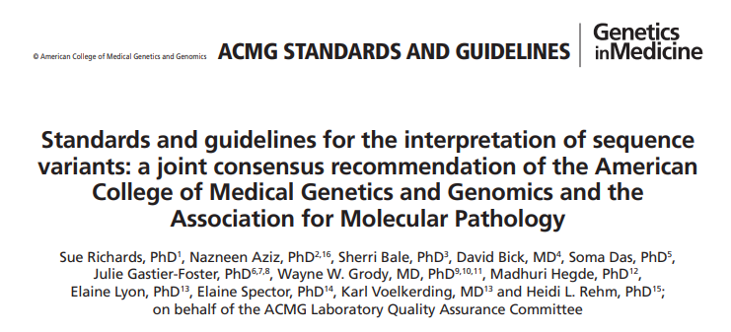
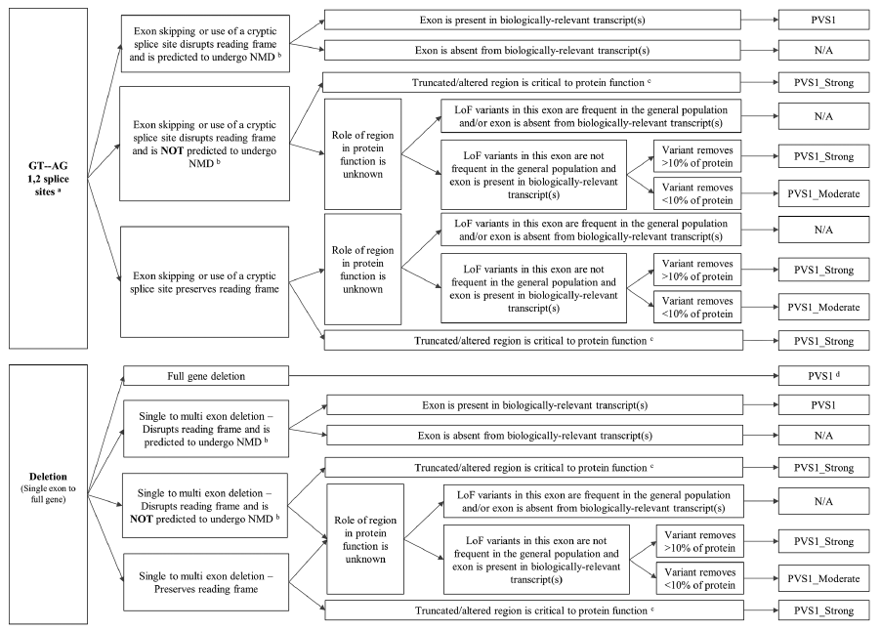
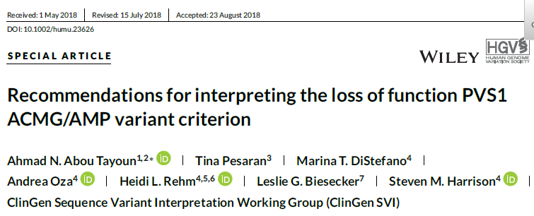
Notes:
ACMG guidance from 2015 published in Richards et al lacked some detail on how to apply PVS1.
Everyone will be familiar with the Tayoun publication from 2018, with the flowchart guiding decision making for a variety of LOF variants, nonsense/frameshift, canonical splice sites, exon level deletions, exon level duplications and initiation codon variants.
This is a critical publication for clarifying the strength at which PVS1 should be applied and the evidence required in this process.

Slide 3
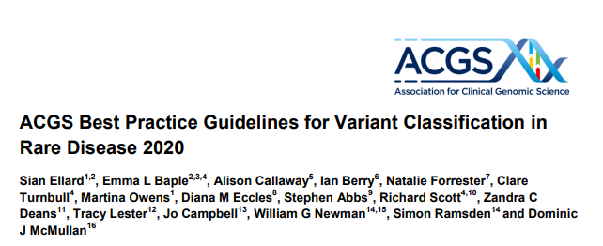
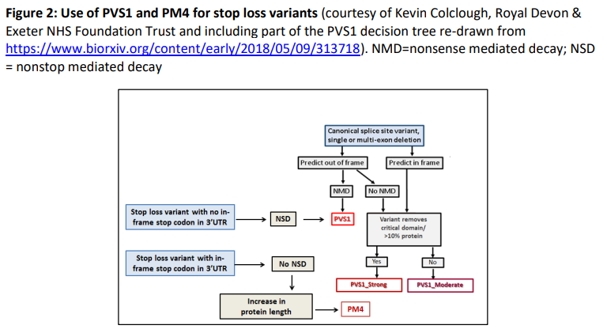
Notes:
The subsequent 2020 ACGS best practice guidelines also provide support in interpretation of PVS1 & PM4 including NSD and extension variants.

Slide 4
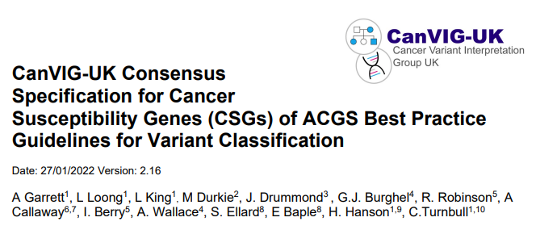
Notes:
For generic CSG guidance the latest guidance release is version 2.16 from January this year. This highlights the CSG guidance for PVS1 is based on both Tayoun et al 2018 and the main ACGS best practice guidance from 2020 and aims to clarify several areas in a bit more detail.

Slide 5
Notes:
The CanVIG MMR specific guidance updated this year with gene specific PVS1 guidance pertaining to the first 100bp of the genes – more detail on this later.
NB this guidance is interim until the ACMG based InSiGHT guidance is published via ClinGen

Slide 6
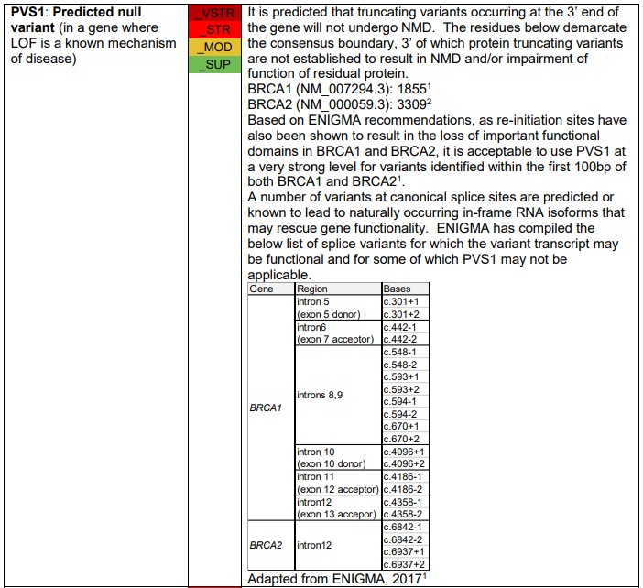
Notes:
The CanVIG BRCA specific guidance updated this year with gene specific PVS1 guidance pertaining to the 3’end of the gene, the first 100bp of the genes and splicing – more detail on this later.
NB this guidance is interim until the ACMG based ENIGMA guidance is published via ClinGen

Slide 7
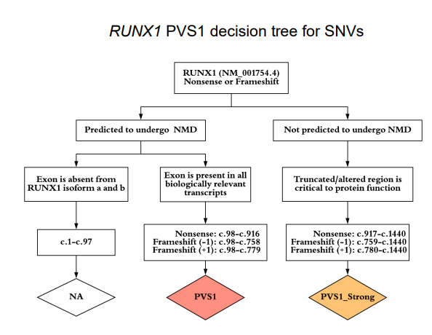
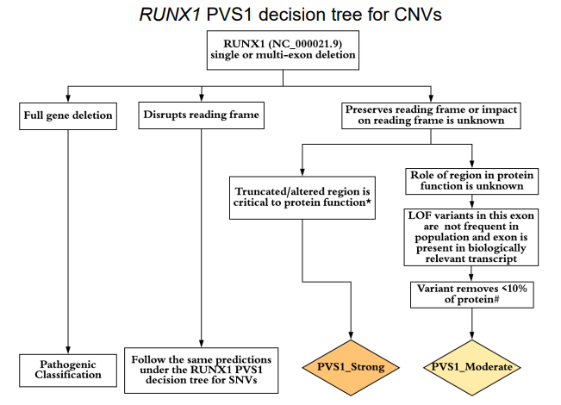
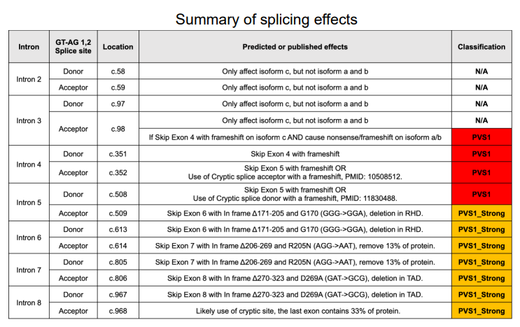
Notes:
An example of highly specific PVS1 guidance from the ClinGen myeloid malignancy expert panel for the RUNX1 gene, which makes applying PVS1 very consistent and clear.
We can increasingly expect gene specific guidance for highly studies CSGs, particularly those with functional data and large cohorts of studied patients that allow application of clear guidance.

Slide 8
Notes:
In fact here you can see the recently released ATM guidance form ClinGen and this contains highly specific guidance on the use of PVS1…

Slide 9
Notes:
…including modifications to use of PVS1 strength across all categories (highlighted in this excerpt from the summary table in red – upgraded and green – downgraded), specification of relevant residues outlining functionally defined domains, and detailed lists of canonical splice site variants and the strength these should be used at (from vs to n/a) – examples here from the summary tables
Gene specific adaptations based on Tayoun guided by detailed knowledge of the gene.
NB PALB2 VCEP guidance also in process of being ratified with specific decision tree.

Slide 10
Using these sources of guidance for all classification criteria:
ClinGen VCEP gene specific guidance should be used where available
For CSGs where no gene specific guidance is available from ClinGen then use CanVIG guidance with gene specific guidance where available.
Generic CanVIG CSG guidance is based on the main ACGS rare disease guidance with additional specifications shaded in grey. Evidence items in white have no additional specification beyond ACGS BPGs. These guidelines should be used in conjunction with one another.
Notes:
So then there are a range of guidance resources available to assist with classification using PVS1 each of which is based on the others with progressively more specificity (rare disease>CSGs>gene specific).
It s critical to use the most appropriate and up to date guidance to ensure variant classification consistency and to record the guidance used in your reporting to allow other labs to determine how classification has been performed. Partic important if dischordant classes noted. Cancer community very luck to have so much specific guidance compared to much of rare disease.
ClinGen gene specific tend to be stand alone but CSG may need to reference main guidance – should be clear where this is the case.
VCEP guidance for range of genes already but also in dev for BRCA1&2 (ENIGMA), PALB2, Lynch genes (InSiGHT) & APC.

Slide 11
Nonsense mediated decay
Notes:
Whilst PVS1 is often seen as simple, it is critical to get it right as it is often the strongest evidence in a variant classification where a variant is extremely rare, often it is the only additional evidence beyond rarity so if you get the strength wrong the classification will be incorrect. Using the exponent scoring system then you may be able to apply 8, 4, 2 or 0 points for vs, s, m or n/a respectively.
As I said at the start of the presentation I will cover the more complex decision trees for 3 parts that are most frequently encountered: nonsense/frameshift, splice alterations & exon level deletions today
Lets start by looking at NMD as this is a key factor in deciding the strength at which you can use PVS1 across multiple variant types.

Slide 12
NMD: Location of the novel Premature Termination Codon is critical
“NMD prediction based on the premature termination codon not occurring in the 3′ most exon or the 3′-most 50 bp of the penultimate exon.” Tayoun et al 2018
First 100bp
Notes:
Useful resources for investigating this: Decipher plots. Example here is MSH2 (NB remember to check transcript – default is MANE select).
Top track: Light grey bar at top is gene composed of exons (each exon boundary is designated by a darker line).
Next track down is predicted NMD escape track which helps to quickly check location of your identified PTC compared to the escape.
For example in this gene, any PTC between dark grey bars (codon 35-860) predicted to undergo NMD and be a null allele (red oblong)
**Note: caution if relying on other resources that just state “exon x of y exons” as these often include non-coding exons at either end of the gene which can be misleading (eg last/penultimate exon or first exon).**

Slide 13
Predicted NMD is limited in some cases (PVS1_strong max in these cases):
Large last exon: APC where only codons 35-635 predicted to undergo NMD (so 600aa of 2844aa total, ie ~21% coding)
Small number of exons: VHL only 3 coding exons (>half gene not subject to NMD)
Single exon gene: CEBPA (none of gene subject to NMD)
Notes:
Note: APC gene specific ClinGen guidance is currently in development and awaiting ratification to help: this includes info on how to use PVS1. This is likely to greatly extend region where PVS1_vs is applicable at 3’ end of gene (proposal for nonsense or frameshift is ~2600aa covered instead of current 600aa ie ~90% of coding rather than 21% currently).
NB remember to check CanVIG excel for previous occurrences of fs vars to use in case control analysis that may aid in boosting classification if PVS1 evidence not high (as fs not in main CanVar except where manually added)

Slide 14
Interpretation of variants undergoing NMD
Nonsense example: PALB2 c.1240C>T p.(Arg414Ter)
Notes:
So a couple of examples where PTC is located in region where NMD is predicted to occur
Straightforward nonsense example

Slide 15
Frameshift example: BRCA2 c.1231del p.(Ile411TyrfsTer19)
Notes:
Straightforward frameshift example

Slide 16
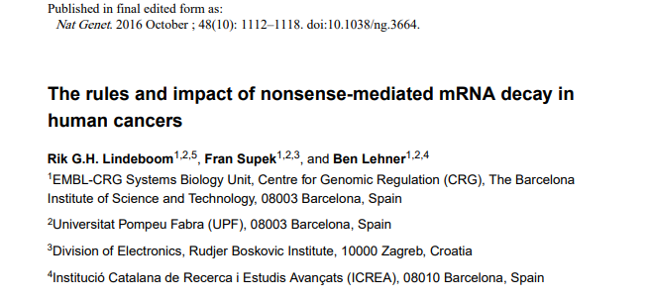
First variant of the month: MSH2 c.21 dup
Updated generic CanVIG guidance:
Stop gain variants within the first 100bp of the gene: for these, nonsense mediated decay is likely to be evaded and re-initiation of translation may occur using an alternate start codon (see Lindeboom et al 2016).

Slide 17
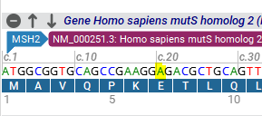
MSH2 c.21dup
Frameshift variant
p.(Thr8Aspfs*74)
ATG GCG GTG CAG CCG AAG GAA GAC GCT GCA GTT GGA GAG CGC GGC CGA GGT CGG CTT CGT GCG CTT CTT TCA GGG CAT GCC GGA GAA GCC GAC CAC CAC AGT GCG CCT TTT CGA CCG GGG CGA CTT CTA TAC GGC GCA CGG CGA GGA CGC GCT GCT GGC CGC CCG GGA GGT GTT CAA GAC CCA GGG GGT GAT CAA GTA CAT GGG GCC GGC AGG AGC AAA GAA TCT GCA GAG TGT TGT GCT TAG TAA AAT GAA TTT TGA
Termination occurs at around c.240; therefore PVS1 can be used at Very Strong as Nonsense Mediated Decay would be predicted (termination is not within the first 100 bp).
Notes:
Does not evade NMD

Slide 18
Submitter classifications
Comments
PVS1-V.STR
Stop codon not within the first 100bps of MSH2
Predicted to undergo Nonsense Mediated Decay
Protein Truncating Variant predicted to be created at codon 74
PVS1-STR
Reading frame disruption as the other possible MET starts in exon 1 would be lost, PVS1 decision tree indicates PVS1-strong
Notes:
Good news that most people were using this guidance appropriately. Sample size small
If only PVS1 & PM2 applicable here then 6 points (LP) vs 10 points (P) so clinical impact ok

Slide 19
Interpretation of variants escaping NMD
Dependent on:
Function of truncated /altered region
Amount of protein predicted to be removed
Let’s begin at the 5’ end of gene
Stop gain variants within the first 100bp of the gene: for these, nonsense mediated decay is likely to be evaded and re-initiation of translation may occur using an alternate start codon (see Lindeboom et al 2016).
Identify whether there is another potential in-frame initiation codon downstream; If there is, assess the missing N-terminal region of the protein according to the principles described in the decision tree in Tayoun et al 2018 to determine the strength of PVS1 (i.e. is the missing region critical to protein function / is it >10% of the entire protein length / are there ≥1 pathogenic variant(s) upstream of the potential new initiation codon).
If no alternative in-frame start codon is identified, use PVS1 at maximum strength according to the gene-disease relationship.
Notes:
So we have determined how to apply guidance where NMD is occurring, what about variants predicted to escape NMD?
Lets start at the 5’ end of the gene. Read info on slice.
Worked examples on next slides:

Slide 20
Stop gain variants within the first 100bp
BRCA1 & BRCA2:
Based on ENIGMA recommendations, as re-initiation sites have also been shown to result in the loss of important functional domains in BRCA1 and BRCA2 (as witnessed by number of expert reviewed variants upstream of the re-initiation sites), it is acceptable to use PVS1_very strong level for variants identified within the first 100bp of both BRCA1 and BRCA2
MMR genes:
Based on InSiGHT recommendations for initiation codon variants, the following PVS1 strengths apply to truncating variants identified in the first 100 bp of the MMR genes:
MLH1 – PVS1_very strong
MSH2 – do not use
MSH6 – PVS1_strong
PMS2 – PVS1_strong
Notes:
Updated guidance in CanVIG CSG gene specific guidance that have been recently released
See second following slide for more info on MSH2 & MSH6 to see examples of how this has been evidenced

Slide 21
PALB2:
Closest potential in frame Methionine is to be at codon 296 in exon 4. If this was used the critical coiled coil domain located from codons 10 to 40 would be lost. There is plenty of functional evidence that this is a functionally critical region. Based on VCEP recommendations for initiation codon variants it is acceptable to use PVS1_very strong level for variants identified within the first 100bp of PALB2.
Notes:
NB SLIDE ADDED AFTER PRESENTATION agreed by JD, AC & MD using method for other genes.

Slide 22
MMR genes in more detail for two of these:
MSH2 – do not use PVS1 for stop gains in first 100bp
Why? Further ATGs exist in frame in exon 1, so PVS1 is not applicable at any evidence weight.
Closest in-frame ATG = c.76-.c.78 (p.Met26). Although there are pathogenic variants in ClinVar that are 3* reviewed in the first 100 bp, only two are truncating (where the termination also occurs within the first 100 bp); they appear to have been primarily assessed against the predicted function of being truncating although one case is also MSI-high. The frameshifts that start in the first 100bp terminate after this position.
MSH6 – PVS1_strong for stop gains in the first 100bp
Why? The next ATG is c.298-300, which if used would remove the beginning of the PWWP domain (involved in DNA binding and recognising methylated lysines on histones) which starts at residue 94 (https://www.ncbi.nlm.nih.gov/pmc/articles/PMC5425739/).
This removes <10% of the protein but removes a region critical to protein function, which is in line with the guidance for initiation codons in the draft InSiGHT VCEP guidelines, and the principles described in Tayoun 2018.
Notes:
We will go into MSH2 in more detail on the following slides using our second variant of the month

Slide 23
Second variant of the month: MSH2 c.28C>T
Nonsense variant
p.(Gln10Ter)
ClinVar information (1)
Classified by InSiGHT in 2013 as pathogenic:
Coding sequence variation resulting in a stop codon
Classified by the Laboratory for Molecular Medicine as pathogenic in 2017 :
The p.Gln10X variant in MSH2 has been reported in 1 individual with MSH2-associated cancer (Mangold 2005) and was absent from large population studies. This nonsense variant leads to a premature termination codon at position 10, which is predicted to lead to a truncated or absent protein… …ACMG/AMP Criteria applied: PVS1_Strong, PM2, PS4_Supporting.

Slide 24
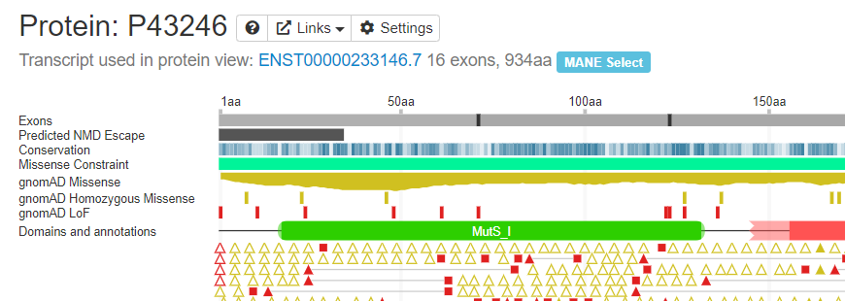
ClinVar information (2)
Classified by Invitae in 2020 as uncertain significance:
This sequence change results in a premature translational stop signal in the MSH2 gene (p.Gln10*). It is expected to result in an absent or disrupted protein product. This variant is not present in population databases (ExAC no frequency). This variant has been observed in individual(s) with clinical features of Lynch syndrome (PMID: 15849733). ClinVar contains an entry for this variant (Variation ID: 91055). Reports on variants that affect the MSH2 initiator codon, c.1A>C and c.1A>T, indicate that Met26 may serve as an alternate initiator codon (PMID: 21837758, 9718327, 18781192). An experimental study of a recombinant MSH2 protein lacking the first 25 amino acid residues has shown that the truncated protein remains partially functional (PMID: 21837758). The clinical significance of these findings is unknown. Loss-of-function variants in MSH2 are known to be pathogenic (PMID: 15849733, 24362816). However, there is uncertainty with this variant as to whether an alternate in-frame methionine, downstream of the initiator codon, could potentially rescue translation initiation. In summary, the available evidence is currently insufficient to determine the role of this variant in disease. Therefore, it has been classified as a Variant of Uncertain Significance.
Position c.28 is not predicted to undergo NMD
Other in-frame methionines

Slide 25
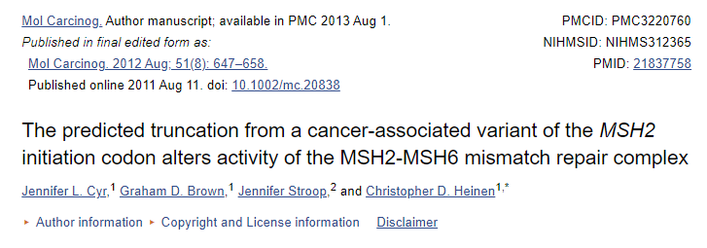
MSH2 initiation codon variants
Mutations affecting the MSH2 start codon have been described previously for LS-related malignancies. However, the patients often lack a clear family history indicative of LS and their tumors often fail to display microsatellite instability, a hallmark feature of LS. Therefore, the pathogenicity of start codon variants remains undefined. Loss of the MSH2 start codon has been predicted to result in a truncated protein translated from a downstream in-frame AUG that would lack the first 25 amino acids…
…We found that the MSH2(NΔ25) mutant confers distinct biochemical defects on MSH2-MSH6, but does not have a significant effect on MSH2-MSH3. We confirmed that expression of the MSH2 c.1A>C cDNA results in the production of multiple protein products in human cells that may include the truncated and full-length forms of MSH2.

Slide 26
MSH2 initiation codon variants
We report a brother and a sister with bi-allelic germline mutations in MSH2; a pathogenic deletion of the first 6 exons and a variant of the initiation codon (c.1A>G (p.Met1?)), whereas their phenotypes (four colorectal cancers, small bowel carcinoma and 15 adenomas at age 39 and 48, and colorectal cancer, endometrial cancer and four adenomas at age 33 and 44, respectively) are more suggestive of a mono-allelic pathogenic MMR gene mutation.
Notes:
note the lack of CMMRD in case with initiation codon loss (use of downstream Met) and first 6 exon deletion.

Slide 27
Draft ACMG InSiGHT guidance
Does not specifically cover variants in the first 100bp but here is the guidance for initiation codons:
https://www.insight-group.org/content/uploads/2021/11/DRAFT_Nov_2021_TEMPLATE_SVI.ACMG_Specifications_InSiGHT_MMR_V1.pdf

Slide 28
Back to MSH2 c.28C>T p.(Gln10Ter)
In line with the guidance for initiation codon variants, variants not predicted to undergo NMD should be treated with similar caution.
If Nonsense Mediated Decay does not occur, it is plausible that re-initiation of translation will occur at p.Met26
PVS1 therefore should not be used for this variant

Slide 29
Submitter classifications
Comments
NA
Stop codon IS within the first 100bps
Reading frame remains intact
Alternative start codon at codon 26 could be used
Some function is retained and <10% protein is lost, PVS1_mod appropriate BUT MMR guideline say PVS1 should not be used for truncating variants in the first 100 bases of MSH2
PVS1-MOD
Met at codon 26 could be used as an alternate initiation codon, and MSH2 protein without the first 25 amino acids shown to have reduced function
Notes:
Great news, although sample size low almost everyone using guidance as laid out in latest CanVIG MMR guidance. I can clearly see why PVS1_mod would be used if not following CanVIG MMR guidance but using generic CSG guidance and principles in PVS1 decision tree.
Hopefully, the preceding slides have clarified why we classified as we did. Highlights importance of using most specific and up to date guidance.

Slide 30
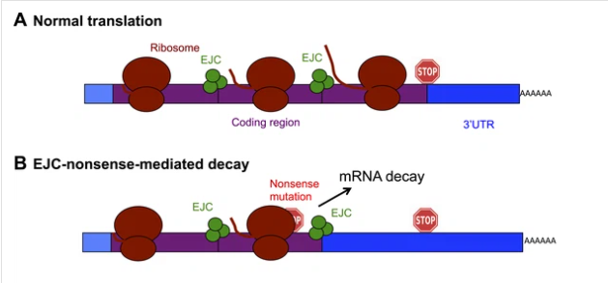
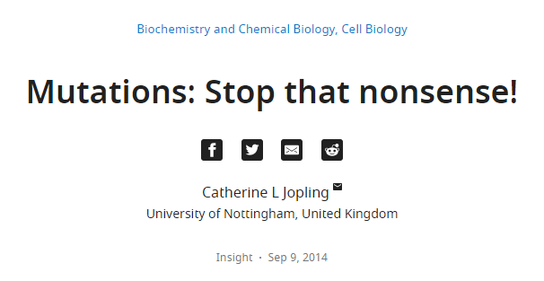
Interpretation of variants escaping NMD
Dependent on:
Function of truncated /altered region
Amount of protein predicted to be removed
Let’s now look at the 3’ end of the gene
Nonsense mediated decay
Notes:
So we have had a good look at the 5’ end of the gene now let’s shift to the other end
NMD at 3’ end happens when PTC is found upstream of last EJC –includes 50bp upstream as ribosome takes up that much space so stop not “seen” ahead of EJC

Slide 31
Interpretation of variants escaping NMD
Dependent on:
Function of truncated /altered region
Amount of protein predicted to be removed
Example: BRCA1 c.5463_5464insT p.(His1822SerfsTer8)
Frameshift in penultimate coding exon , with PTC in last exon , NMD evaded, part of BRCT domain disrupted (aa 1650-1863), PTC upstream of last codon that is proven to impair function of residual protein (p.1855). PVS1_str
NB if frameshift starts outside region of NMD escape but novel PTC within NMD region then NMD escape predicted, eg BRCA1 c.5410_5411del p.(Val1804ProfsTer25). Note new Ter at same location as variant above PVS1_str
Notes:
NB In a case of frameshift var that evades NMD = loss of % protein = loss of wt protein (so do not count all alternative seq)

Slide 32
Example: BRCA1 c.5561del p.(Leu1854ArgfsTer68)
Frameshift in last coding exon, with protein extension beyond normal stop codon (PTC in 3’UTR), NMD evaded, NSD not predicted. PTC is downstream of last codon that is proven to impair function of residual protein (p.1855), all missense variants downstream of this variant are functional in Findlay et al 2018. Last 10 aa of normal protein disrupted (less than 10% total protein). PVS1_mod
NB We will look at NSD in next slide
Notes:
Orange arrow denotes approx. start of frameshift, red arrow location of new PTC
NB this variant has been more extensively covered at CanVIG meeting July 2021 “variants of the month” as part of GenQA feedback session

Slide 33
When to use PVS1 or PM4 for stop loss variants
Notes:
Extensions into the 3’UTR may evade NMD but be subject to NSD which would still attain PVS1_vs.

Slide 34
Example: INS c.331T>G, p.(*111Gluext*?)
Targeted for NSD. PVS1_vs applicable
c.331T>G variant abolishes the TAG termination codon at the end of the ORF (p.*111Gluext*?)
Stop codon
3’ UTR lacking an in-frame termination codon
polyadenylation signal sequence AATAAA
Recognised by CPSF enzyme
Cleaves RNA
Allows polyadenylation to start
Slide kindly provided by Kevin Colclough
Notes:
Extensions into the 3’UTR may evade NMD but be subject to NSD which would still attain PVS1_vs. This case is an example of when NSD would be applied.

Slide 35
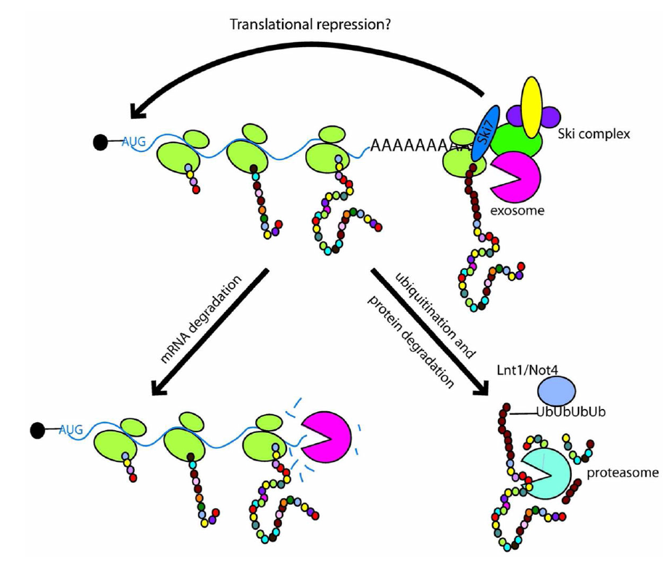
What happens when a ribosome doesn’t encounter a stop codon?
Slide kindly provided by Kevin Colclough
Notes:
Loss of stop leads to ribosome crashing into polyA - gets stuck and degradation of protein complex and mRNA

Slide 36
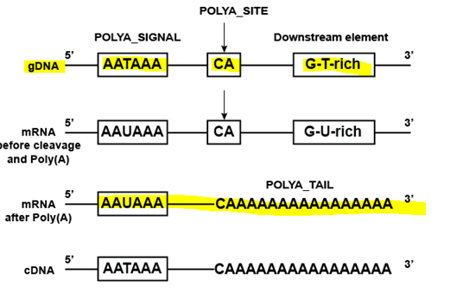
Example: MLH1 c.2163_2164dupTA, p.(Lys722IlefsTer62)
Frameshift in last exon upstream of normal Termination codon, region of abnormal aa and then further extension after normal termination codon, escapes NMD, escapes NSD but region critical to protein function as evidenced by multiple pathogenic variants reported in this region. PVS1_str
Should evade NSD – novel termination codon in fs protein is upstream of PolyA region, so ribosome should be able to dissociate from mRNA
Notes:
Example from previous presentation on PVS1 – for more info see CanVIG presentation PVS1/PM4 case studies Nov 2020 (https://www.cangene-canvaruk.org/canviguk-resources).

Slide 37
An example of PM4
MLH1: c.2269T>A p.(*757Lysext*36)
In this case the Termination codon T>A with an in frame read through to another stop codon upstream of the upstream of PolyA region, so ribosome should be able to dissociate from mRNA. No NSD.
Simple protein extension so PM4_mod

Slide 38
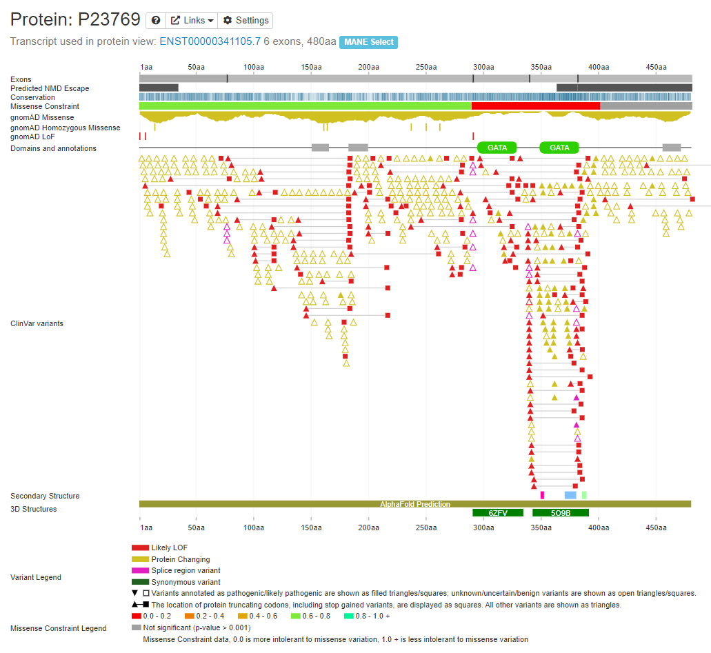
Assessing functional importance of a gene region:
Domains
Functional studies
Conservation
Constraint
Other pathogenic variants
Notes:
Moving on to generic guidance on determining the functional importance of a gene region when looking at PVS1 – these are fairly obvious
Example of regional missense constraint illustrated by Decipher (red bar & yellow plot) – GATA2 example here – clear where the critical functional domains are
Other path vars: Missense, missense, missense!
Some worked examples on next slides

Slide 39
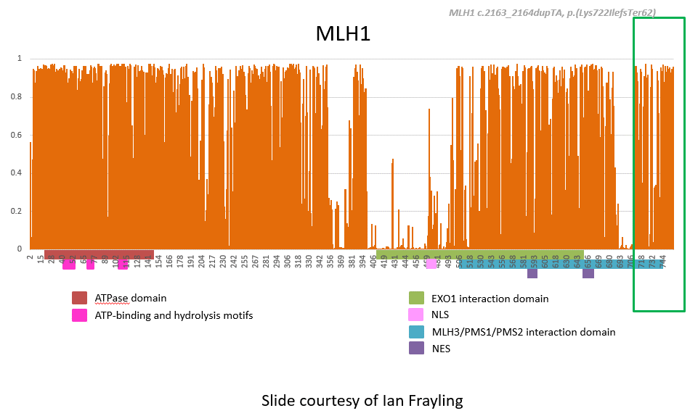
Assessing functional importance of a region. “Domains not enough”
Courtesy: Thompson, Bryony A., et al. "Calibration of multiple in silico tools for predicting pathogenicity of mismatch repair gene missense substitutions." Human mutation 34.1 (2013): 255-265.
http://hci-lovd.hci.utah.edu/home.php?action=switch_db
Notes:
From my previous PVS1 talk.
Ian Frayling: Note that despite the fact the end of the gene isn’t a defined domain priors are higher
We should replace "domains" with "bits that matter", as domains are merely a surrogate for what we think we know, and when we have a better idea as to the bits that matter (such as these priors) that is better than "domains". Or something like that! Thing is all can see that there are bits in and outside of "domains" that nature clearly classes as important in these proteins.

Slide 40
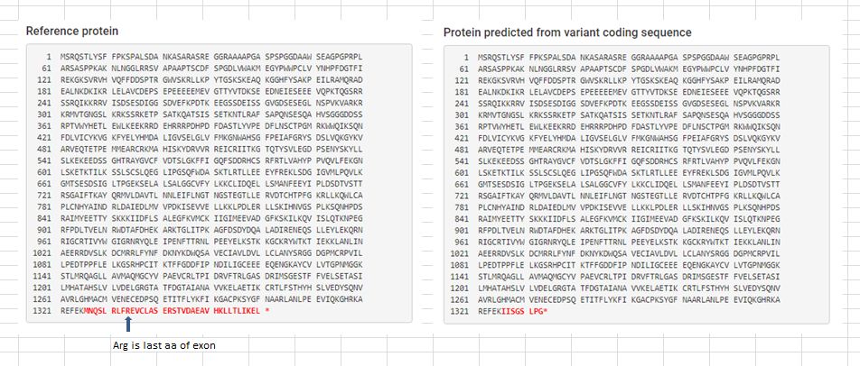
MSH6 c.3978_3994del p.(Met1326IlefsTer9) – exon 9 of 10
Frameshift and loss of last exon (no ext)
NMD not predicted

Slide 41
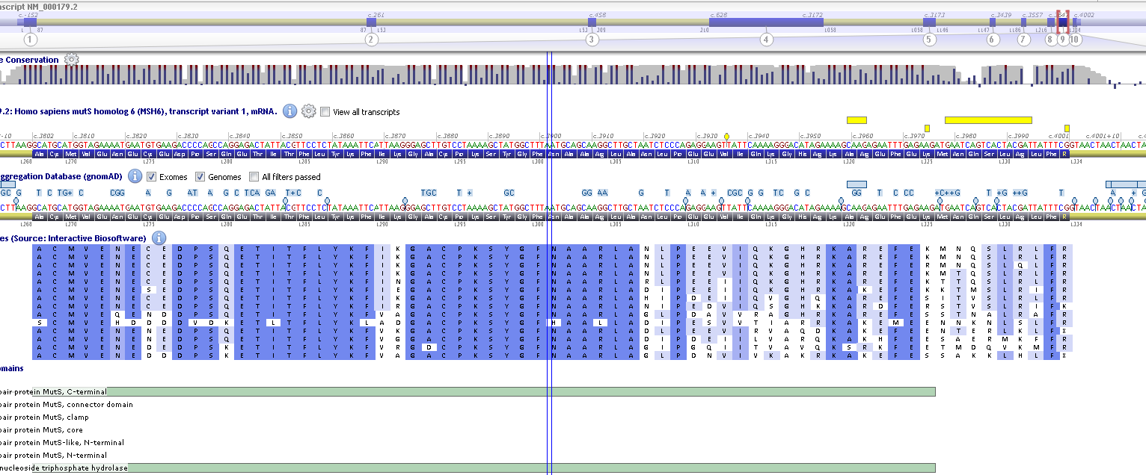
Location & conservation
Absent from InSiGHT

Slide 42
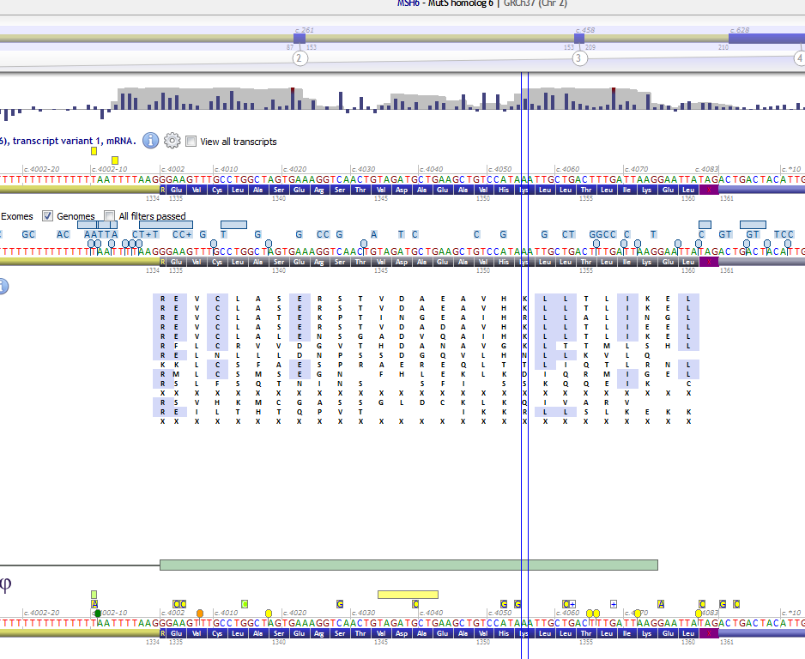
Last exon looks poorly conserved and no pathogenic variants on ClinVar

Slide 43
Variants downstream:
c.3959_3962del | Class 3 on Insight
c.3974_3976del | Class 3 on Insight
c.3969_3979del | Class 3 on Insight
c.3991C>T p.(Ala1268GlyfsTer6) | Class 5 on Insight – different mechanism, shown to impact splicing (skipping of exon9)
c.4028C>G p.(Ser1343Ter) | VUS on ClinVar
c.3984_3985insATCA p.(Ser1329IlefsTer13) | Class 3 on Insight
c.3984_3987dup p.(Leu1330ValfsTer12) | Class 3 on Insight
NB Issue of ClinVar InSiGHT entries – need to check InSiGHT directly:
https://www.insight-database.org/classifications/

Slide 44
PCNA interaction domain
DNA binding domain
ATPase domain
PWWP domain
Connector domain
ATP-binding motif
NLS
Lever domain
Mg²⁺ binding site
MSH2 interaction domain
Clamp domain
Slide courtesy of Ian Frayling
Courtesy: Thompson, Bryony A., et al. "Calibration of multiple in silico tools for predicting pathogenicity of mismatch repair gene missense substitutions." Human mutation 34.1 (2013): 255-265.
http://hci-lovd.hci.utah.edu/home.php?action=switch_db
Notes:
In this case the domain is defined but priors are lower!

Slide 45
MSH6 c.3978_3994del p.(Met1326IlefsTer9):
Not predicted to undergo NMD, role of region unknown, predict loss of <10% protein… loss of function variants in this region are rare in general population. PVS1_mod

Slide 46
TSC2: c.5171delA p.(Gln1724ArgfsTer102) – termination at codon 1826
Penultimate exon but extension of protein beyond normal termination site
Other TSC2 variants classified as pathogenic on LOVD also terminating at 1826:
c.5161del p.(Met1721TrpfsTer105)
c.5173del p.(Val1725CysfsTer101) – de novo
c.5192del p.(Asn1731ThrfsTer95)
c.5196del p.(Thr1733ProfsTer93) – de novo
c.5247del p.(Leu1750SerfsTer76)
https://databases.lovd.nl/shared/variants/TSC2/unique
GAP domain affected – deleting terminal x aa and replacing them with novel seq

Slide 47
TSC2: c.5171delA p.(Gln1724ArgfsTer102)
Novel termination at codon 1826 (usual at 1808)
TGA stop codon for extended protein – upstream of Poly A
No NMD as frameshift and extension so stop codon in 3’UTR
No NSD

Slide 48
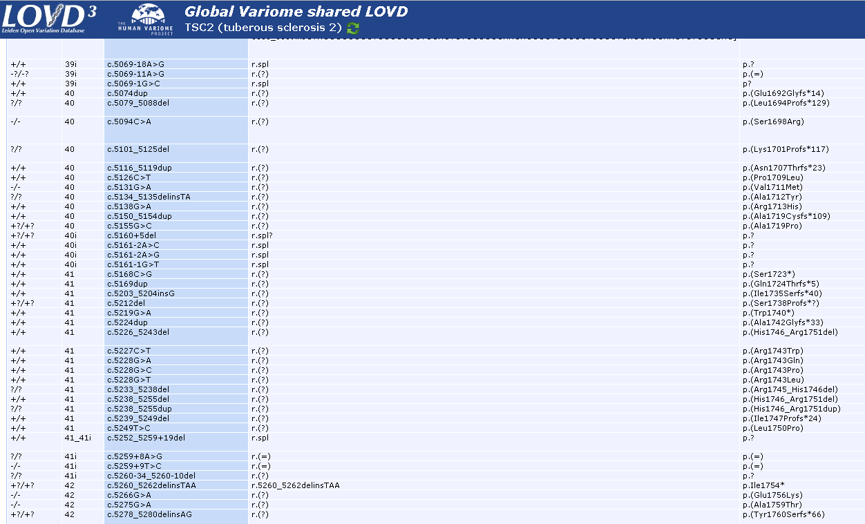
Plenty of other pathogenic changes in region:

Slide 49
TSC2 c.5171delA p.(Gln1724ArgfsTer102):
Frameshift not predicted to undergo NMD, altered region critical – pathogenic missense 3’ of this change described (including de novo with TS phenotype) and includes part of GTPase activating protein domain. PVS1_strong

Slide 50
Exon level deletions
Notes:
Sub-exon level deletions/duplications in frame (seq): refer to PM4
Exon level / single gene events (NGS/MLPA): stick to SNV guidance for now using PVS1
Multigene events (WGS/array): refer to ACMG CNV guidance or SASI guidance for specific cancer susceptibility genes
Notes:
Moving on to deletions.
Note we currently use Tayoun for these, but there is pressure to move to the CNV guidance which are more geared towards whole gen/multigene/chromosomal abnormalities and currently don’t work as well as Tayoun for exon level events. For now stick with SNV guidance.
NB see CanVIG excel for case control data to help with interpretation of exon level events

Slide 51
Generally, exon level deletions are easy to assess for frame using software such as Alamut and deducing whether frame is disrupted and if NMD applies based on where PTC occurs. Guidance then follows similar process to that outlined in previous slides.
For in frame deletions the functional designation and size of the region affected is again important.

Slide 52
Caution: Penultimate exon deletions
Either due to splice or CNV.
Shift of NMD site 5’ – bear this in mind when classifying
Notes:
Note example where penultimate exon deleted and it is out of frame then new PTC in final exon then loss of protein equates to deleted exon plus loss of end of protein (ie may equate to 2 exon deletion)
See ClinGen “splicing and in silico splicing predictors” presentation by Marcy Richardson 2019 for more info.

Slide 53
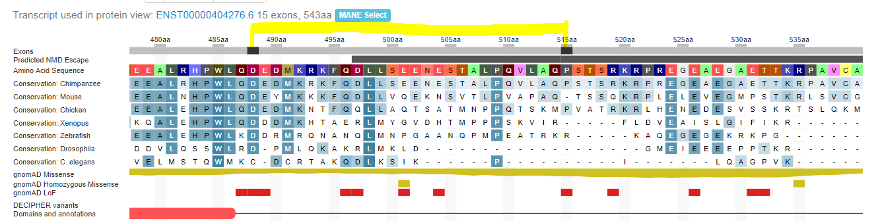
Example of assessing single exon deletion: CHEK2 exon 14 deletion
In frame single exon deletion at 3’end of gene, not highly conserved, weak missense constraint
Deletion of 26 aa from total of 543 (~5%)

Slide 54
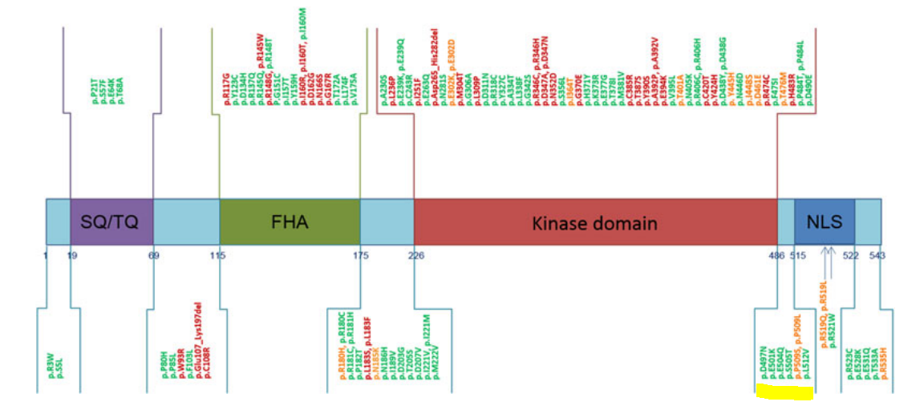
Functional evidence suggests this region is not critical to protein function

Slide 55
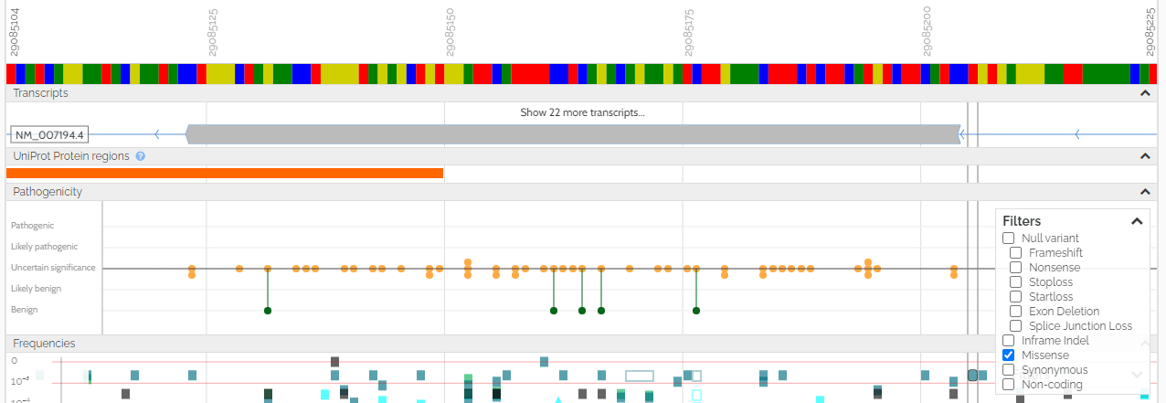
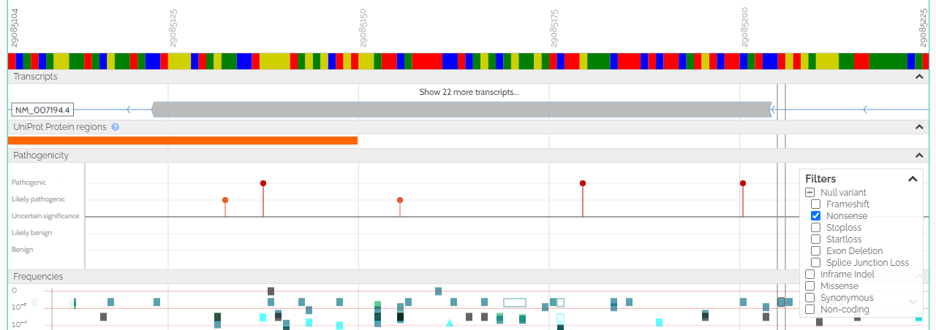
Evidence from other variants in exon:
Missense reported on ClinVar: max VUS (supporting functional data)
Usually good to assess function as doesn’t default to LP/P with poor classification
Nonsense reported on ClinVar: some LP/P
However, although these would disrupt his exon they would also be predicted to remove downstream NLS region leading to protein mislocalisation, so evidence from these not great.
NB NMD escape from codon 497 onwards
Frameshift reported on ClinVar: some LP/P
However, although these would disrupt his exon they would also be predicted to remove downstream NLS region leading to protein mislocalisation, so evidence from these not great
NB NMD escape from codon 497 onwards
Notes:
Note this is in reverse orientation compared to gene level images on previous slides, gene is running 5’ to 3’ in direction of blue arrow. From approximately blue bar everything is predicted to escape NMD

Slide 56
CHEK2 exon 14 deletion:
In frame deletion, role of region of protein not clearly critical to protein function, less than 10% protein removed. PVS1_mod

Slide 57
Splicing
Note: PVS1 is currently only used for canonical 1,2 splice variants in generic guidance (not last base of exon or +5)
Guidance is based on predictions/evidence of effect on frame, NMD, function & proportion of protein lost.
Notes:
Essentially same as deletions, but much more care needed when assessing if predicted event is actually what happens.

Slide 58
U2 type (>99%)
Figure from Ito et al 2017 (https://doi.org/10.1073/pnas.1707741114)
Generally: Splice site alterations that weaken/abolish the native splice site (in absence of cryptic) typically cause skipping of the closest exon:
3’ss Acceptor (-1/2) alterations cause skipping of the following exon
5’ss Donor alterations (+1/2) cause skipping of the preceding exon
Notes:
Any errors during the splice process may lead to improper intron removal and therefore cause alterations to the open reading frame
NB this data is bias and there is some suggestion that 5’ donor alterations may commonly cause intron retention but that this is not well detected in available assays. This info is not terribly useful here for us to make predictions with! See ClinGen “splicing and in silico splicing predictors” presentation by Marcy Richardson 2019 for more info.

Slide 59
However splicing can be complex and difficult to predict the outcome of:
Notes:
Canonical splice alterations: Partial exon skipping (cryptic site use), intron retention, partial intron retention (cryptic site use).
Non-canonical splice alterations: exonic variants that create new sites or deep intronic variants that cause intron retention /cryptic econ use etc
The complexity around splicing highlights need to check literature for each splice site variant you identify in case there is assay data that indicates they may not behave as expected (see Nix et al 2022 and a couple of examples on next slides).

Slide 60
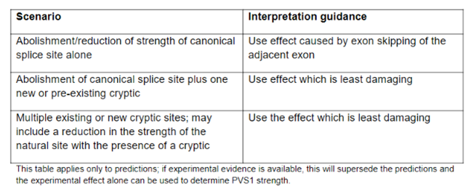
Suggested in silico assessment of splicing
Notes:
Need to check region (NB Splice AI by default searches 50nt either side for additional alterations).

Slide 61
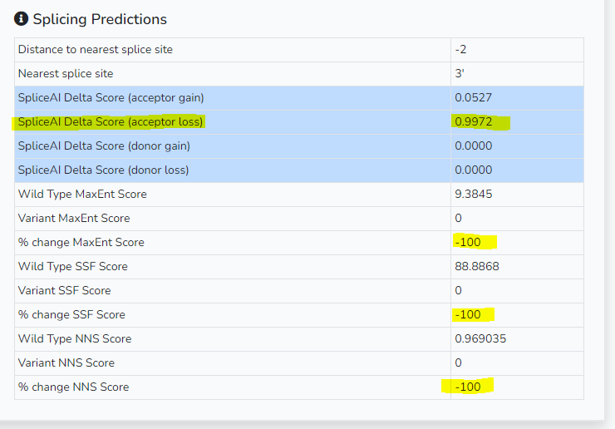
Here we can look at a CHEK2 example that is predicted to results in the same as exon level deletion we have already looked at in the previous slides.
CHEK2 c.1462-2A>G
Acceptor loss predicted strongly, skip of following exon (exon 14)

Slide 62
CHEK2 exon 14 deletion:
In frame deletion, role of region of protein not clearly functionally important, less than 10% protein removed. PVS1_mod
Notes:
Reassuringly the same as single exon deletion example!
NB ClinVar entries cite this as LP variant based on deletion in relevant gene where LOF is cause of phenotype and seem to weight this evidence more heavily but without explanation

Slide 63
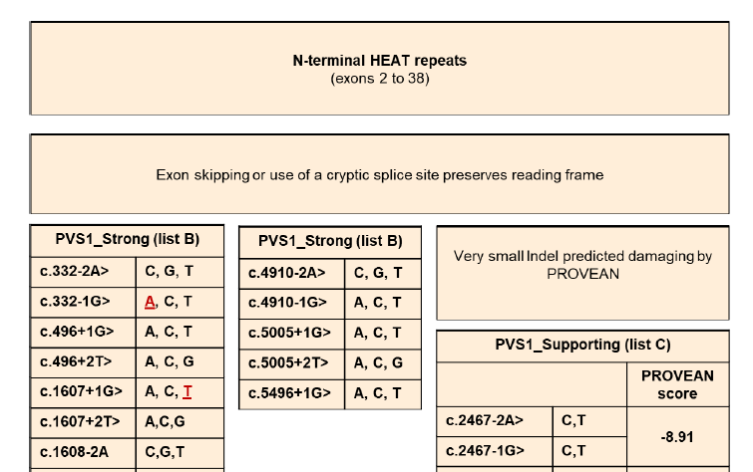
ATM examples: not all +2 variants are equal: from PVS1_n/a to PVS1_strong…
c.7515+2C>T
c.7629+2T>C
c.1607+2T>A
No +2 examples for PVS1_sup!
Notes:
NB red = variants with direct experimental evidence

Slide 64
…to PVS1_very strong:
c.72+2T>A
Notes:
Highlights joy of carefully highly curated gene specific guidance for consistency in variant interpretation

Slide 65
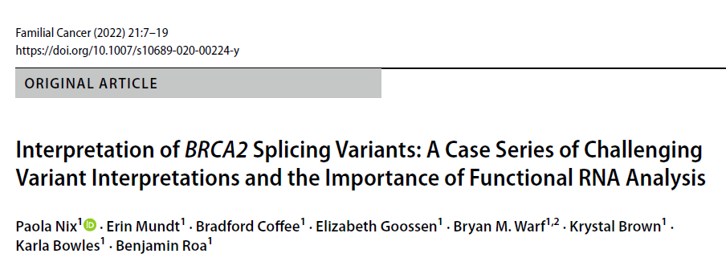
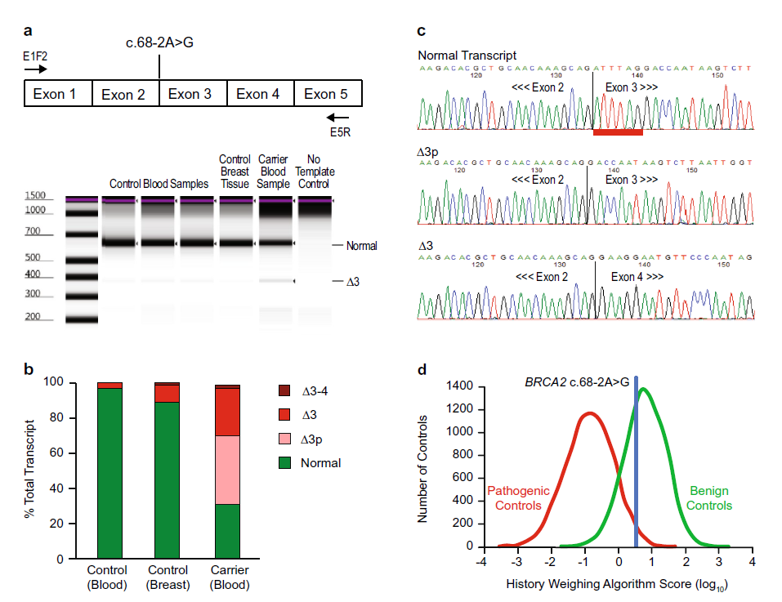
An example of the complexity in splicing in practice
Example: BRCA2 c.68-2A>G
Previous evidence:
In silico, absence in pop db, published functional data, ClinVar classifications (LP x3)
New evidence:
RNA->cDNA and single molecule PCR
History weighting algorithm
Expected:
Exon 3 skip
Identified:
31% normal transcript
27% transcripts Exon 3 skip
39% had exon 3 shortened by 6nt (in frame cryptic acceptor, 2 aa del)
2% skipped exons 3&4
FH weighting inconsistent with pathogenicity - VUS
Notes:
Myriad study.
Also highlights ClinVar entry reliance for var classification

Slide 66
Lastly another note of caution:
Last exon donor alterations – nothing to skip to therefore prediction problematic & should rely on functional evidence
Notes:
Donor site alterations typically cause skipping of the following exon, but there is nothing to splice to on the other end. The results of this event need to be experimentally derived.
See ClinGen “splicing and in silico splicing predictors” presentation by Marcy Richardson 2019 for more info.

Slide 67
Conclusions:
PVS1 is often seen as a simple criteria to use, but because of the range of variant types it covers there is complexity in using it correctly
There are multiple sources of guidance, make sure you are using the most appropriate and up to date
Gene specific VCEP guidance from ClinGen for CSGs is increasingly common with several examples already available (eg CDH1, PTEN, ATM) and the next few months will see this improve further with major releases expected from InSiGHT for MMR genes, ENIGMA for BRCA1&2, VCEPs for PALB2 & APC.
This talk was to highlight recent alterations/clarifications in the CanVIG guidance and present some insight into how to apply guidance.
Hopefully, this presentation and these case studies will provide some support in your future PVS1 variant interpretation

Slide 68
Acknowledgments:
Alison Callaway - sorry if I didn’t do your variant of the month slides justice!
Alice Garrett & Sophie Allen for sorting out the variant of the month classifications
Kevin Colclough & Ian Frayling who provided slides for previous talk that I have shamelessly reused here

