Slide 1
COsegregation OnLine (COOL) -accurate Bayes factor co-segregation analysis
Refresher, practical example and thoughts
George Burghel

Slide 2
Evolution of Segregation analysis

Slide 3
Evolution of Segregation analysis
Genetics in Medicine (2020) 22:2052–2059; https://doi.org/10.1038/s41436- 020-0920-4

Slide 4
ACMG/AMP case counting – limitations
Evidence against cosegregation is not fully considered by the PP1 rules which may lead to a systematic bias towards a type I error (false positive)
Age of onset is not taken into account which could cause false counting
For example diagnosis with cancer at 80 years of age provides little evidence for pathogenicity but absence of cancer before 80 years of age in individuals carrying a variant provides evidence against pathogenicity.
Does not fully consider sex, phenocopy, incomplete penetrance, allele frequency, and multiple diseases associated with the same gene

Slide 5
ACMG/AMP case counting – limitations
Evidence against cosegregation is not fully considered by the PP1 rules which may lead to a systematic bias towards a type I error (false positive)
Age of onset is not taken into account which could cause false counting
For example diagnosis with cancer at 80 years of age provides little evidence for pathogenicity but absence of cancer before 80 years of age in individuals carrying a variant provides evidence against pathogenicity.
Does not fully consider sex, phenocopy, incomplete penetrance, allele frequency, and multiple diseases associated with the same gene
meiosis counting is not suitable for complex diseases like cancers

Slide 6
Bayes-factor based approach
Measures the likelihood that co-segregation patterns represent a gene–disease penetrance model.
Considers allele frequency, background disease, incidence in the population, expected risk elevation conferred by a pathogenic variant, and age and sex of each individual
Superior power, accuracy, and flexibility compared with meiosis counting
produces a Bayes factor, which can be integrated with other lines of evidence within a quantitative multifactorial likelihood variant classification scheme
BUT requires parameters that may only be accessible for well-studied genes
Notes:
The above is all very important for analysing complex diseases like cancer

Slide 7
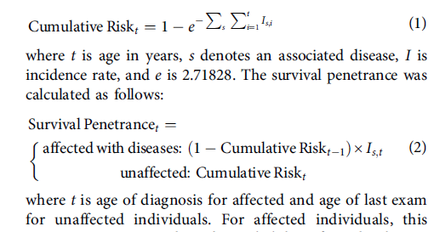
Explored models
Age-dependent cancer incidence rate in the general population was obtained from the Cancer Incidence in Five Continents
http://iarc.fr/en/publications/pdfs-online/epi/sp164/
Incidence rate model
Incidence in pathogenic variant carriers calculated as: incidence without a pathogenic variant X relative risk for the disease for each age group
Cumulative rate model
Based on probability of having any of diseases considered at any age before the last examination
Survival penetrance model
For affected individuals: probability of not developing any of the relevant diseases before age t X probability of developing the observed disease at age t

Slide 8
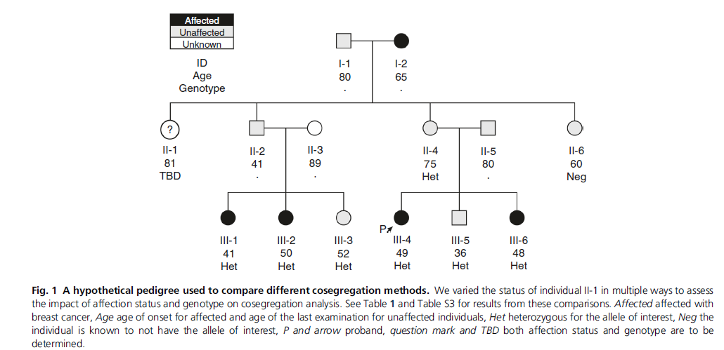
Model comparison for hypothetical BRCA1 pedigree

Slide 9
Model comparison for hypothetical BRCA1 pedigree
They set the relative risk to 1 for 80-90 age group, if model correct would expect:
Bayes factor not to be affected by cancer diagnosis in II-I in view of age (81)
Bayes factor to be lower if II-I has variant, because presence of the variant in unaffected older individuals is evidence against pathogenicity, while absence of the variant in unaffected individuals is complementary evidence that the variant cosegregates with the disease

Slide 10
Model comparison for hypothetical BRCA1 pedigree
They set the relative risk to 1 for 80-90 age group, if model correct would expect:
Bayes factor not to be affected by cancer diagnosis in II-I in view of age (81)
Bayes factor to be lower if II-I has variant, because presence of the variant in unaffected older individuals is evidence against pathogenicity, while absence of the variant in unaffected individuals is complementary evidence that the variant cosegregates with the disease
Meiosis counting doesn’t consider age of onset so it incorrectly upgrades co-segregation from 5 to 6 meioses
Notes:
If individual II-1 is affected and carries the variant, and if we do not consider her age of onset, meiosis counting incorrectly upgrades cosegregation from 5 meioses to 6 meioses

Slide 11
Model comparison for hypothetical BRCA1 pedigree
They set the relative risk to 1 for 80-90 age group, if model correct would expect:
Bayes factor not to be affected by cancer diagnosis in II-I in view of age (81)
Bayes factor to be lower if II-I has variant, because presence of the variant in unaffected older individuals is evidence against pathogenicity, while absence of the variant in unaffected individuals is complementary evidence that the variant cosegregates with the disease
Cumulative risk model treats affection of II-I at 81 as evidence towards pathogenicity (as does meiosis counting) and again, doesn’t incorporate evidence from the cancer free years
Incidence rate model does not incorporate the evidence against pathogenicity that II-I had not developed cancer prior up to age 80 years i.e. treats affection of II-I as neutral evidence, regardless of testing status

Slide 12
Model comparison for hypothetical BRCA1 pedigree
They set the relative risk to 1 for 80-90 age group, if model correct would expect:
Bayes factor not to be affected by cancer diagnosis in II-I in view of age (81)
Bayes factor to be lower if II-I has variant, because presence of the variant in unaffected older individuals is evidence against pathogenicity, while absence of the variant in unaffected individuals is complementary evidence that the variant cosegregates with the disease
Survival penetrance model only one which behaves as expected and so it is incorporated in their COOL bayes tool

Slide 13
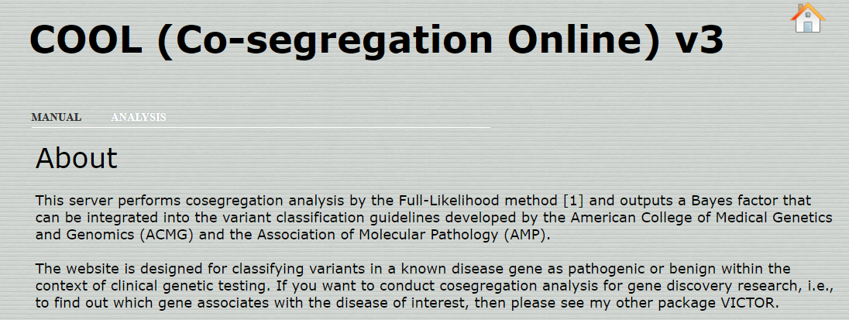
Go to http://bjfenglab.org/cool3/index.html

Slide 14
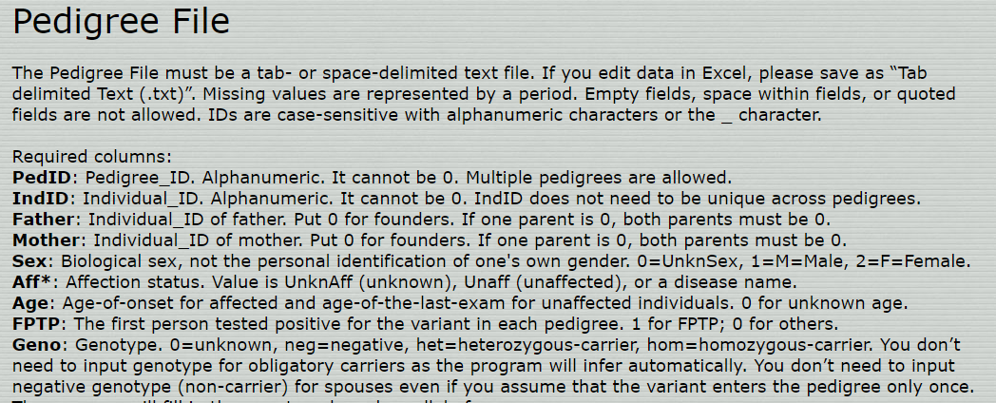
Pedigree input
Can also use freestyle format with certain required columns or
LINKAGE, BOADICEA (CanRisk), and PROGENY formats but must be saved as text file

Slide 15
Manual pedigree input
Create a tabular format of the pedigree
Information on age (for affected and unaffected) where available
Create a separate file for the pedigree and save as .txt

Slide 16
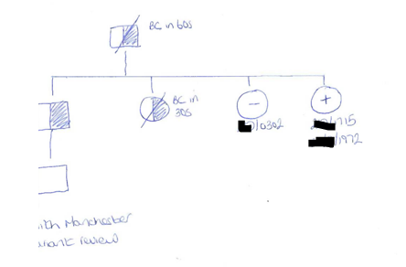

Slide 17
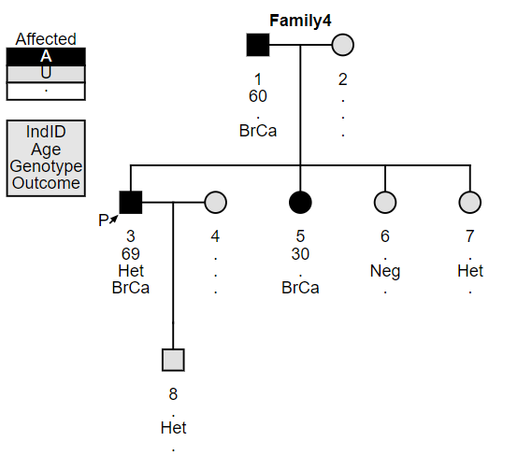

Slide 18
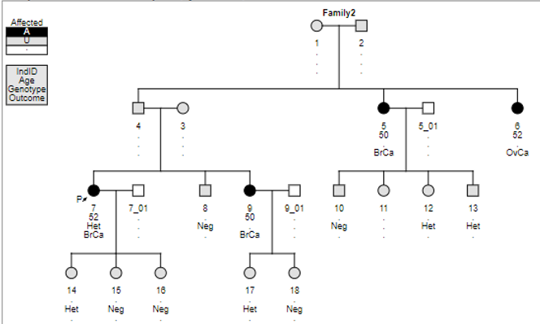
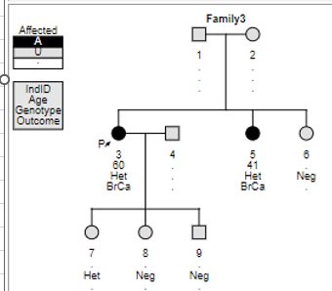
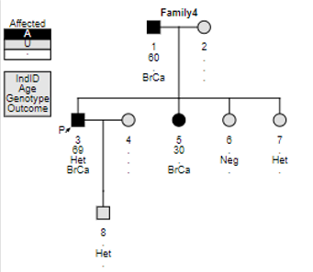
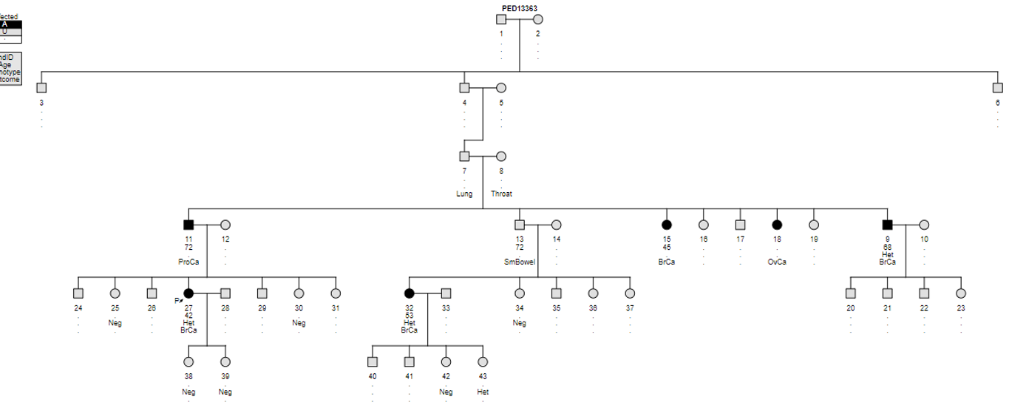
Can handle multiple pedigrees at the same time (single file)
Notes:
Please note that diseases are set for each gene so provide as much information for example prostate in big pedigree was considered affected while lung and throat wasn’t

Slide 19
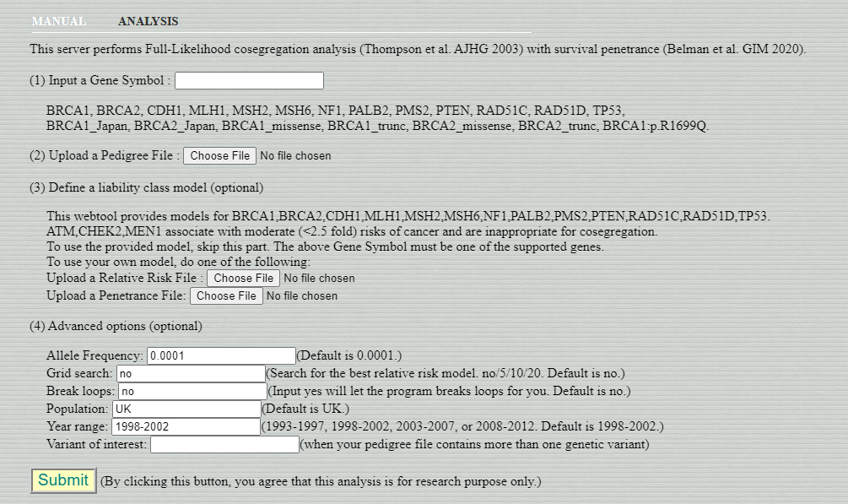
Under analysis tab, add the name of the gene and upload the pedigree file

Slide 20
Model incorporates multiple tumour types – gene specific
Notes:
Please note that diseases are set for each gene so provide as much information for example prostate in big pedigree was considered affected while lung and throat wasn’t

Slide 21
Model incorporates multiple tumour types – gene specific
Notes:
Please note that diseases are set for each gene so provide as much information for example prostate in big pedigree was considered affected while lung and throat wasn’t

Slide 22
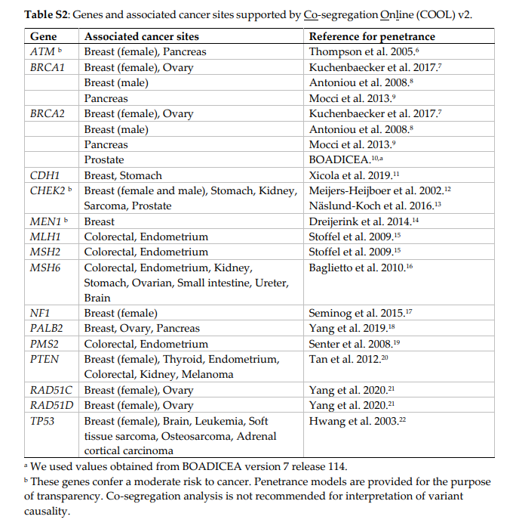

Slide 23
Save results (pedigree and output)

Slide 24
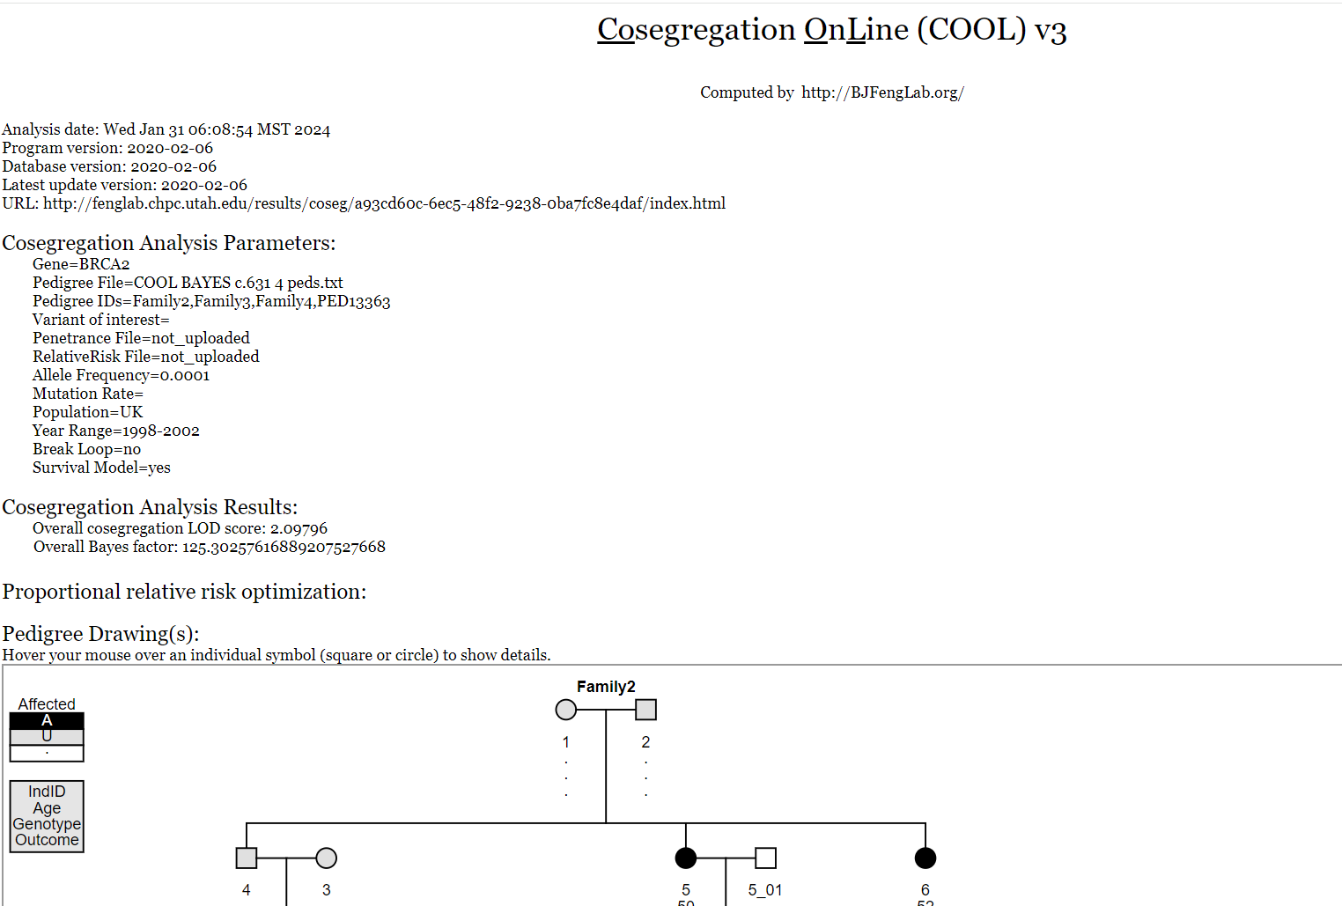
Download a full pdf with all information

Slide 25
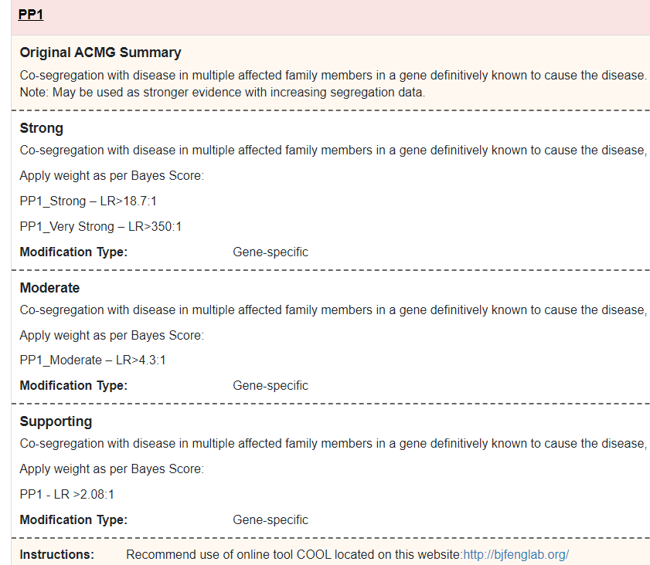
Recommended by Enigma guidelines

Slide 26
Additional thoughts
Meiosis counting may not be the best model for variants in CSGs
Bayes factor using COOL BAYES may provide a better approach when accurate penetrance estimates are available. However:
Not super user friendly
Creating pedigrees is time consuming and can be difficult (good for combining large ones though!)
Limited to specific genes
Risk of using a research online tool?
Do we need to assess against published Enigma co-segregation analysis (although they recommend the tool)? Or using wider UK data?
Reduced penetrance variants and modified relative risk/reduced penetrance files

