Slide 1



UKCGG, CanGene-CanVar and NHSE GLH Haematological Oncology Malignancies Working Group Consensus Meeting: Germline predisposition to haematological malignancies
Background, Outcomes and Next Steps…
Dr Terri McVeigh
Consultant Clinical Geneticist
The Royal Marsden NHS Foundation Trust

Slide 2
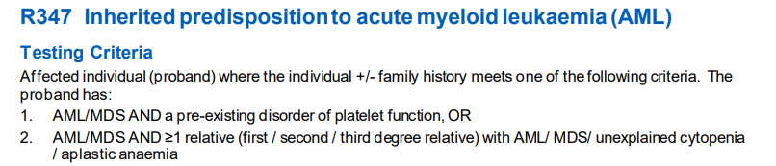
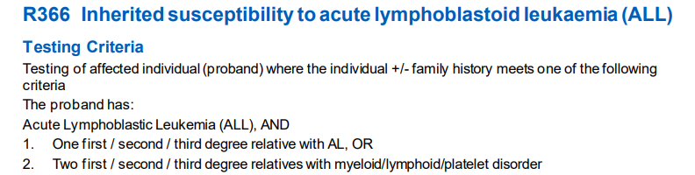
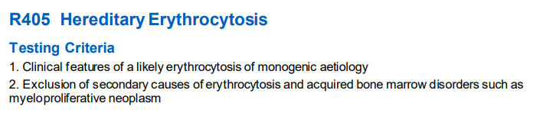
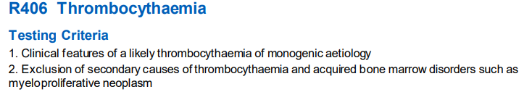
Background
Identification and recognition of monogenic risk factors for myelo- and/or lymphoproliferative neoplasms increasing
  Rare syndromic causes (e.g. Fanconi Anaemia, Ataxia Telangiectasia, Dyskeratosis Congenita, Rasopathies, etc…)
  As part of broader cancer predisposition syndromes (e.g. TP53, CHEK2)
  Myelo-/ lympho-proliferative neoplasm predominant phenotype (e.g. DDX41, CEBPA, ETV6, ANKRD26, GATA2, RUNX1, etc.)
  Germline genetic testing now offered for certain genes associated with haematological neoplasia under various indications for patients meeting eligibility criteria

Slide 3
Heritable Predisposition to Myeloproliferative neoplasm
High level evidence for gene-disease association
(Green genes)
DDX41
Moderate level evidence for gene-disease association
(Amber genes)
Others?
MDB4
ETV6
ANKRD26
GATA2
CEBPA
TERT
TERC
TP53
RUNX1
ACD
RTEL1
SRP72
SBDS
WAS
MECOM
ERCC6L2
FANCx genes
ATGB2
SAMDL9
CHEK2
SAMD9
https://panelapp.genomicsengland.co.uk/panels/525/

Slide 4
Heritable Predisposition to Myeloproliferative neoplasm
Age of onset of manifestations genotype-dependent
  Onset from childhood: ANKRD26, GATA2, ETV6, CEBPA, RUNX1
  Onset from (late) adulthood: DDX41
Variable expressivity and incomplete penetrance

Slide 5
Gene | CEBPA | RUNX1 | ETV6 | GATA2 | ANKRD26
Associated condition | Familial AML | Familial Platelet Disorder with Predisposition to Myeloid Malignancy (FPD-MM) | ETV6-associated Leukaemia/Familial Thrombocytopenia | GATA2 deficiency | ANKRD26-related thrombocytopenia
Phenotype | AML – frequent late disease relapse and second/ subsequent leukaemias | Platelet dysfunction (>90%), Myeloid malignancy (~25-50%) Lymphoid malignancy (25%), skin features (eczema, psoriasis) | Mild-moderate thrombocytopenia (>90%), increased risk of leukaemia (~30%) (B-ALL, AML/MDS/MPN), ? Other cancers (CRC) | Recurrent infections, cytopenias, Haematological manifestations: MDS, myeloid neoplasm, Cancer risk (skin, Pulmonary Alveolar Proteinosis, Lymophoedema, hearing loss, hypothyroidism | GOF variants → mild-moderate thrombocytopenia with normal platelet size, MDS, AML
Penetrance | N-terminal variants >C-terminal variants (~80-v-50%) | Malignancy 25-50%, other features >90% | Malignancy 30%, other features 90% | High: non-malignant manifestations >80%, AML risk ~14%, MDS risk ~80%. Allele-specific expression associated penetrance. | High - thrombocytopenia, malignancy risk ~8%
Frequency of somatic variants in Haematological disease | ~9% | Not rare | ETV6-RUNX1 fusions common in B-ALL (25%), frequently with variant on other allele | Common in CEBPA-associated disease | Very rarely somatically mutated in sporadic AML
Frequency of second/more somatic hits | 90% - more commonly in C terminal | 30% (usually RUNX1, GATA2) | Uncommon | Uncommon | n/a
Age of onset | Youngest case 1.8years | Median age of malignancy: 33, other features from childhood | Malignancy reported as young as 2 | Manifestations (lymphoedema/ infections) may be evident from childhood | Childhood
Of note | Post-transplant donor-derived leukaemia has been reported |  | Most reported germline variants are in DNA-binding domain at C terminus. Mostly missense. | Synonymous variants reported in ~8% cases with GATA2 deficiency –mechanism: selective loss of mutant RNA. ? Reduced penetrance | Families with ANKRD26-associated MDS/AML and normal platelets have been reported
Notes:
median age at diagnosis of persons with sporadic AML is 65 years.
Germline events reportedly more likely N terminal, frameshift
RUNX1 Bleeding disproportionate to assessment of platelet function – platelets may be n or mildly decreased
ETV6 – bleeding not all that common even w thrombocytopenia, B-ALL accounts for 2/3 cancers
ANKRD26 normal hemostasis/mild bleeding
Significant proportion of adolescents with monosomy 7 MDS have underlying GATA2 deficiency

Slide 6
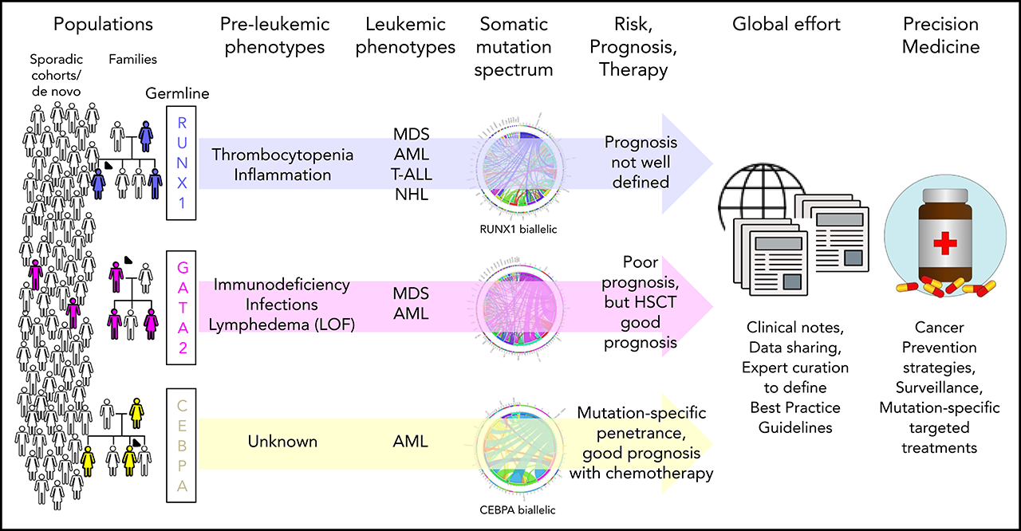
Heritable Predisposition to Myeloproliferative neoplasm
Brown AL, Hahn CN, Scott HS. Secondary leukemia in patients with germline transcription factor mutations (RUNX1, GATA2, CEBPA). Blood. 2020 Jul 2;136(1):24-35. doi: 10.1182/blood.2019000937. PMID: 32430494; PMCID: PMC7332898.

Slide 7
Heritable Predisposition to Myeloproliferative neoplasm: DDX41
DDX41 variants are the most common variants predisposing to MDS/AML in adults
  5-10% of all AML
Characteristics of DDX41-associated familial AML:
  Normal karyotype (>60%)
  Late onset – age of onset typically >6th decade
  Male preponderance (3:1)
  Second/more somatic hit in other allele frequent
Spectrum of haematological manifestations in DDX41
  Single/multi-lineage cytopenia
  Red cell macrocytosis
  MDS/AML
  CMML/CML
  MPN
  NHL/HL
  Multiple Myeloma
  ALL/CLL
Other features: autoimmune disorders
  Rheumatoid arthritis
  Systemic Lupus Erythematosus
  Thyroid issues
  Asthma
  Eczema
  Solid organ cancer risk??
Penetrance
  Uncertain
  Age-related

Slide 8
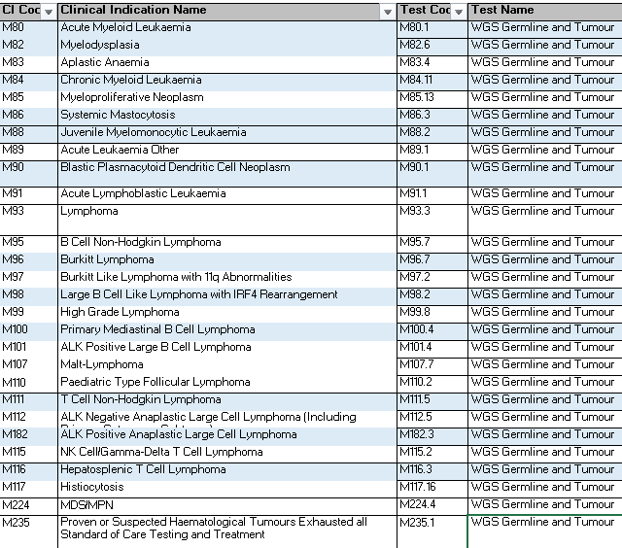
Somatic/Germline Testing in NHS
Cytogenic and Molecular phenotyping fundamental in diagnostic evaluation of patients with haematological malignancy, as well as in ongoing monitoring of disease response and relapse
Paired constitutional and tumour-based whole genome sequencing available for a host of indications as per NHS Genomic Directory
  Increasing identification of patients with underlying constitutional risk factors
In many (?most) centres, testing is being undertaken in an unpaired, asynchronous manner, with analysis of bone marrow/peripheral blood by multi-gene panels
  Increasing identification of variants of possible constitutional origin
    Both on- and off-target (variability in panels in place in labs)

Slide 9
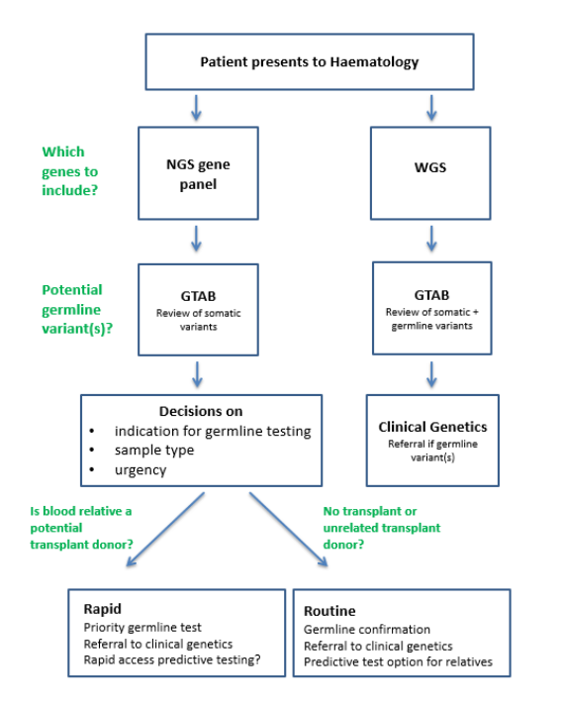
Current pathway
Increasingly, patients being referred for site-specific testing to confirm germline origin of variants identified during somatic testing rather than formal diagnostic germline panel testing
  Pathway more acute
  Impact on therapeutic decision-making
  NB for decisions re suitable related bone marrow donors
Interpretation of variants identified in somatic context needs to be undertaken with germline implications in mind

Slide 10

Issues…
Prior to germline testing
  For which variants should we offer confirmatory germline testing?
    Variants present at VAF > X%?
    On tumour only?
    Off-target incidental findings? Recessive traits?
    Would testing ever be offered for variants of uncertain significance
Germline testing pathways
  What sample types should be used?
  Who should undertake pre-test counselling? Haem/Genetics?
Handling of results
  Is predictive testing useful?
  What type (if any) screening should be arranged in pre-symptomatic inidividuals?
  Who is responsible for organising screening (if any) in the unaffected individual?

Slide 11
Consensus meeting aims
1. To review current evidence regarding penetrance of and phenotype associated with pathogenic constitutional variants in DDX41, ETV6, CEBPA, RUNX1, ANKRD26 and GATA2.
2. To establish current practice and agree future best practice regarding site-specific confirmatory constitutional testing where a variant of likely germline origin in one of these genes is identified during “somatic” testing, including sample selection and the pre-test counselling process.
3. To outline indications and pathways for urgent and non-urgent predictive genetic testing where a variant of germline origin in one of these genes is confirmed in an affected individual.
4. To discuss novel clinical referral pathways that need to be developed and implemented, including where and how consent for urgent constitutional testing (confirmatory/predictive) should be undertaken.
5. To discuss best practice regarding screening of unaffected carriers of pathogenic variants in these genes, including type, frequency, and age of commencement of screening, if indicated.
6. To consider the potential impact on resources and existing clinical pathways of the application of urgent pathways and carrier screening within the NHS.
7. To identify knowledge gaps and the potential for national, collaborative, interdisciplinary research projects and service/registry development.

Slide 12
Pre-meeting survey
Wide variability in practice across the UK currently
  Genes being tested
  Testing being offered
  Pathways for testing
  Infrastructure and support
  Reporting
Definite enthusiasm for establishment of national infrastructure to ensure standardised variant interpretation, reporting and management, AND to facilitate prospective data collection to inform best practice.

Slide 13
Structure of meeting: Talks from experts
Progress in variant interpretation for cancer susceptibility genes (relating to solid tumours) – CanVIG-UK network – Prof Clare Turnbull, Institute of Cancer Research
National Infrastructure for collection and linkage of genomic data – Dr Steven Hardy, National Disease Registration Service, NHS Digital
Developing a sustainable national infrastructure for assessment and management of genomic variation predisposing to haematological malignancies – Dr James Drummond, Cambridge University Hospital, East GLH
Germline variants in Myeloid Malignancies – Dr Jamshid Khorashad, Royal Marsden NHS Foundation Trust
Somatic Variant Interpretation Guidelines – Dr Chris Wragg, North Bristol NHS Trust, UK S_VIG Working Group
Undertaking germline confirmation of somatic findings – Dr Paula Page, West Midlands Regional Genetics Laboratory and Dr Nick Parkin, Viapath Molecular Pathology at King’s College Hospital
Genetic predisposition to myeloid malignancies: CEBPA, RUNX1, ANKRD26, ETV6, GATA2 and DDX41 – Prof Jude Fitzgibbon and Dr Ana Rio-Machin, Barts Cancer Institute, Queen Mary University of London, and Dr Austin Kulasekararaj, King’s College Hospital
Considerations for consent and cascade screening – Ms Bev Speight, East Anglican Medical Genetics Service

Slide 14
Structure of meeting: Polls
Themes:
  germline confirmation of somatic findings
  variant interpretation
  onward referrals
  need for national database and framework for management of variants of uncertain significance
  pre-test counselling and consent pathways
  management and screening of confirmed carriers

Slide 15
Consensus
Variant reporting issues:
  Consider germline origin if VAF >30%
  Ideally should involve scientists with expertise in interpretation of variants in germline context if:
    variant is suspected of germline origin
    Variant not clearly pathogenic
  Standardised templates required
  Variant classification should be as per ACMG/gene-specific guidance where available
  Sample selection
    Cultured fibroblasts preferred
      May not be possible in time sensitive situations

Slide 16
Next steps
Write up consensus statements
Continued work of S-VIG to generate standardised reporting templates
Use data from meeting to leverage support to develop registries/infrastructure
Gene specific guidelines are required with respect to management of gene carriers
Standardised patient information will be developed (patient charities and UKCGG)
Increase education (BSGM)
BMT/donor focused consensus workshop planned (July 2022)

