Slide 1
COOL Bayes Example
Megan Carney
Manchester Centre for genomic Medicine
14/02/2025

Slide 3
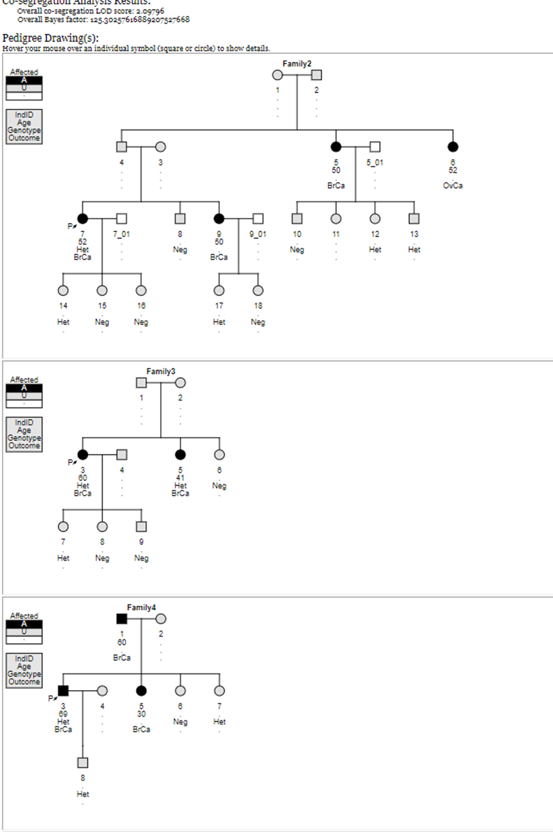
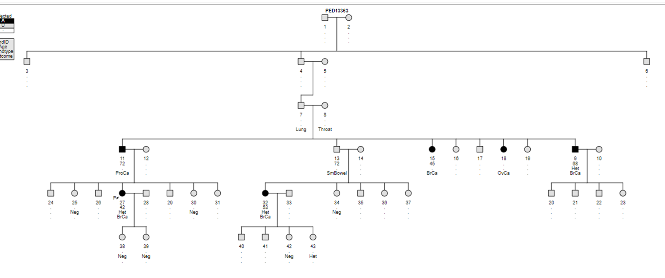
BRCA2 variant detected in 4 unrelated families in Ireland
Large number of unaffecteds have had presymptomatic testing so we analysed the pedigrees with COOL Bayes

Slide 4
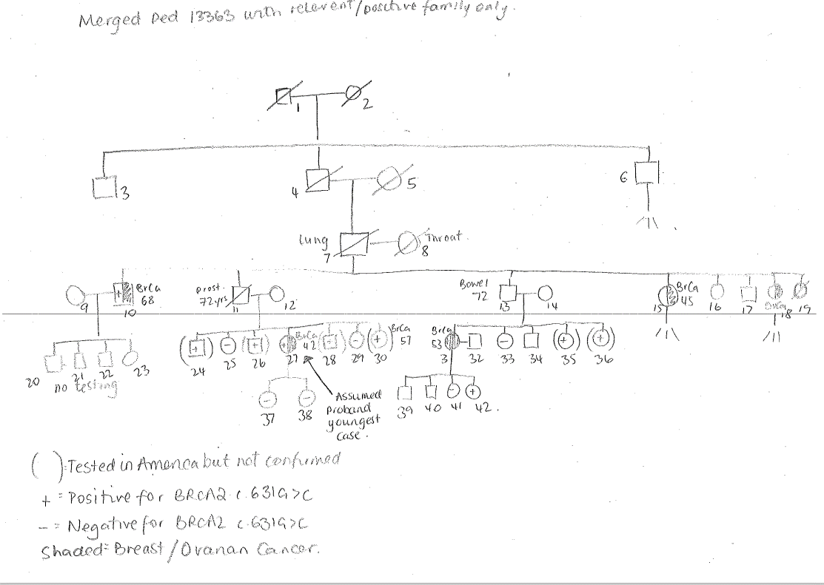

Slide 5
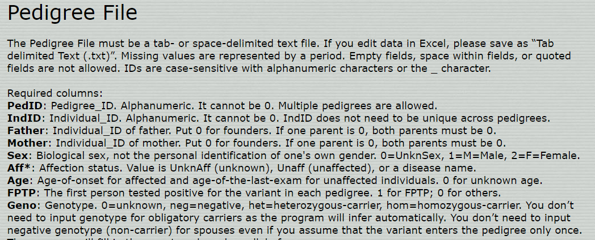

Slide 6
PedID | IndID | Father | Mother | Sex | Twin | Aff | Age | Geno | FPTP
PED13363 | 1 | 0 | 0
All individuals on the pedigree must have parental information – for individuals at the top of the pedigree 0 can be used for “founders”

Slide 7
PedID | IndID | Father | Mother | Sex | Twin | Aff | Age | Geno | FPTP
PED13363 | 1 | 0 | 0 | M | 0 | Unaff | 0
Age-of-onset for affected and age-of-the-last-exam for unaffected individuals. This information is often unavailable. 0 for unknown age.

Slide 8
PedID | IndID | Father | Mother | Sex | Twin | Aff | Age | Geno | FPTP
PED13363 | 1 | 0 | 0 | M | 0 | Unaff | 0
Age-of-onset for affected and age-of-the-last-exam for unaffected individuals. This information is often unavailable. 0 for unknown age.

Slide 9
PedID | IndID | Father | Mother | Sex | Twin | Aff | Age | Geno | FPTP
PED13363 | 1 | 0 | 0 | M | 0 | Unaff | 0 | 0 | 0

Slide 10
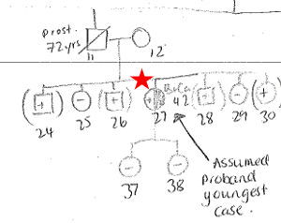
PedID | IndID | Father | Mother | Sex | Twin | Aff | Age | Geno | FPTP
PED13363 | 27 | 11 | 12 | F | 0
Tip: Some pedigrees don’t include unrelated partners, if you are needing to add them in number add the father as the first number

Slide 11
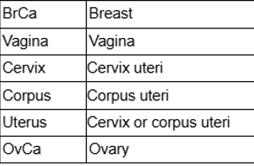
PedID | IndID | Father | Mother | Sex | Twin | Aff | Age | Geno | FPTP
PED13363 | 27 | 11 | 12 | F | 0 | BrCa | 42 | Het | 1
The first person tested positive for the variant in each pedigree. 1 for FPTP; 0 for others. (Proband case)

Slide 12
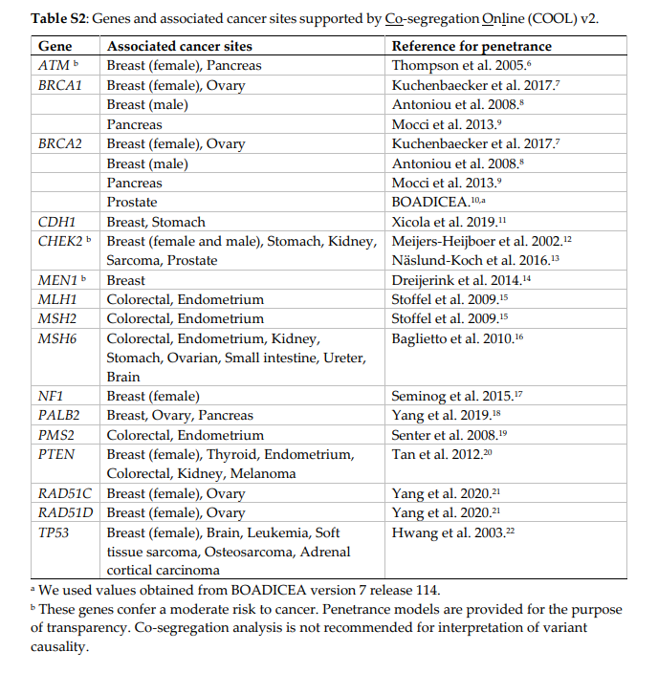
“Tips 2, regarding affection status: If a person is affected with multiple diseases known to be associated with the gene, then Aff should be the disease with the earliest age of onset. If a person is affected with other diseases unrelated to the associated diseases, those diseases should be ignored.”
COOL v2 Manual

Slide 13
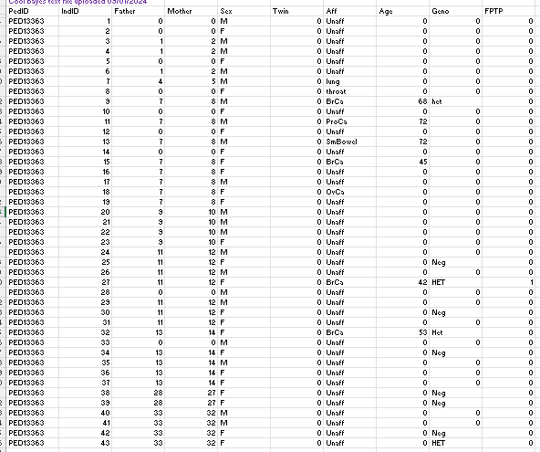
Save as “Tab delimited Text (.txt)
One file for all pedigrees in your variant analysis – distinguish by PedID

Slide 14
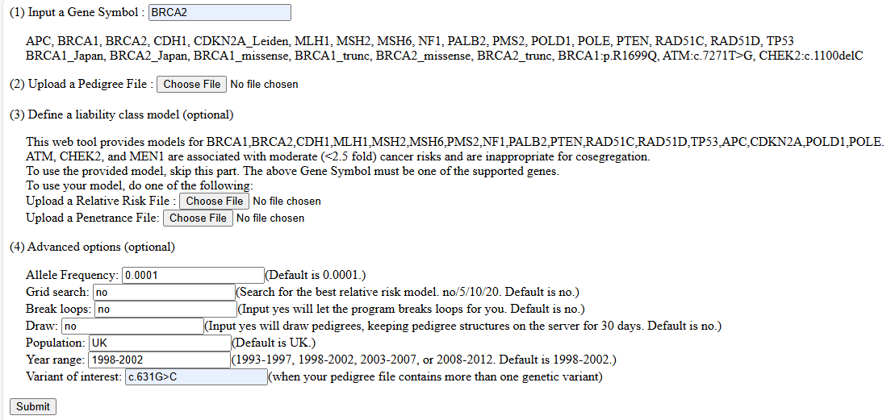

Slide 16
BRCA2 variant detected in 4 unrelated families in Ireland

Slide 17
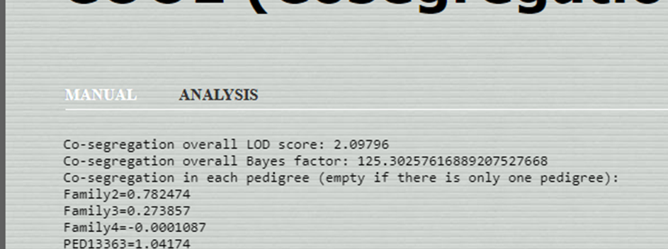
COOL BAYES output
LOD = 2.09796 BF = 125.30257… > 18 which is strong criteria
ENIGMA BRCA guidance:

Slide 18
Potential issues that need consideration
Patient with multiple diagnoses – software only uses first diagnosis
Impact of risk reducing surgeries
Families with multiple variants
The online server can be unreliable
Sometimes down for maintenance
Currently unable to view pedigrees See below for solution – Draw = yes (new in v3)_{thanks Jess Willan}
Prefers certain browsers over others

