Slide 1
ATM, CHEK2 variant interpretation
CanVIG-UK meeting
Friday April 8th
Clare Turnbull

Slide 2
Scope of test
Specialist Inherited Cancer Network meeting 10/3/22
It was agreed that the analysis of CHEK2/ATM variants is expected to include evaluation of the following variants:
Nonsense
Frameshift
Canonical splice site (+/- 1,2)
ATM c.7271T>G Val2424Gly
These should be reviewed and classified as per Richards 2015/Tayoun 2018. It is not anticipated at the current time that other variants will be evaluated. The test scope/guidance is likely to evolve in time

Slide 3
Pre-meeting classifications April 2022

Slide 4
ATM c.5932G>T p.(Glu1978Ter)

Slide 5
ATM c.5932G>T p.(Glu1978Ter)
nonsense variant so use PVS1_vstr also as this is upstream of p.Arg3047*
PM3 not applied in this case for AD disorder
reported hom in AT patients so apply PM3 - not sure what level so conservatively used sup
Found in at least 7 AT patients, not looked at second variants in these cases and if phenotype
Multiple reports of this variant in AT.
PS4 have not identified case data to use so not applied at the moment
PS4 downgraded from str as lower CI 1.3
PM2_sup not applied because AF is 0.002 in all non cancer sub polulations.
Quite common in Russia (AT cases) -PMID: 30772474 and Poland -25614872
functional studies show splicing impact so have not applied PS3 at any strength.

Slide 6
CHEK2 1100delC p.(Thr367fs)

Slide 7
CHEK2 1100delC p.(Thr367fs)
deletion causing frameshift so PVS1_vstr as per CanVig guidelines
PS4_str applied based on meta analysis by Weischer et al 2008 PMID: 18172190. OR 4.8 (95% CI, 3.3 to 7.2)for familial breast cancer.
PS4_str- uncertain on this but meta analysis with OR>2 and p<0.5 so used at strong level
segregation data incorporated into case-control evidence (PP1 not applied)
PS3_sup as functional data shows removes kinase activity but did not have access to full details so sup level only
PMID: 11053450 reports result in loss of kinase activity in functional studies.
Increase of risk of BC: 2x in women and 10x in males from families with BC and no path variants in BRCA1/2 - no increased risk if BRCA1/2 pathogenic variant (https://www.nature.com/articles/ng879z.pdf). Multitude of literature supporting a moderated increase risk of BC.
PP5 could be applied as multiple commercial labs have classified as pathogenic.

Slide 8
ATM

Slide 9
VCEP ATM (draft) guidance
Relevant evidence items for variant types in scope for UK R208 testing
PVS1_variable
PVS1_O (splice variants with splicing assay)
PM2_sup
PS4 (case control)
PS3/BS3 (assay of protein function)
PP3 (Revel) /BP4 (Revel+splice)
PM5_sup: fudge for truncating vars // BP7: fudge for benign/deep intronic, BP7_O_Variable: vars benign wrt splice
PM3/BP2_variable (observation in trans)
BA1/BS1

Slide 10
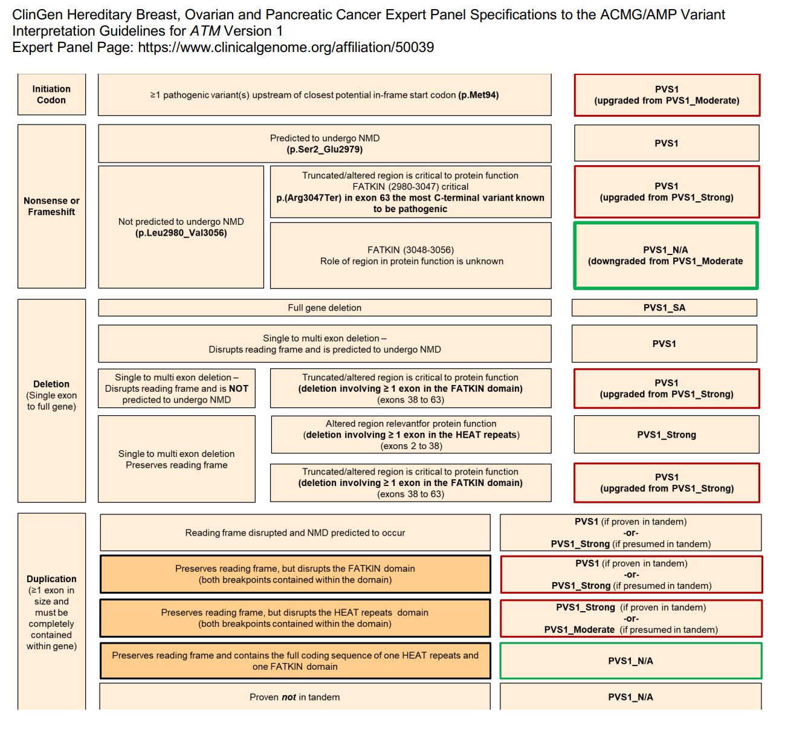
PVS1
Gene-specific adaptations
Based on Tayoun et al 2018
HEAT/FATKIN domains

Slide 11
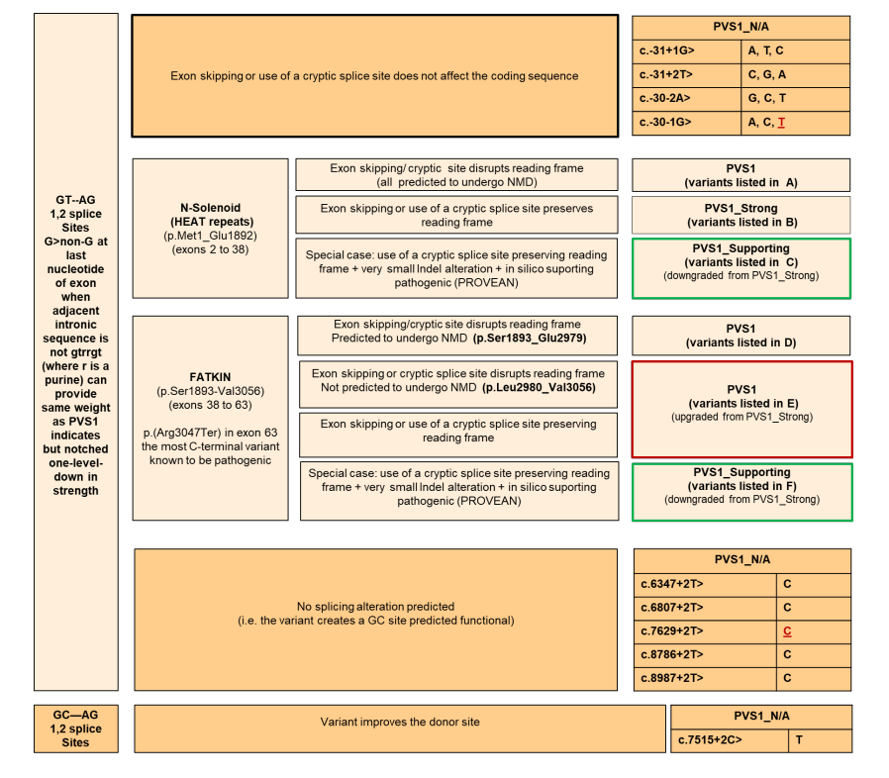
PVS1 splicing
6 variant lists (A-F), of canonical splice sites

Slide 12
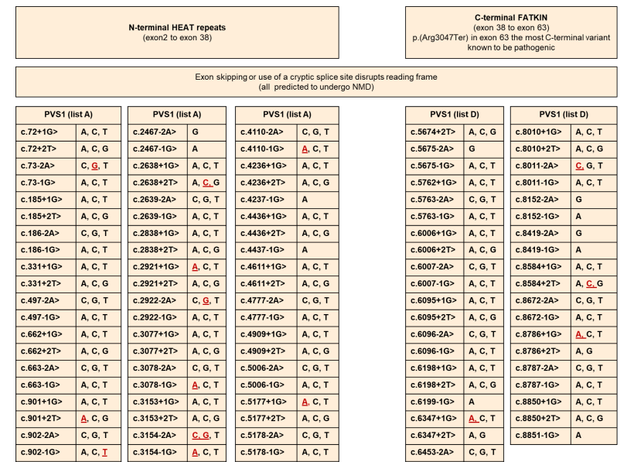
PVS1 splicing

Slide 13
PVS1_O_variable
PVS1_O_Variable shall be used for observed splice defects, whether from canonical +/-1,2 positions or other spliceogenic regions (including mid-exonic missense/synonymous variants that cause splice
defects) with baseline weight as per the below decision tree. Weight can be further modified based on
the quality of the RNA study including consideration of concepts such as:
• Starting material (where patient material is preferable to in vitro minigene)
• Use of NMD inhibitors (where use of NMD inhibitors is critical in assays using cells vs. blood)
• Primer design (to make sure it’s comprehensive to capture possible multicassette events)
• Method of quantification
o where e.g. capillary electrophoresis is preferable to estimation by gel band density
o where SNP analysis is most preferred (where analysis of exonic SNPs and their relative
presence in aberrant and WT transcripts is informative)
• Quantification (where complete effects should have increased weight over incomplete effects)
Specific guidance on the use of RNA evidence in variant assessment is not a gene-specific consideration for ATM at this time, therefore discretion is left to assessors until further guidance is provided for this general concept from the Sequence Variant Interpretation group.
Use CANVIG-UK consensus guidance for splicing assays

Slide 14
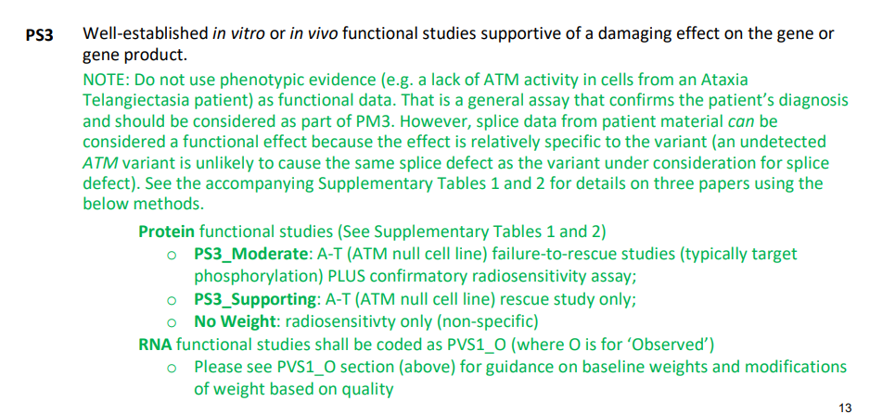
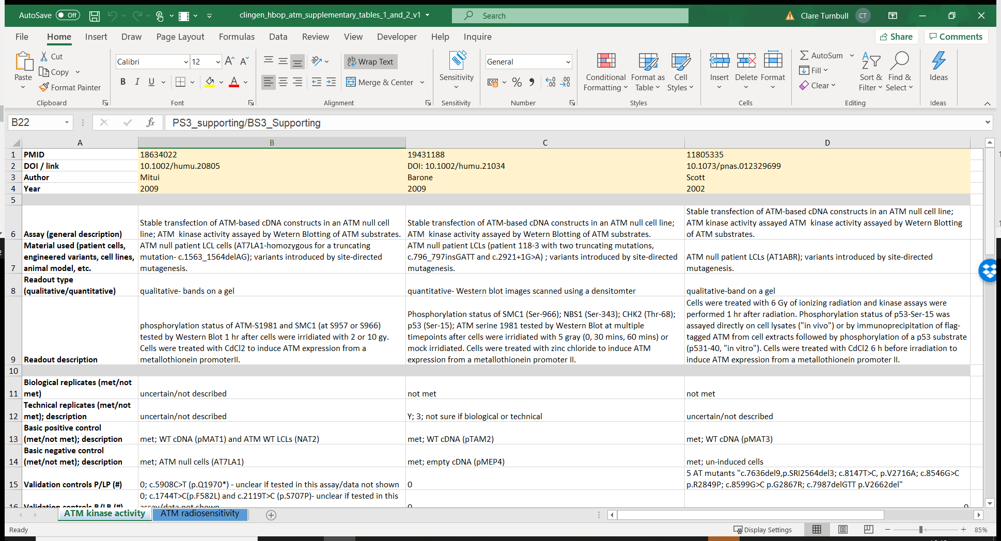
PS3/BS3

Slide 15
PS4
p-value ≤.05 AND
OR ≥2 or lower 95% CI ≥1.5

Slide 16
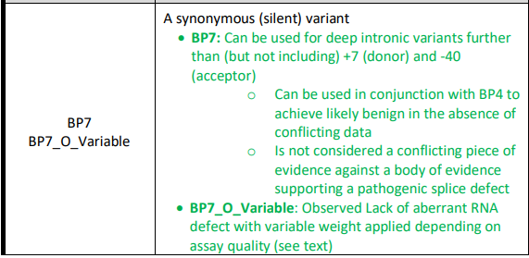
PM5_sup/BP7
PM5_sup: extra point where frameshift
BP7 (sup): extra point for deep intronic var or synonymous (with BP4)
BP7_O_var: normal splice assay (like BS3 but for splice assays (in opposition to PVS1))

Slide 17
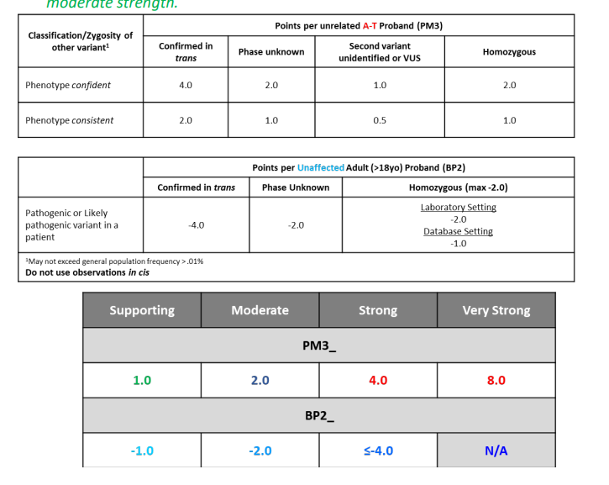
PM3: occurrence in AT BP2: observation in trans with no AT

Slide 18
ATM c.5932G>T p.(Glu1978Ter)

Slide 19
ATM c.5932G>T p.(Glu1978Ter)
nonsense variant so use PVS1_vstr also as this is upstream of p.Arg3047*
PM3 not applied in this case for AD disorder
reported hom in AT patients so apply PM3 - not sure what level so conservatively used sup
Found in at least 7 AT patients, not looked at second variants in these cases and if phenotype
Multiple reports of this variant in AT.
PS4 have not identified case data to use so not applied at the moment
PS4 downgraded from str as lower CI 1.3
PM2_sup not applied because AF is 0.002 in all non cancer sub polulations.
Quite common in Russia (AT cases) -PMID: 30772474 and Poland -25614872
functional studies show splicing impact so have not applied PS3 at any strength.

Slide 20
Variants of month for classification
ATM c.5932G>T p.(Glu1978Ter)
PVS1 +PM5 sup (9)
https://doi.org/10.1007/s10549-008-0189-9: Case control data: (Mantel–Haenszel OR: 5.6, 95% CI: 1.3–21.4, P = 0.01). Lower CI below 1.5 (no PS4)
PM2_sup (1) : MAF in NFE: 5/102582 (0.005%)
Observed in multiple AT cases (PMID: 15880721, 16266405, 17124347, 18807267, 19691550, 25614872, 18497957)
PM3: prob VS (8) as eg 8/32 in PMID: 15880721)
No functional results in Mitui 2009, Scott 2002, Barone 2009

Slide 21
CHEK2

Slide 22
CHEK2 guidance
Relevant evidence items for variant types in scope for UK R208 testing
(? Do we adopt as per HBOP VCEP ATM (draft) guidance)
PVS1/PVS1_O: use as per standard Tayoun/CanVIG-UK/ACGS
PM2: ? per standard CanVIG-UK/ACGS (??sup as per ATM)
PS4 (case control): use as per ATM (OR=2, as per CanVIG)
PS3/BS3 (assay of protein function): ? But which assays
PP3/BP4 (Revel) use as per standard CanVIG-UK/ACGS
PM5_sup/BP7/BP7_O_Variable ?implement PM5_sup (at what 3’ threshold)
PM3/BP2_variable (observation in trans): N/A
BA1/BS1: thresholds likely similar to ATM

Slide 23
CHEK2 1100delC p.(Thr367fs)

Slide 24
CHEK2 1100delC p.(Thr367fs)
deletion causing frameshift so PVS1_vstr as per CanVig guidelines
PS4_str applied based on meta analysis by Weischer et al 2008 PMID: 18172190. OR 4.8 (95% CI, 3.3 to 7.2)for familial breast cancer.
PS4_str- uncertain on this but meta analysis with OR>2 and p<0.5 so used at strong level
segregation data incorporated into case-control evidence (PP1 not applied)
PS3_sup as functional data shows removes kinase activity but did not have access to full details so sup level only
PMID: 11053450 reports result in loss of kinase activity in functional studies.
Increase of risk of BC: 2x in women and 10x in males from families with BC and no path variants in BRCA1/2 - no increased risk if BRCA1/2 pathogenic variant (https://www.nature.com/articles/ng879z.pdf). Multitude of literature supporting a moderated increase risk of BC.
PP5 could be applied as multiple commercial labs have classified as pathogenic.

Slide 25
CHEK2 1100delC
Exon 11: premature termination PVS1-_VS (8)
https://www.nature.com/articles/ng879z 1.1% in healthy individuals/5.1% of individuals with breast cancer from 718 families that do not carry mutations in BRCA1 or BRCA2 (P = 0.00000003)
PS4_S (4)
PS3 assay difficult to validate. PMID: 11053450 ?? Pos/neg controls

