Slide 1
BRCA2 c.7976+5G>C
George Burghel and James Drummond

Slide 2
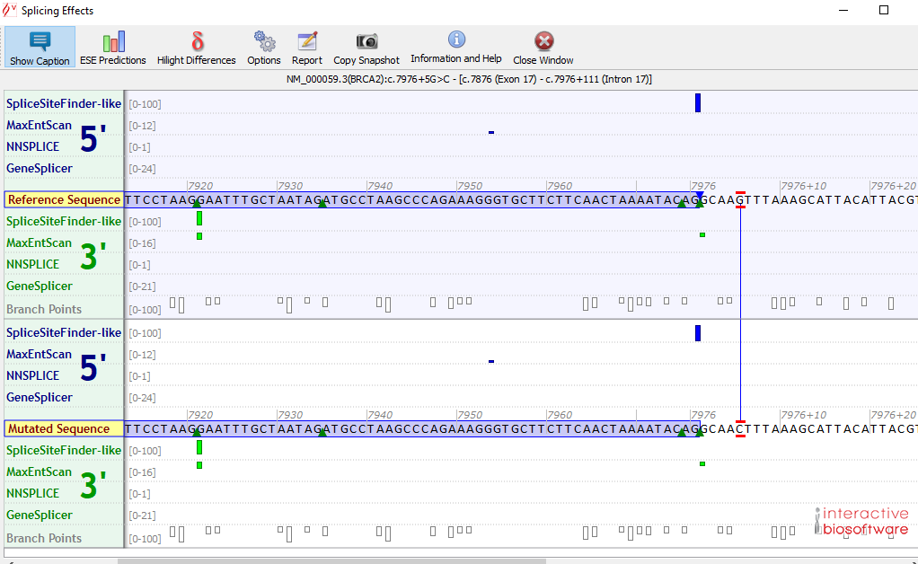
Referral to Manchester
Deceased index case - 2019
Clinical history
Ovarian cancer
Result: BRCA2 c.7976+5G>C
Variant interpretation
Rare in gnomAD 1/102448
No evidence of effect on splicing but predictions not great
Other variants?
BRCA2 c.7976+5G>A
Pathogenic CIMBA – contacted Michael Parsons and the team contacted submitting lab but no details.
Kwong et al J Med Genet 2016 53(1) 15-23. spectrum of mutations in Asian populations, no functional studies or controls reported, using mutations previously reported in lit or novel (this variant was novel, single case HK).
BRCA2 c.7976+5G>T – significant exon 17 skipping (G>T - PMID: 29969168).
Both class 3 (not enough evidence)
CanVIG email: Marsden and Cambridge

Slide 3
Marsden
First picked up in one of our patients in 2006 and classified then as VUS
Reclassified in 2012 as pathogenic
There is a huge family history of breast & ovarian cancer and currently it is being treated as likely pathogenic
Most recent patient – positive predictive test

Slide 4
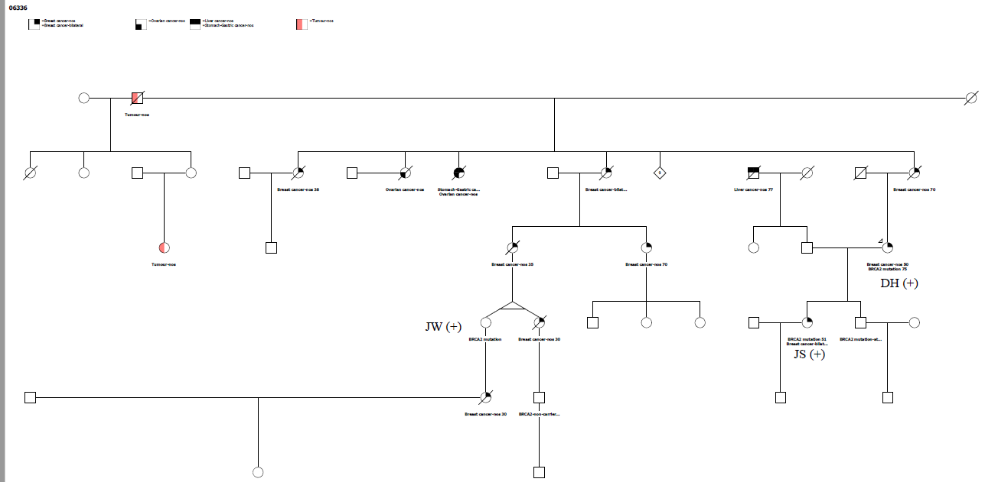
Marsden - pedigree

Slide 5
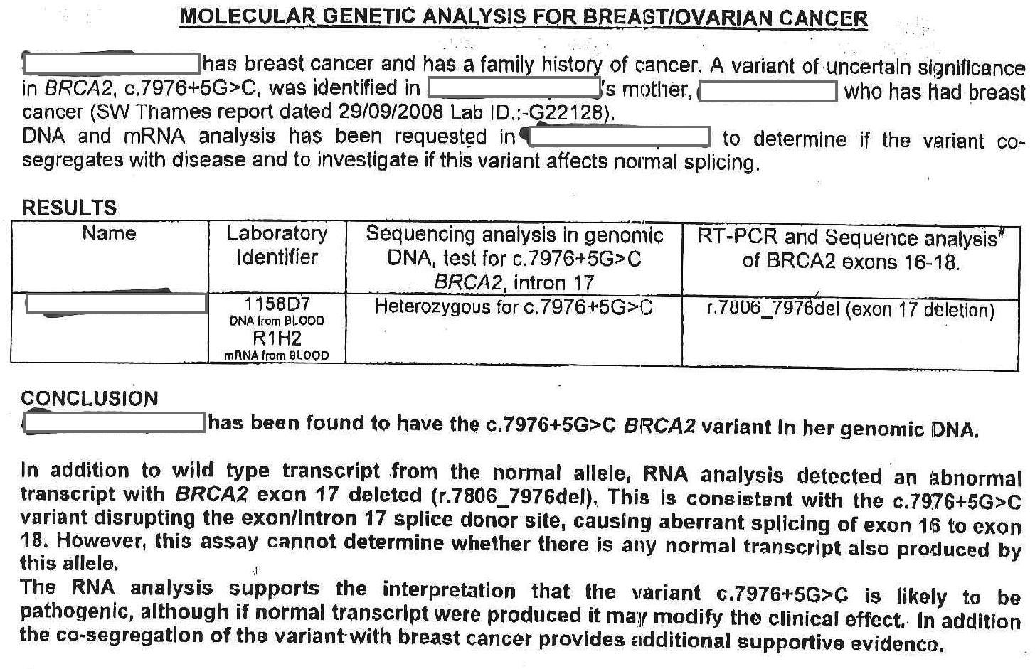
Marsden/Oxford report

Slide 6
Cambridge
Seen once in a BRCA screen (our ref GM12.08733, amplicon based NGS & MLPA), back in 2012 when it was reported as a VUS.
The patient tested had ovarian cancer age 44 and a maternal history of breast cancer (mother 40, maternal aunt age 54 and grandmother age 56).
Dad had skin cancer age 60 and paternal uncle had bowel cancer age 50.
Patient has kids

Slide 7
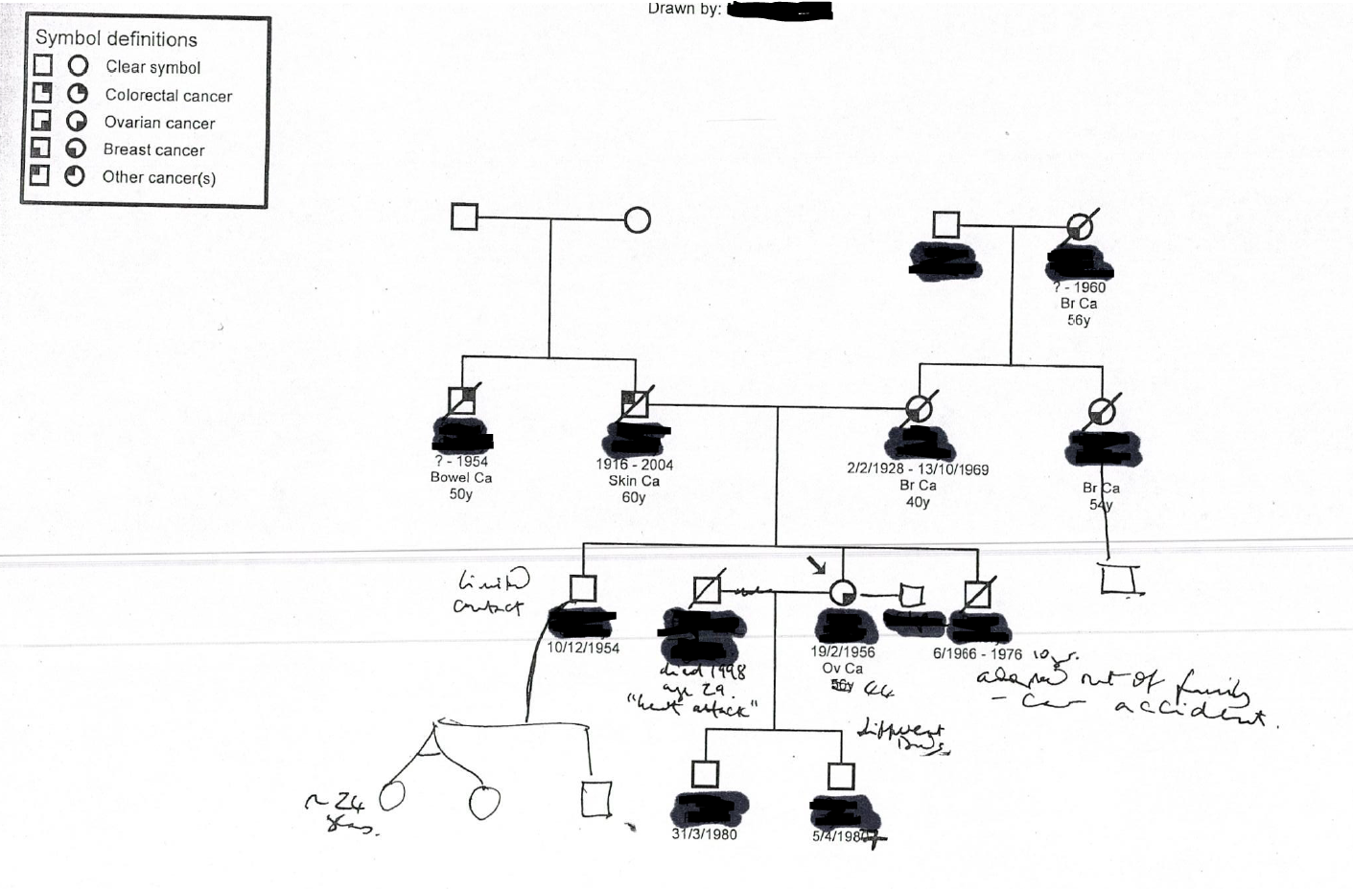
Cambridge - pedigree
BRCA2 c.7976+5G>C

Slide 8
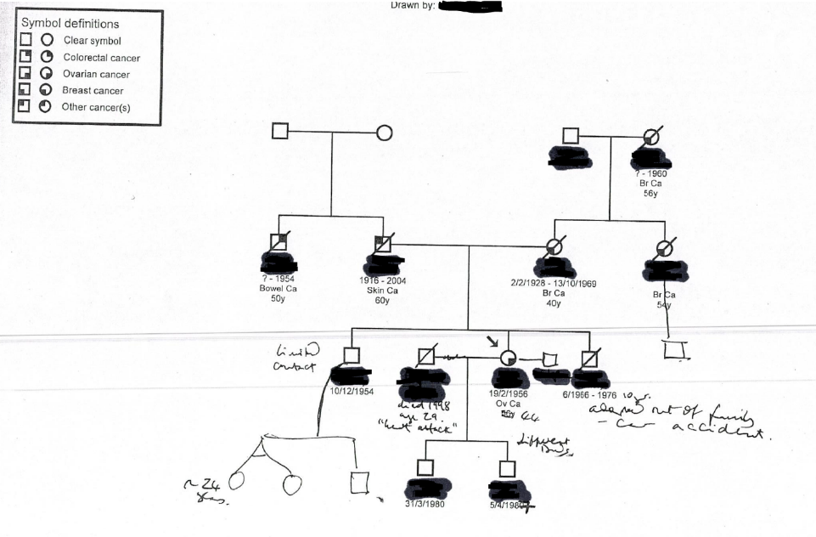
Back to deceased index
Genetic counsellor contacted the daughter of deceased index case to try and determine if the two families with this variant in are region are related.
No obvious way in which the two families are connected

Slide 9
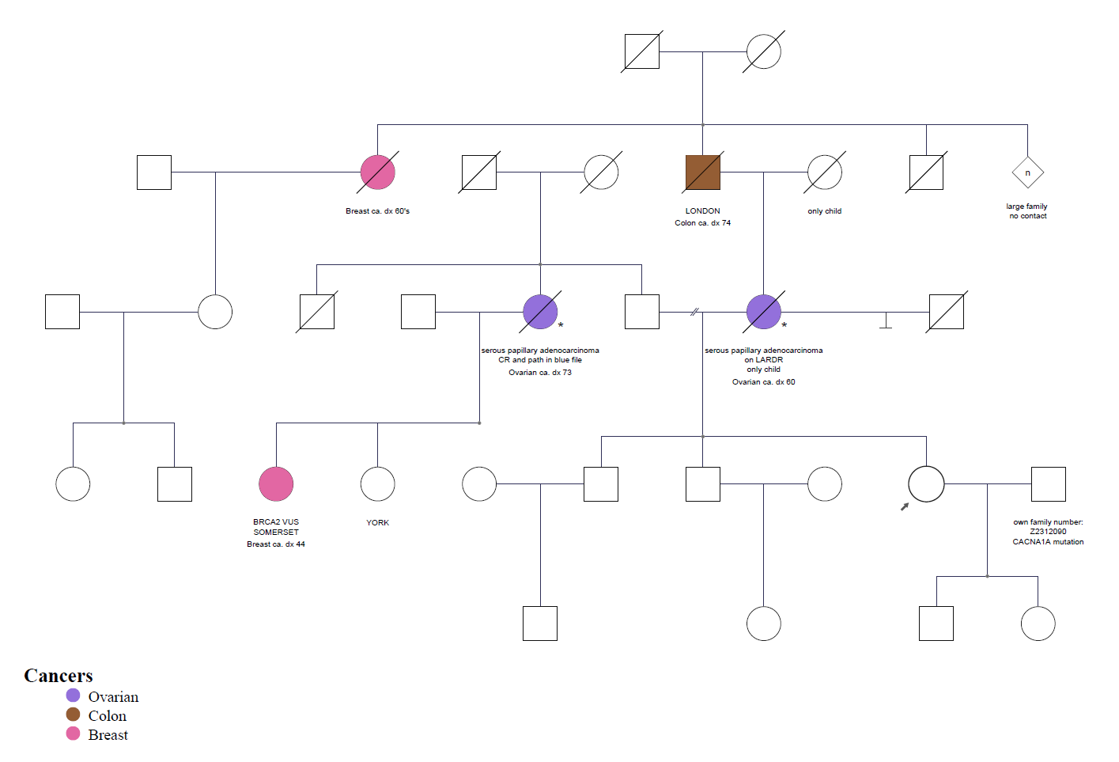
Deceased index pedigree
BRCA2 c.7976+5G>C

Slide 10
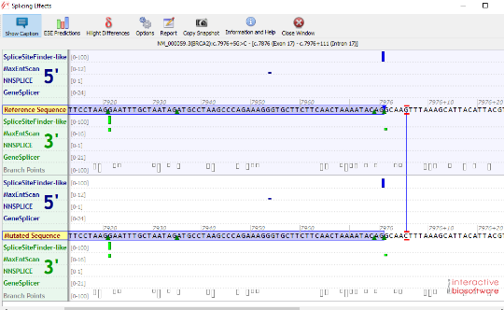
Variant interpretation 2019
Absent in Gnomad (~0/65,000) (female population excluding NFE) ?
No predicted effect on splicing cant use PP3
3 unrelated Affected individuals in the UK
3/25773? Vs ~1/51,224 (Female NFE)
Fisher’s exact: 0.112 (Supporting) PS4 - sup
UK numbers accurate? Needs confirming denominator
Segregation Marsden pedigree 1/16 (PP1 – Moderate)
RNA work Oxford – PS3 sup? Or none? 1 assay that cannot determine leakiness – (need more functional work?)
Different pathogenic change at same location (support the classification without using as weighted evidence)

Slide 11
Variant interpretation 2022
Very rare in gnomAD – PM2-supp
NHSD data – not enough for PS4
Multiple independent families but cant use case counting
Splice AI = 0.9196 – PP3 (rather than previous splice predictions)
Oxford report shows loss of exon 17, but not enough information to use PS3 (supports PP3 predictions)
G>T and G>A reported in the literature to also cause exon 17 skipping; both as Class 3 reviewed in house for this case. Supports importance of this nucleotide position

Slide 12
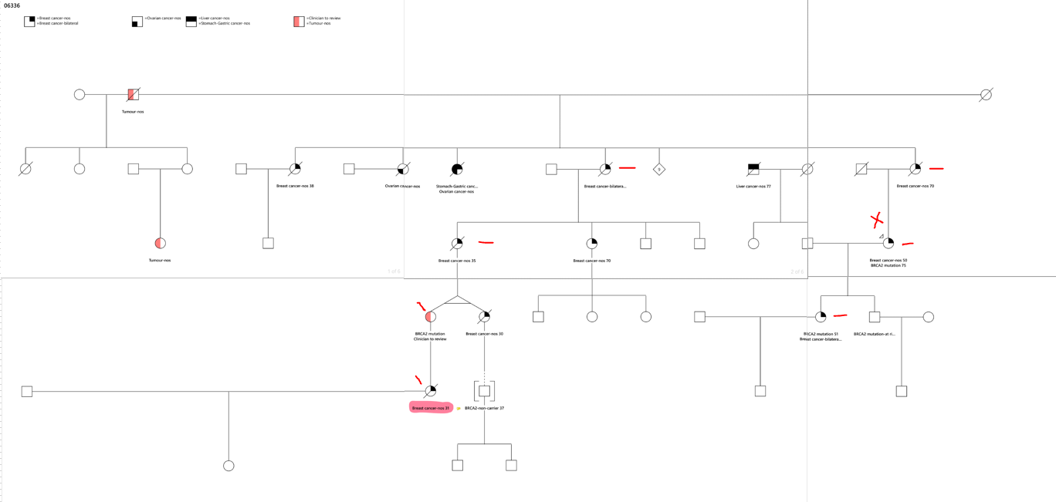
Variant interpretation 2022
6 informative meioses from Marsden pedigree = 1/64 = PP1 strong

Slide 13
Variant interpretation 2022
PM2 – supporting
PP3 – supporting
PP1 – strong segregation (Marsden Family)
Additional supporting information
Relevant functional evidence but not enough)
Three independent families in the UK (awaiting updated NHSD data)
Other changes at the same nucleotide reported to impact splicing but not enough evidence

